Slide 1
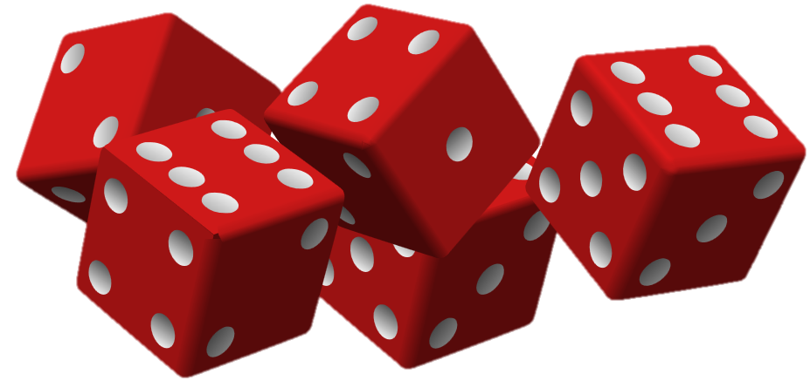
DigiPen
A Data Scientist plays games
Nick Berry
M.Eng, ARAeS, CIPP
Data Scientist, Facebook

Slide 2

WARNING
I’m going to talk fast!
Rules:
1 – Sit back and relax
2 – Don’t try and makes notes

Slide 3
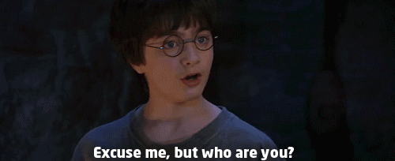

Slide 4
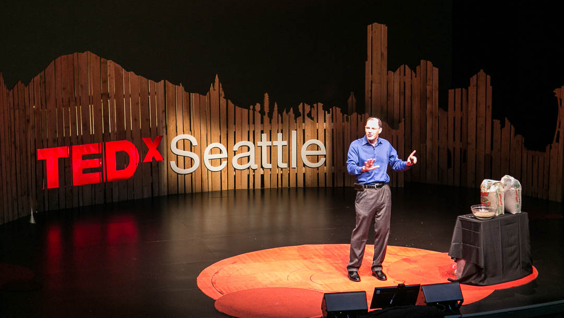
Hi, my name is Nick, and I’m a Data Scientist …

Slide 5


“
Data Scientist:
The sexiest job of the 21st Century.
”

Slide 6
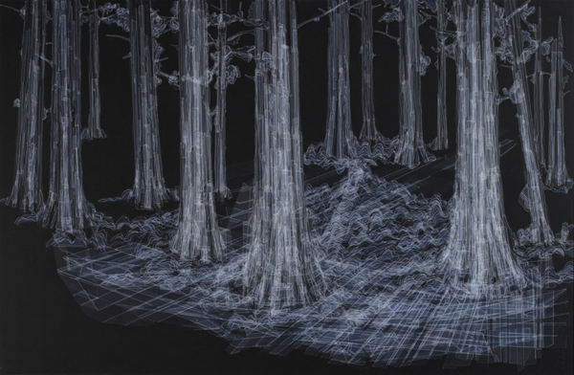
Image Credit - Hong Seon Jang

Slide 7


Slide 8
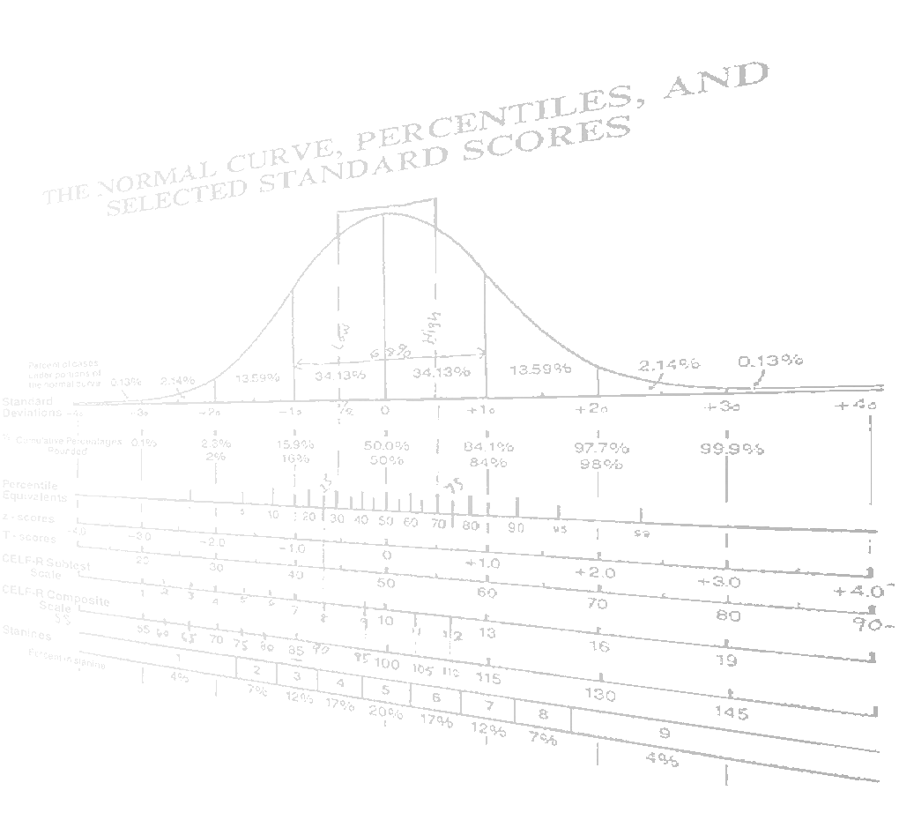
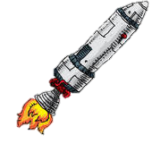
Confession

Slide 9
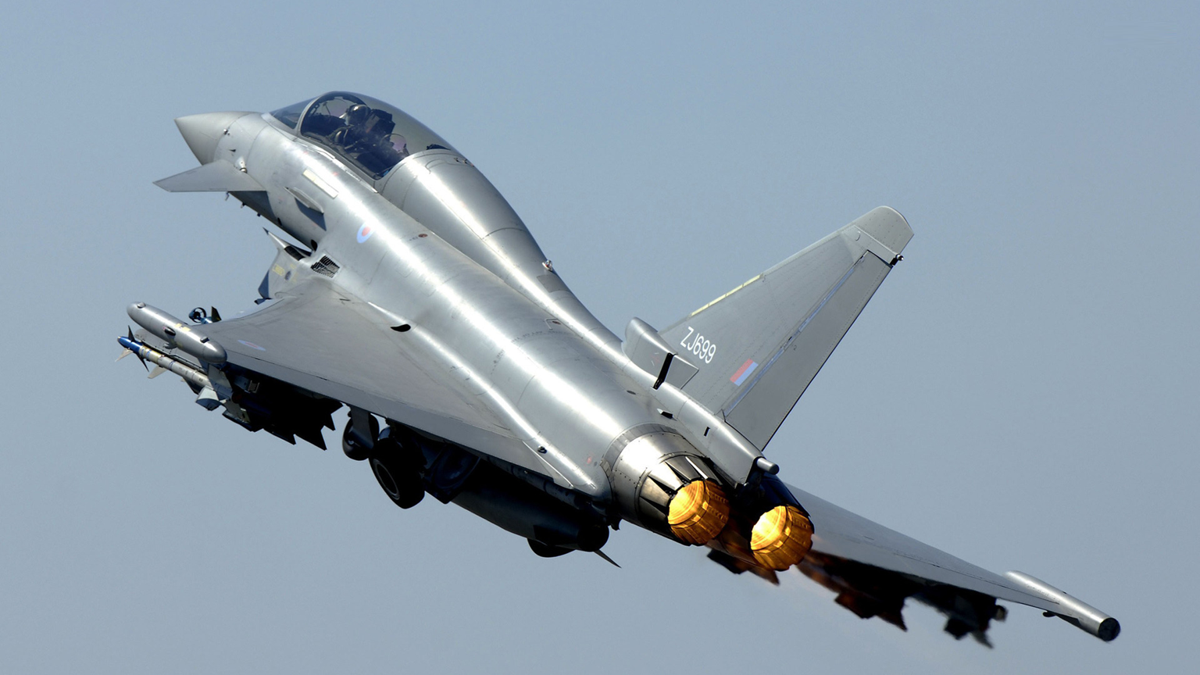

Slide 10
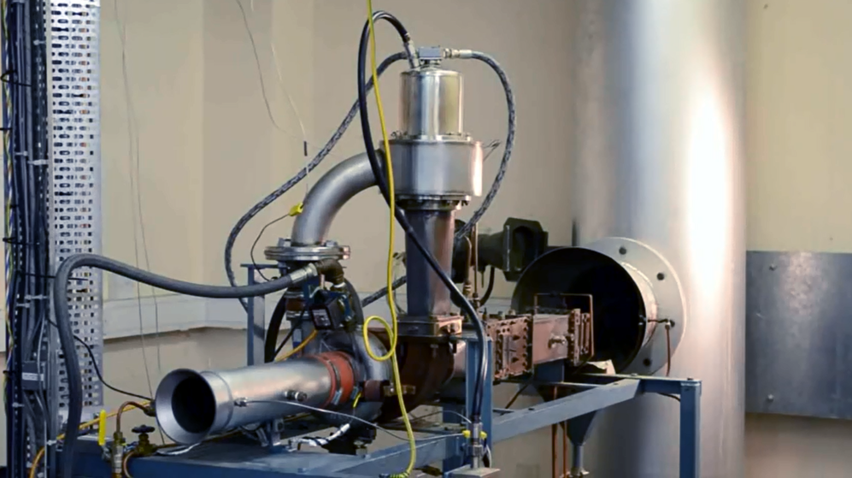
https://www.youtube.com/watch?v=rpm0gMIlc_0

Slide 11




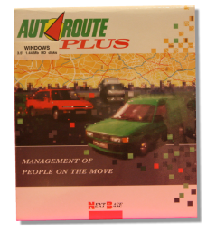
Biography – Nick Berry
DataGenetics
1988
1994
2008
2010
2012
2015

Slide 12
How do I get into Data Science and Analytics?

Slide 13

Martin Gardner
“Martin has turned thousands of children into mathematicians, and thousands of mathematicians into children.”
- Ronald Lewis Graham

Slide 14

F425: 18 ADD CLC CLEAR CARRY
F426: A2 02 LDX #$2 INDEX FOR 3-BYTE ADD.
F428: B5 F9 ADD1 LDA M1,X
F42A: 75 F5 ADC M2,X ADD A BYTE OF MANT2 TO MANT1
F42C: 95 F9 STA M1,X
F42E: CA DEX INDEX TO NEXT MORE SIGNIF. BYTE.
F42F: 10 F7 BPL ADD1 LOOP UNTIL DONE.
F431: 60 RTS RETURN
F432: 06 F3 MD1 ASL SIGN CLEAR LSB OF SIGN.
F434: 20 37 F4 JSR ABSWAP ABS VAL OF M1, THEN SWAP WITH M2
F437: 24 F9 ABSWAP BIT M1 MANT1 NEGATIVE?
F439: 10 05 BPL ABSWAP1 NO, SWAP WITH MANT2 AND RETURN.
F43B: 20 A4 F4 JSR FCOMPL YES, COMPLEMENT IT.
F43E: E6 F3 INC SIGN INCR SIGN, COMPLEMENTING LSB.
F440: 38 ABSWAP1 SEC SET CARRY FOR RETURN TO MUL/DIV.
F441: A2 04 SWAP LDX #$4 INDEX FOR 4 BYTE SWAP.
F443: 94 FB SWAP1 STY E-1,X
F445: B5 F7 LDA X1-1,X SWAP A BYTE OF EXP/MANT1 WITH
F447: B4 F3 LDY X2-1,X EXP/MANT2 AND LEAVE A COPY OF
F449: 94 F7 STY X1-1,X MANT1 IN E (3 BYTES). E+3 USED
F44B: 95 F3 STA X2-1,X
F44D: CA DEX ADVANCE INDEX TO NEXT BYTE
F44E: D0 F3 BNE SWAP1 LOOP UNTIL DONE.
F450: 60 RTS RETURN
F451: A9 8E FLOAT LDA #$8E INIT EXP1 TO 14,
F453: 85 F8 STA X1 THEN NORMALIZE TO FLOAT.
F455: A5 F9 NORM1 LDA M1 HIGH-ORDER MANT1 BYTE.
F457: C9 C0 CMP #$C0 UPPER TWO BITS UNEQUAL?
F459: 30 0C BMI RTS1 YES, RETURN WITH MANT1 NORMALIZED
F45B: C6 F8 DEC X1 DECREMENT EXP1.
F45D: 06 FB ASL M1+2
F45F: 26 FA ROL M1+1 SHIFT MANT1 (3 BYTES) LEFT.
F461: 26 F9 ROL M1
F463: A5 F8 NORM LDA X1 EXP1 ZERO?
F465: D0 EE BNE NORM1 NO, CONTINUE NORMALIZING.
F467: 60 RTS1 RTS RETURN.
F468: 20 A4 F4 FSUB JSR FCOMPL CMPL MANT1,CLEARS CARRY UNLESS 0
F46B: 20 7B F4 SWPALGN JSR ALGNSWP RIGHT SHIFT MANT1 OR SWAP WITH
F46E: A5 F4 FADD LDA X2
F470: C5 F8 CMP X1 COMPARE EXP1 WITH EXP2.
F472: D0 F7 BNE SWPALGN IF #,SWAP ADDENDS OR ALIGN MANTS.

Slide 15
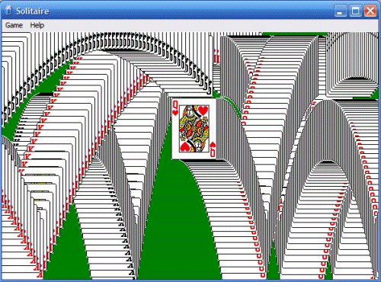
What is the most popular Windows application of all time?

Slide 16
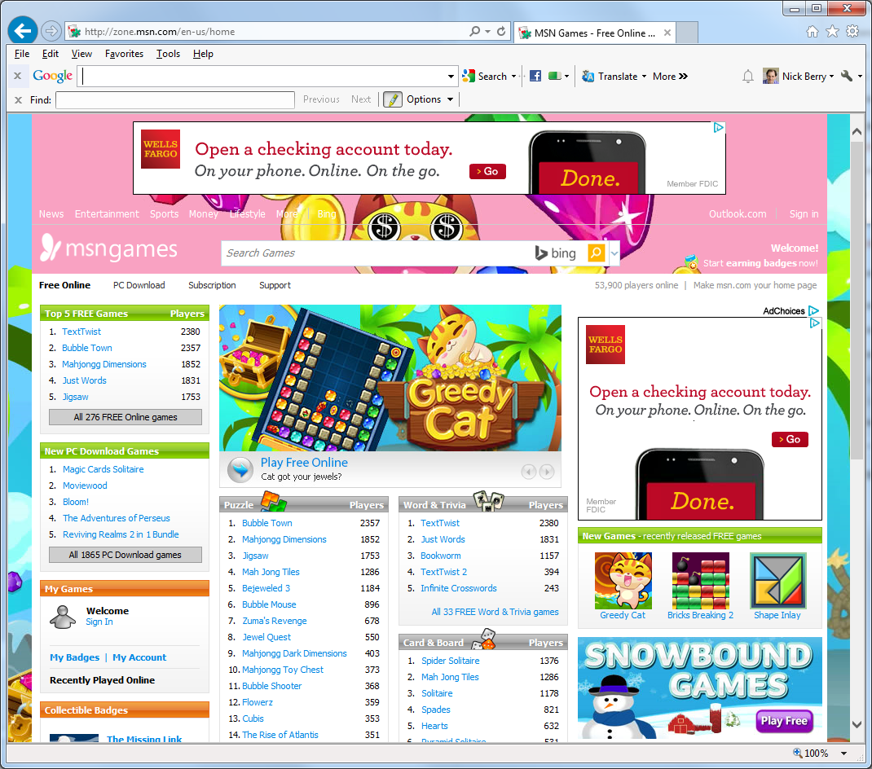
Welcome to games
What time of day do people play the most games?

Slide 17
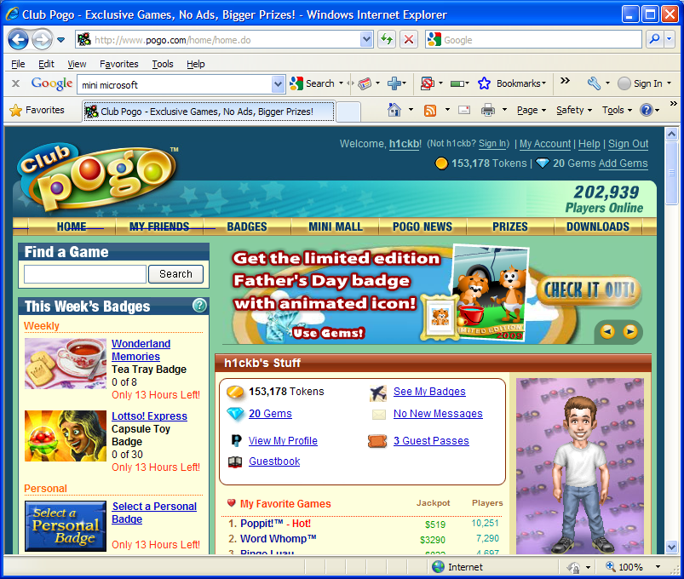
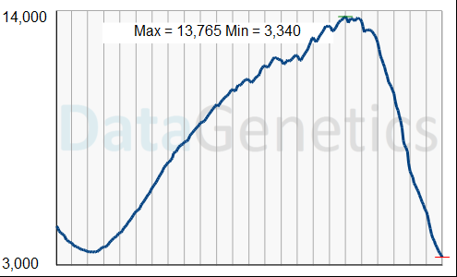
24 hours

Slide 18
Mathematical Analysis of Games
Chapter 1

Slide 19
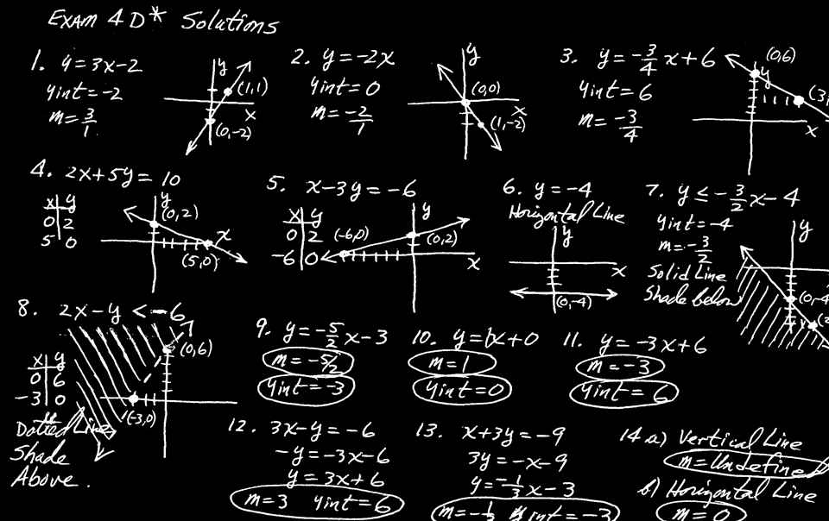
Don’t
Panic!

Slide 20
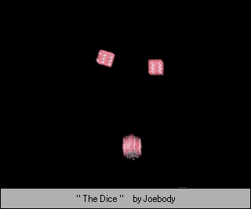
Let’s start with a game …

Slide 21
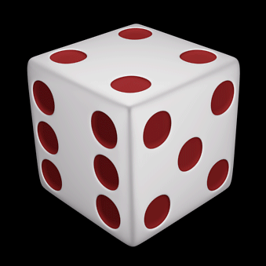

Roll 1 die
You give me $1
I’ll give you $1
1,2,3
How about now?
3,
4,5,6
I give you $1.00
You give me $1.00
Would you play this game?

Slide 22
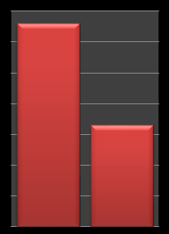
Two basic methods:
Experimentation
Formal Modeling
ü Easy to Write
ü Exact answers
2/6
ü Don’t need to understand complex mechanics
1,2
û May need long runs to get sufficient accuracy
3,4,5,6
û Very unlikely paths can be poorly represented
4/6
û Can be hard to write
Repeat the same experiment over and over again to compile results.
Mathematically model and calculate exact probabilities.

Slide 23

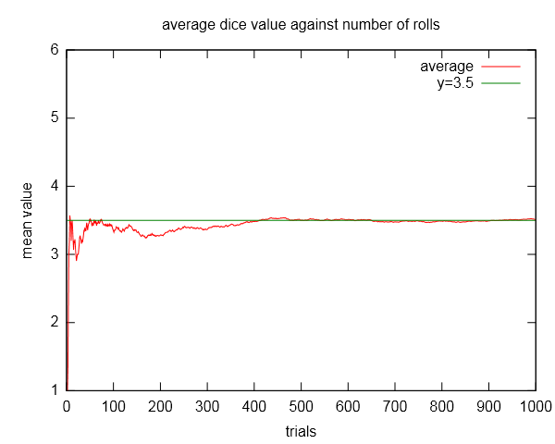
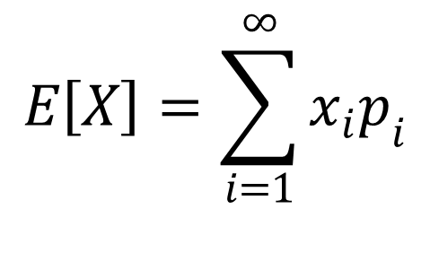
Expected Outcome
The expected outcome is the sum of all the possible outcomes multiplied by chance of each event.
Formal Modeling
$$E\left[X\right]=\sum_{i=1}^{∞}{x_{i}p_{i}}$$
Experimentation
If the experiment was repeated a large number of times, what would be the average results be?
E_{x} = (¹/₆ x 1) + (¹/₆ x 2) + (¹/₆ x 3) + (¹/₆ x 4) + (¹/₆ x 5) + (¹/₆ x 6)

Slide 24
Roll 3 dice
If there are three odd numbers, re-roll two lowest dice.
If there are two odd numbers, re-roll lowest dice.
Sum all dice.
If total is odd, add highest number again.
If total > 17, I give you $7.00
Otherwise you give me $3.00
Would you play this game?

Slide 25

Subjective Approach
D₃
D₂
D₁
1/6
1/6
1/6
How many odd numbers?
1/6
1/6
1/6
Very complex to model !

Slide 26
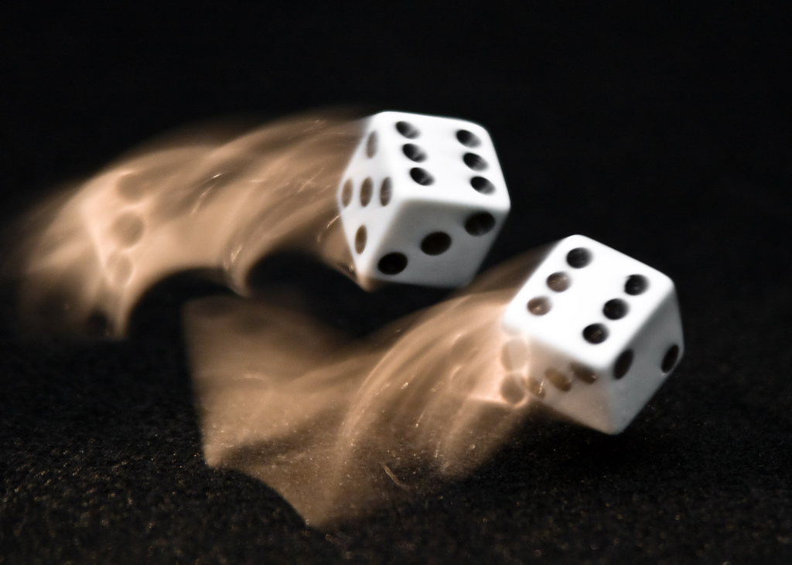
Monte Carlo Simulation
Yes, named after a casino!
Play the game with random rolling of dice.
Do it again, and again, and again … record results.

Slide 27
Should you play?
Probably not!
Number of times this score was observed in 1 million games
76.57%
23.43%
- $3.00
+ $7.00
Score
(0.7657 x - $3.00) + (0.2343 x $7.00) = - $0.657
Objective Approach

Slide 28
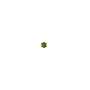


Real Game Examples

Slide 29
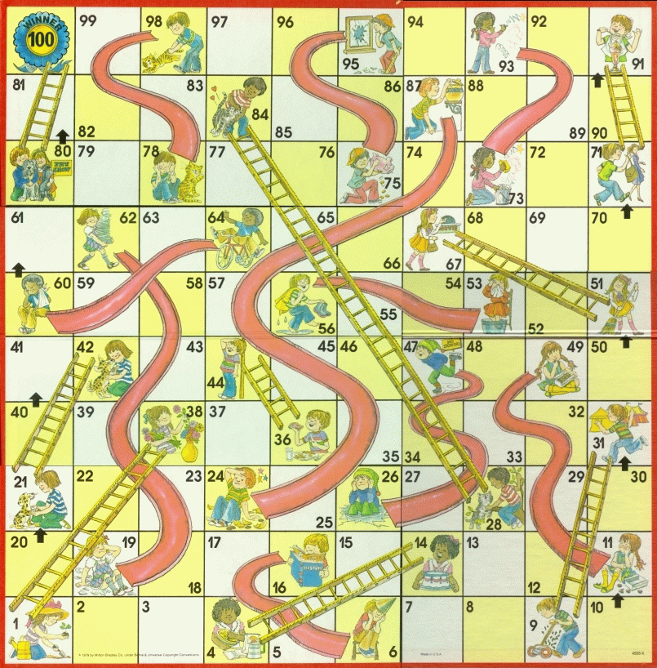

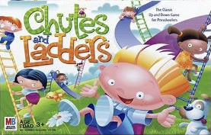
Chutes and Ladders
Snakes and Ladders

Slide 30
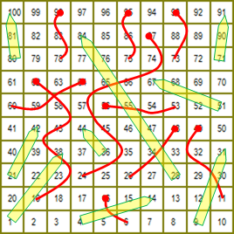
Win!
How long does a game last?
The shortest possible game takes just seven rolls.
There are multiple ways this can be achieved, it happens approximately twice in every thousand games played.
One possible solution is the rolls: 4, 6, 6, 2, 6, 6, 4
Directed Graph

Slide 31
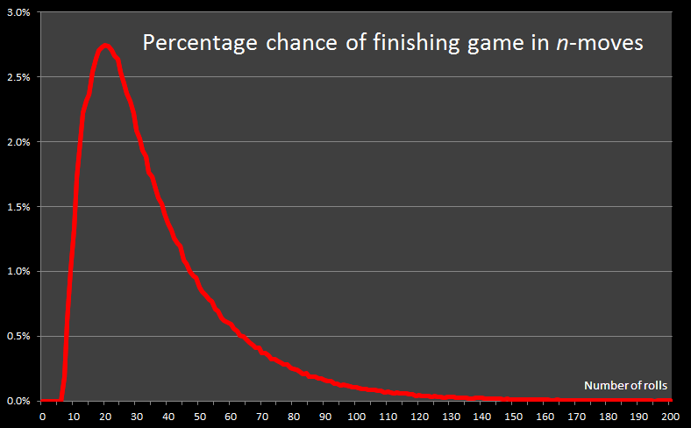
Monte-Carlo Simulation
One billion games!
Modal number of moves is 20

Slide 32
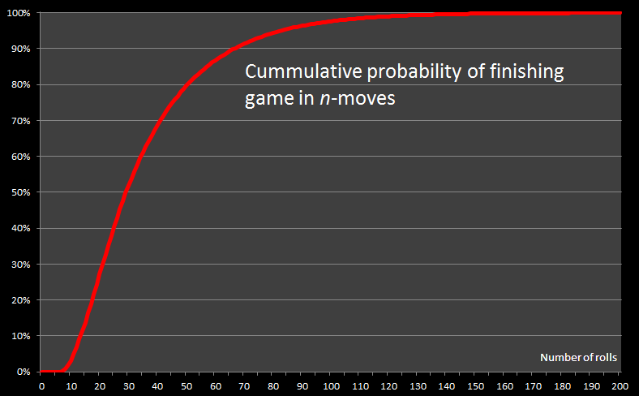
Cumulative chance of winning
Median number of moves is 29
97.6% of games take 100 moves (or less)

Slide 33
What kind of average are you looking for?
MODAL number of moves = 20
(Most common number of moves to complete the game)
MEDIAN number of moves = 29
(As many games take less time to complete as do more)
(Arithmetic) MEAN number of moves = 36.2
(Sum of all moves divided by number of games, for large N)

Slide 34
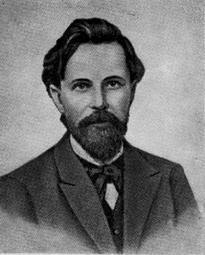
Subjective Approach – Markov Chains
Model a system as a series of states.
Calculate the stochastic probabilities of transitioning from one state to any other.
State #2
State #3
State #1
Андре́й Андре́евич Ма́рков
(1856-1922)
State #4

Slide 35
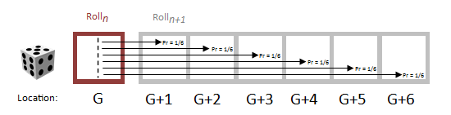
Stochastic Process
Crucial to this simple analysis is the concept of a memoryless system.
It does not matter how we got to square G, but once there, we know the probabilities of moving to other squares.
All probabilities must add up to 1.0 (something must happen)

Slide 36
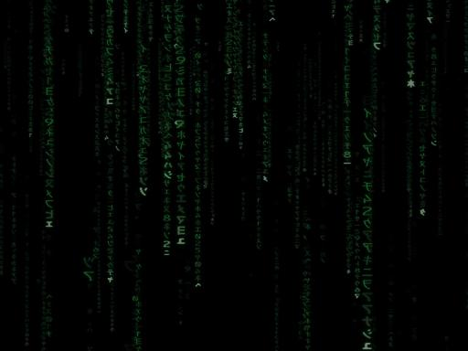
j
1 2 3 4 5 6 7
1
2
3
4
5
6
7
i
a _{i,j}
Square matrix containing probabilities of transitioning from state i to state j on next step.
Transition Matrix

Slide 37
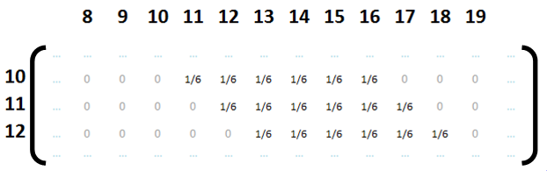
Transition Matrix
(Sparse) matrix containing probabilities of transitioning from state i to state j on next move

Slide 38
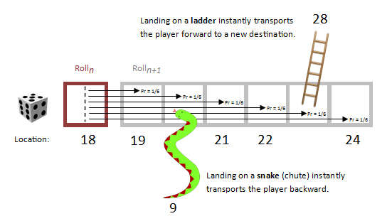
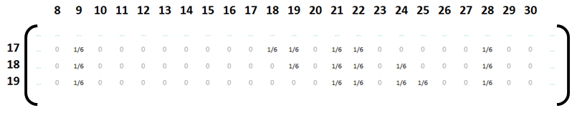
Snakes and Ladders Transition Matrix

Slide 39
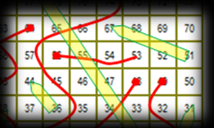
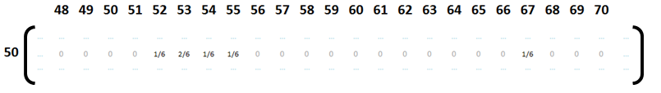
Watch out ! #1
Some squares you can get to in more than one way!

Slide 40
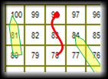
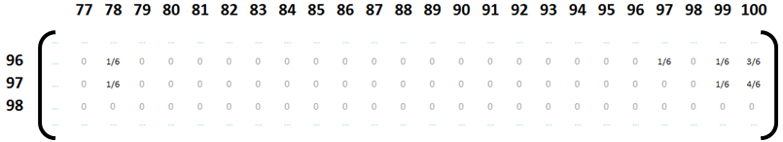
Watch out ! #2
When you get to the end of the game, you don’t need an exact roll to finish.

Slide 41
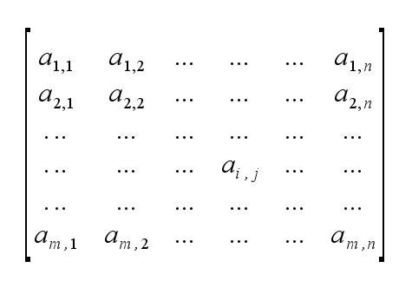
Transition Matrix in Action
Starting States
Ending States

Slide 42
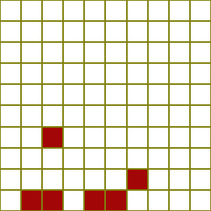
Results – Roll #1
Create a column vector with 1.0 in location i=0
(Player starts at state zero, off the board)
Multiply this by the Transition Matrix
Output row vector shows probability of where player could be after one roll

Slide 43
Wash, Rinse, Repeat
New Ending States
Starting States
Ending States

Slide 44
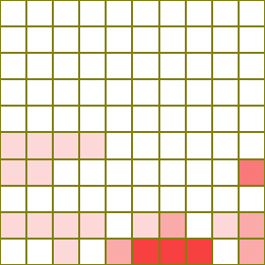
Roll #2
Now use the probability output from roll #1 as the input for roll #2, and multiply by the Transition Matrix again.
Roll #1
Roll #2

Slide 45
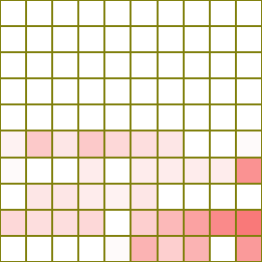
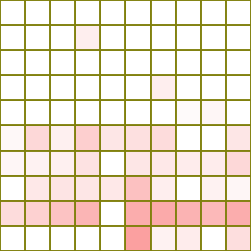
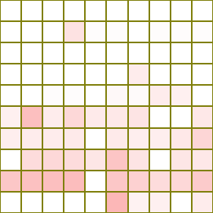
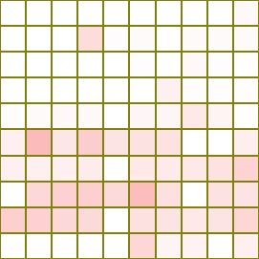
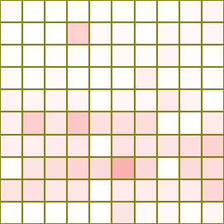
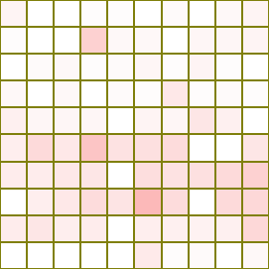
3
4
5
Roll #3, Roll #4 …
7
First time non-zero value appears on final square!
8
6
Possible to finish the game
in seven rolls
(approx. twice per 1000 games)

Slide 46
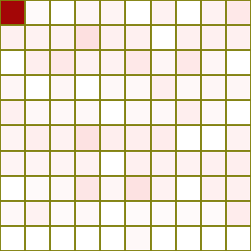
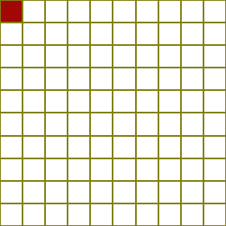
Roll #20, Roll #100
Roll #20
Roll #100

Slide 47


Slide 48
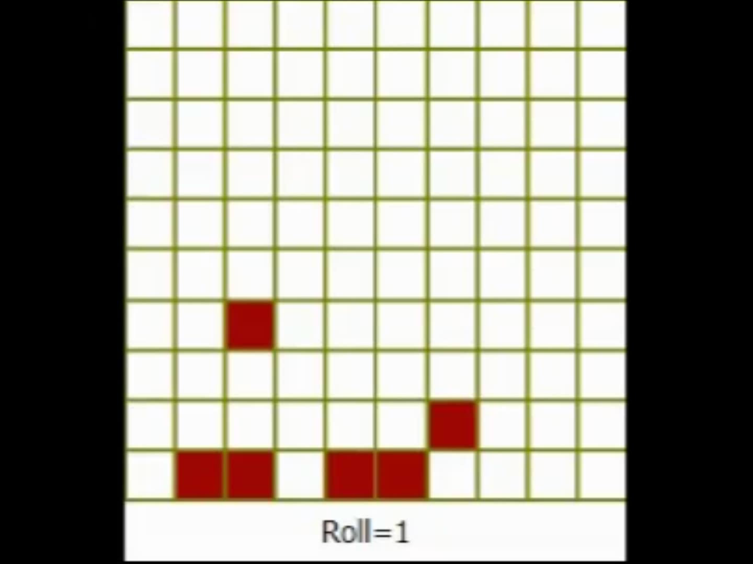
Animation

Slide 49
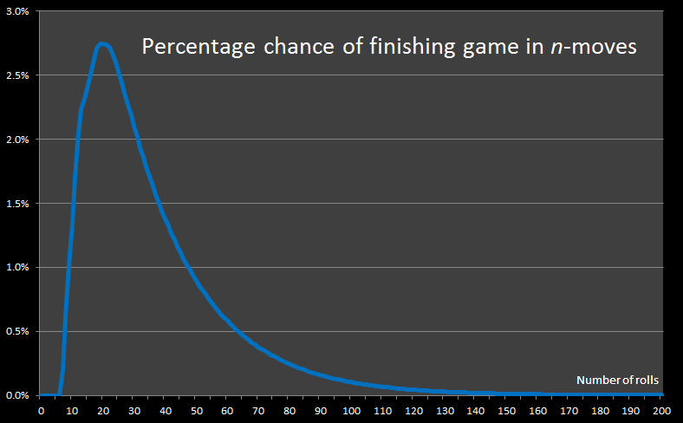
Markov Chain Analysis Results

Slide 50
Formal model
Experimentation

Slide 51
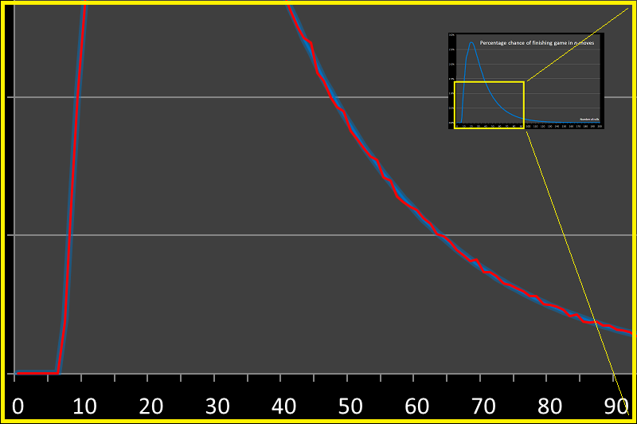
Comparison of methods

Slide 52


Trivia Take-Aways
16.67%
Not all ladders are equal
Adding extra Snakes can decrease the average number of moves! How come?
Adding a snake that slides a player backward that could give them a second chance at using a really long ladder.

Slide 53

Paramapada Sopanam — "The Ladder to Salvation."
2nd Century B.C.
It was invented by Hindu spiritual leaders to teach children about the rewards of good deeds and the negative consequences of bad ones.
Snakes represent vices and poor choices.
Ladders represent virtues and sound morality
Square 100 is “Nirvana”

Slide 54




Candyland®

Slide 55

Uh-oh! Not a memoryless system
Cards are drawn from a deck and then discarded.
Probability of drawing the next card depends on cards already drawn (Like playing Blackjack).

Slide 56



Crippled Markov Chain
Approximate system by drawing a card, acting on it, then inserting back into deck, shuffling and then drawing again.
Transition Matrix is easy to create based on relative distributions of cards in the deck.
Bridges act like ‘ladders’

Slide 57


Slide 58


Slide 59


Slide 61

Animation

Slide 62

Comparison to Monte-Carlo

Slide 63


Slide 64


Texas Hold’em Poker

Slide 65





What is the best starting hand?

Slide 66

Poker odds are complex
Expected outcome is based on superposition off odds of making each different kind of hand against all possible combinations of opponents hole cards against all combinations of community cards!
The odds change depending on the number of people at the table!

Slide 67

Combinatronics too complex
With just two players, there are billions of combinations:
1,335,062,881,152,000
52 x 51 x 50 x 49 x 48 x 47 x 46 x 45 x 44
With ten players, the numbers are immense:
7,407,396,657,496,430,000,000,000,000,000,000,000,000
The number of combinations of starting conditions is just too complex to work through by modeling. Need to use an exclusively objective approach.

Slide 68


© GreatPokerHands.com

Slide 69





Risk®
Risk®

Slide 70
Basic Risk Mechanic
Attacker rolls (up to) 3 dice
Defender rolls (up to) 2 dice
Highest dice attacks highest dice
In a tie, defender wins

Slide 71
Sometimes Brute-Force is easier!
For Attack1 = 1 to 6
For Attack2 = 1 to 6
For Attack3 = 1 to 6
AttackHigh = Highest (Attack1, Attack2, Attack3)
AttackMedium = Medium (Attack1, Attack2, Attack3)
For Defence1 = 1 to 6
For Defence2 = 1 to 6
DefenceHigh = Highest (Defence1, Defence2)
DefenceLow = Lowest (Defence1, Defence2)
Calculate_Win_Loss_Tie (AttackHigh, AttackMedium, DefenceHigh, DefenceLow)
Next
Next
Next
Next
Next
There are only 7,776 combinations. It’s easier, simpler, and less error-prone to just brute-force and enumerate all combinations

Slide 72

Basic Dice Results

Slide 73

More dice …

Slide 74

Results

Slide 75

A picture paints a thousand numbers
After 5x5, advantage goes to attacker
Attacker advantage
Defender advantage

Slide 76

Results
STRATEGY TIP – It's better to attack then defend. Be aggressive.
STRATEGY TIP – Always attack with superior numbers to maximize the chances of your attack being successful.
STRATEGY TIP – If attacking a region with the same number of armies as the defender, make sure that you have at least five armies if you want the odds in your favour (the more the better).
95% confidence level

Slide 77

Social Games – What if you get it wrong?
If your game is too lose, “currency” flows into the universe.
To balance your economy, you need to control your SOURCES and SINKS

Slide 78






What is the “value” of that shield?
10,000 GP
10 GP

Slide 79


Inflation
To stop inflation, there needs to be a fixed amount of currency in the game.
You need to extract currency at approximately the same rate as it is flowing in.
This can be very hard to do. Even if you control the money, you can’t control the number of players joining and leaving the game.

Slide 80



What is the probability of rolling an Yahtzee?
Yahtzee

Slide 81

What is the probability of rolling a Yahtzee?
In one roll, it’s 1/6 x 1/6 x 1/6 x 1/6 = 1/1296
But what about over three rolls?
Markov Chain – Transition Matrix
Watch out! Here you may elect to change your target!
Answer = 4.6029%

Slide 82

Yahztee - “Just one more roll?”
Cummulative chance of Yahztee
Number of rolls

Slide 83

Breakdown of odds

Slide 84


Slide 85



Darts

Slide 86


Where is the best place to aim on a dartboard?
(To maximize expected score)
It depends on how good you are!

Slide 87



Slide 88



“Good” Players
“Bad” Players
σ
High accuracy
Low standard deviation
Low accuracy
High standard deviation

Slide 89


Slide 91

Animation

Slide 92


Slide 93


Slide 94


Slide 95


Slide 96


Slide 97


Slide 98











More examples:
http://DataGenetics.com/blog

Slide 99

















Slide 100



Slide 101
Online Gaming
1010101010100100100100110101010101001001001001101010101010010010010011010101010100100100100110101010101001001001001101010101010010010010011010101010100100100100110101010101001001001001101010101010
Chapter 2

Slide 102

Facebook Worldwide Monthly Active Users
MM

Slide 103


Over 1.442 billion
monthly active people
(Q4 2015)

Slide 104

People take out their phone, on average, 250/day.
(Up from 221 times/day last year)
The World is moving mobile
*
Avg mobile games approx 8 minute session time for a total of 30-50 minutes a day.
Re-think for "Touch-first" (Different from "Hover for hints" with mouse pointer)
*Techmark Study, UK

Slide 105



Annual Sales (bn)

Slide 106



Slide 107

When did the revolution start?

Slide 108

“Smartphone Shipments Reach Second Highest Level for a Single Quarter as Worldwide Volumes Reach 355.2 Million in the Third Quarter”
- IDC, October 2015

Slide 109

Mobile usage is not cannibalizing desktop usage, it’s sponging up free time!

Slide 110


300 MHz CPU 1.5 GHz
single core quad core
32 MB RAM 3 GB
6.2 GFLOPS 34.8
5-6x

Slide 111

Approx 5 billion mobile phones in the World
60%+ Smartphones
Source: KPCB

Slide 112



Slide 113

44% of smartphone users take photos/videos “at least once a day!” (90%, “at least once a week”) …
… 76% post these directly to social media.

Slide 114


Slide 115


Slide 116


Slide 117
Over 445 Million people play at least one Facebook connected game every month.

Slide 118

History Lesson

Slide 119


Ancient History
veteres in annales

Slide 120











Online gaming
Web
Download
Social

Slide 121

Online gaming
Web
Download
Advertising
Sales
Micro-transactions
Social

Slide 122

93% of games revenue is freemium on mobile
Source: App Annie 2013 retrospective report

Slide 123
The economic beauty of micro-transactions
Price
The “Tall” Tail …
$19.95
$6.95
The Long Tail …
Volume

Slide 124
Which is bigger, the long tail, or the tall tail?

Slide 125

Micro-transaction types:
Bling
Accelerators
Power-ups
Avatars
Fashion
Accessories
Things that do not adjust the balance of the game
Kill 10 more Orcs
= or =
Pay 10 gold coins
Pay to get 10 gold coins to get +10% attack bonus for 12 hours
+10%
Time
Money

Slide 126

A/B Testing
If you are not doing A/B testing, go home.
Yes, it is that important!

Slide 127

Measure Everything!
Analytics is now just as important as game design!
Play
or
Join

Slide 128
If you don’t measure anything, how can you see if you’ve improved?
“He uses statistics as a drunken man uses lamp-posts ...
... for support rather than illumination!”
Andrew Lang

Slide 129
It’s the tastes of the fish, not the tastes of the fisherman
Don’t be a Prima donna
Data levels all arguments

Slide 130
Iteration is the name of the game
Try
Learn (from results and mistakes)
Iterate
“There is no such thing as a failed experiment, only experiments with unexpected outcomes.”
- Buckminster Fuller
You have to measure everything!
If you don’t, how do you know if you got better or worse?

Slide 131
"It's only a mistake if you don't learn from it."
(Somebody’s mom, or dad, or some teacher or other …)

Slide 132

Image: Brendan Lynch (flickr)
Be DATA DRIVEN – Testing always beats guessing!

Slide 133


Slide 134

Image: BBC
“I never guess. It is a capital mistake to theorize before one has data. Insensibly one begins to twist facts to suit theories, instead of theories to suit facts.”
Sherlock Holmes
(Sir Arthur Conon Doyle)

Slide 135



Slide 136

“You can use an eraser on the drafting table or a sledge hammer on the construction site.”
- Frank Lloyd Wright

Slide 137

“There is nothing so useless as doing efficiently that which should not be done at all.”
- Peter Drucker

Slide 138

T testing
Image: Glengarry Glen Ross – New Line Cinema

Slide 139

50 Shades of Blue
“Switching the shade of blue used on advertising links in Gmail and Google search earned the company an extra $200m a year in revenue!”
Dan Cobley – Google UK Managing Director

Slide 140
“Errors using inadequate data are much less than those using no data at all.”
- Charles Babbage

Slide 141

ARM
How much water is in the bath?

Slide 142

"If a tree falls in a forest and no one is around to hear it, does it make a sound?"
Image: hugovk (flickr)

Slide 143


If you build it, they will come (NOT!)
If you have the greatest game in the world, and nobody knows about it, it’s just the greatest game in the world that nobody knows about!
Content is King!
Distribution is God!

Slide 144

Visibility is oxygen
“We were kind of naïve. We thought if we made a really good product it would just sell, but that’s not the case”
Quiz Up
Image: jcolman (flickr)

Slide 145


Search:
best social game
About 1,570,000,000 results (0.58 seconds)
How often do you click here?

Slide 146
86% of all apps downloaded from the AppStore are from the top 10 charts.

Slide 147
User acquisition costs are probably your single biggest expense?
$1.80 CPI*
*PlayFirst, Login 2013

Slide 148
ARM
How much water is in the bath?

Slide 149

Daily Active People
DAU is a measure of the water in the tub
Source
Sink

Slide 150

What problem are you trying to solve …?
Sink
Source
…Very different problems to solve.

Slide 151
Metrics
A
cquisition
“The price of light is less than the cost of darkness.”
- Arthur C. Nielsen
E
ngagement
R
etention
Make dashboards for these TODAY!
M
onetization

Slide 152

The First Date
Image: unchose (flickr)

Slide 153

Your job is to line-up the blind dates …
You are in the eyeball delivery business
Acquisition

Slide 154

Image: jesjon87 (flickr)
Can you get a second date?

Slide 155
Only 16% of apps get a third date!*
How quickly can you get your customers to that “aha” moment?
Engagement
*Compuware Survey, 2013

Slide 156

Forgetify …
Over 20%
… the long tail of content

Slide 157

Over half of all reddit posts go completely ignored

Slide 158

Composite Social Network for Predicting Mobile Apps Installation
Wei Pan and Nadav Aharony and Alex (Sandy) Pentland, MIT Media Lab 2011
Most people have small number of apps

Slide 159

Few apps are popular!

Slide 160


Slide 161

A relationship
Image: Garry Wilmore (flickr)

Slide 162

Fix the bucket first
Buckets with holes probably need fixing more than they need more water
Retention

Slide 163

Wedding
Image: Alex Gorzen (flickr)

Slide 164
Life Time Value (Marathon, not sprint)
Take care, often the most valuable users can be your early adopters
(and they can be some of your strongest emissaries).
You don’t get a second chance to make a first impression.
(Hard to balance with software as a service).
Monetization
CPI < LTV

Slide 165


Don’t leave green on the screen!
Facebook connected players convert better into paying users! (cf. Non-facebook)
Facebook connected players spend more!
“… are nine times more likely to spend money than players who don’t connect with Facebook”
“Players who log in with Facebook are three times more likely to return to its games and seven times more likely to spend money in them.”
Wooga
Storm8
“Facebook users spend 85 percent more!”
Dragonplay

Slide 166

Value of Facebook connected players
Miniclip (Verbatim quotes from developers)
· ARPDAU. FB users are 70% higher than other Logins
· Conversion Rate. FB users are 65% higher than other Logins
· D1 Retention. FB users are 80% higher than other Logins
· D2 Retention. FB users are approximately 1.5 times higher than other Logins
· D7 Retention. FB users are 2.5 times higher than other Logins
· D28 Retention. FB users are approximately 5 times higher than other Logins

Slide 167
We’re now on the second generation of Social Games
Generation #1
Build it, and throw it live immediately.
Fix and modify it live. Those days are over!
Generation #2 Get it mechanics reasonably polished before general release.
“You don’t get a second chance to make a first impression”
Today’s early adopters of new games:
- Virally introduce more people to your game
- Typically spend more over lifetime
Don’t be a bad date!

Slide 168

“I can change”
Don’t be a bad first date!

Slide 169

Source: http://www.superdataresearch.com/blog/understanding-mmo-retention

Slide 170

First In, Last Out
On average, 6.21% of players who logged in for the first time in the 1st month a game is released will log on one year after their first login.
By comparison, only one tenth of players (0.63%) who logged in for the first time in the 12th month after a game is released will log one year after their first login.
Source: http://www.superdataresearch.com/blog/understanding-mmo-retention

Slide 171

Resurrection
Image: yinyang (flickr)

Slide 172



Resurrection
Nordeus spent $3.5k on re-engagement campaign on facebook …
… gained over $121k in immediate return.
It’s cheaper to bring someone back from the dead than find someone new

Slide 173
93% of games revenue is freemium on mobile
You need ongoing good relationships with your customers
Source: App Annie 2013 retrospective report

Slide 174
You’re a Service not a Product

Slide 175



http://smbc-comics.com/index.php?id=3259

Slide 176

Keep at it – Everything compounds!
$${\left(1.01\right)}^{365}=37.783$$
$${\left(0.99\right)}^{365}=0.0255$$

Slide 177


Slide 178
Which is bigger, the long tail, or the tall tail?

Slide 179


Which comes first, the chicken or the egg …
… the game or the whale?

Slide 180
It’s not all about the person
Great games are needed to encourage people to spend
Different games monetize at different rates, and for different amounts
Need the correct mechanisms to exploit this (game design)
A billionaire spends
the same order of
magnitude at restaurant
as a “regular” person.

Slide 181
What defines a whale?
High value transaction?
Lifetime value of spend?
Frequency of spend?
What defines a successful game?
Most DAU?
High ARPU?
Total lifetime revenue?
High MAU?
High ARPPU?
Is high volume of small transactions better than smaller number of big?

Slide 182

It’s horses for courses
Need to look at game then whales
not whales then game.
Different games monetize in different ways

Slide 183
Lifetime analysis of spending in games

Slide 184

Lifetime Spend

Slide 185

Different volumes of lifetime spend
Super
Monsoon
Mist
Sprinkle
Drizzle
Shower
Rain
Drench
Monsoon
Less than
$2 lifetime spend
$2 - $5 lifetime spend
$5 -$10
Lifetime
spend
$10 -$50
lifetime spend
$50 -$100
lifetime spend
$100 -$500
lifetime spend
$500 - $5,000
Lifetime
spend
More than
$5,000
Lifetime
spend

Slide 186


Slide 187

It’s horses for courses

Slide 188

Cross-Correlations

Slide 189

Serially monogamous, or spreading the love?

Slide 190


Slide 191




Feed the machine, a quarter at time, and again, and again …
… or deposit a pile of cash, and slowly burn through it.

Slide 192
Analytics in Marketing

Slide 193


Get noticed any way you can

Slide 194


Which icon would you use for a kids game?
Test - Don’t guess !!

Slide 195




Slide 196
Price Sensitivity Behavior
downloads
time
Half Price Sale
sales
time

Slide 197


Different people behave different ways

Slide 198
Wave
Particle
Lower price = more sales
Volume of sales proportional to cheapness
Threshold Price, above which no sales
Below this price, many sales
Volume of download unchanged

Slide 199

Micro-transactions
In App Purchases

Slide 200
In game currency …
Most popular!
Best Value!
100 Gems
225 Gems
500 Gems
1200 Gems
$4.99
$9.99
$19.99
$49.99
17%
SAVE

Slide 201


Slide 202

WTF?

Slide 203


Slide 204


Slide 205

#1
#4
#2
#3
#5
Best Value!
Worst Value!
Source: Samurai Siege

Slide 206
Best Selling

Slide 207
Best Selling

Slide 208
Best Selling

Slide 209
Most popular!
Best Selling

Slide 210

Making Good Offer, or frightening people away?

Slide 211



Slide 212

What math is this ?!?!
Best Value!

Slide 213
Best Value!

Slide 214
T testing
Image: Glengarry Glen Ross – New Line Cinema

Slide 215


Slide 216


Slide 217


Slide 218


Slide 219


Slide 220


Slide 221


Slide 222


Slide 223


Slide 224


Slide 225
T testing
Image: Glengarry Glen Ross – New Line Cinema

Slide 226





Slide 227
Appendix
More Price Fails

Slide 228


Slide 229


Slide 230



Slide 231



Slide 232


Slide 233


Slide 234


Slide 235


Slide 236


Slide 237


Slide 238


Slide 239


Slide 240


Slide 241


Slide 242



$$Fog=kP^{1.068041} ?$$

Slide 243


Slide 244


Slide 245

Level up!

