Slide 1

The Demographics and Affinities of FaceBook gamers
Nick Berry President, DataGenetics

Slide 2
Agenda
Brief overview of PC Casual Game Market
Where does the revenue come from?
Facebook
Deep dive into demographics
Case Study
Advice

Slide 3












PC Casual Game Universe
Web
Download
Social
Many different players in many segments

Slide 4

Where does the revenue come from?
Web
Advertising
Sales
Download
Micro-transactions
Social

Slide 5
Traditional Web Game Portals

Slide 6
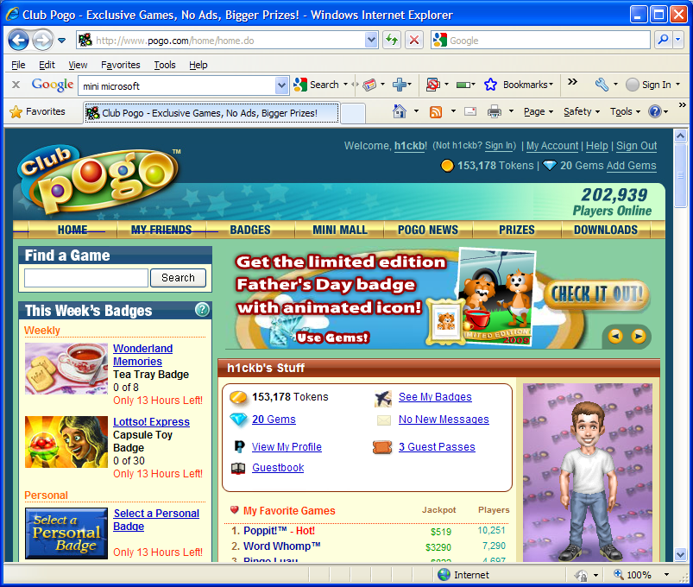
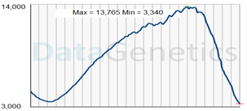
Traditional web portal games
24 hours

Slide 7
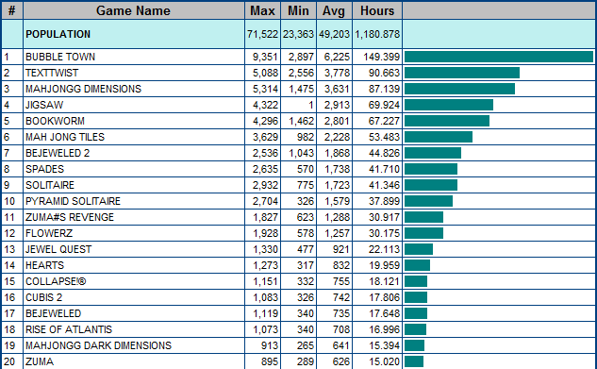
The Results
Advertising Potential

Slide 8
Deluxe Download Games

Slide 9
Price evolution of deluxe downloads
$19.95
$19.99
$15.99
$12.99
$9.99
$6.95
$6.99
Time

Slide 10
Games on Social Networks

Slide 11

Just how big is it?

Slide 12
FaceBook Worldwide Registrations
Year End Registrations (MM)

Slide 13


Just how big is FaceBook?
6.8 billion people on the planet
2.0 billion people connected to the internet
600 million registered facebook accounts
30% of the connected World already has a Facebook account!

Slide 14

If facebook were a country …
#1 China
#2 India
#3 facebook
… it would the 3rd largest in the World.

Slide 15
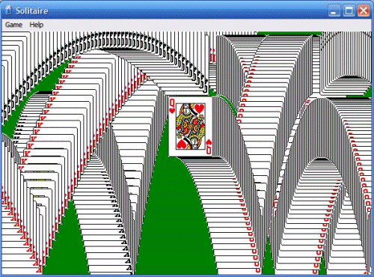
What is the most popular Windows application of all time?

Slide 16

Effect of facebook on traditional Casual Gaming web sites
As facebook grows as a gaming platform, traditional game-only based portals starts to decline
Peak Population
Data courtesy of

Slide 17
People love to play games!
Decline in traditional web portals is not a decline in people playing games.
People are getting their gaming entertainment through other platforms.
Put a device in front of someone and they will want to play a game on it!
Over half of facebook users go there for “entertainment”.

Slide 18
Worldwide Registrations – Social Networks

Slide 19



facebook gaming is big business
“Disney Buys Playdom in $763 Million Deal”
“EA Buys Playfish For $300 Million, Plus a $100 Million Earnout.”
“Zynga Issues Shares at a $4 Billion Valuation”

Slide 20
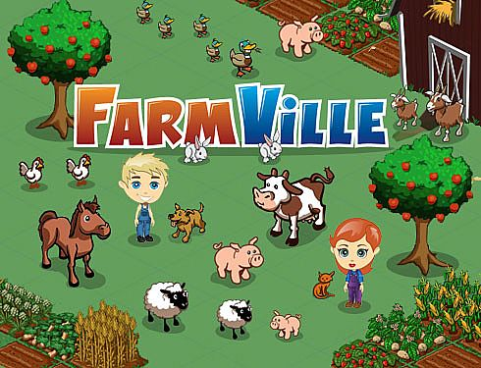
Example of top facebook Game
Peaked at 84 MM Monthly Active Users (MAU).
32 MM distinct people used the application at least once a day (DAU).
Close to 40% of all their users visit the application every single day!

Slide 21
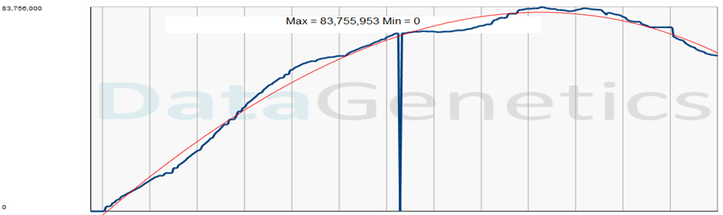
Farmville - MAU

Slide 22
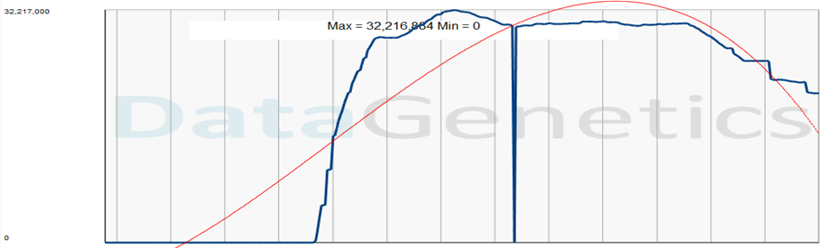
Café World - MAU

Slide 23
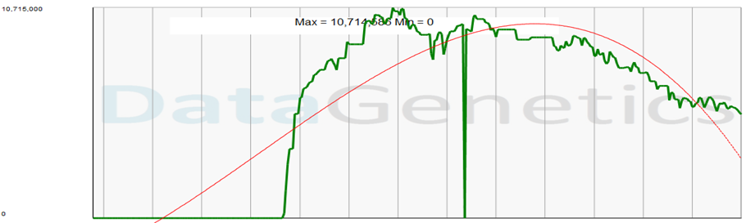
Café World - DAU

Slide 24
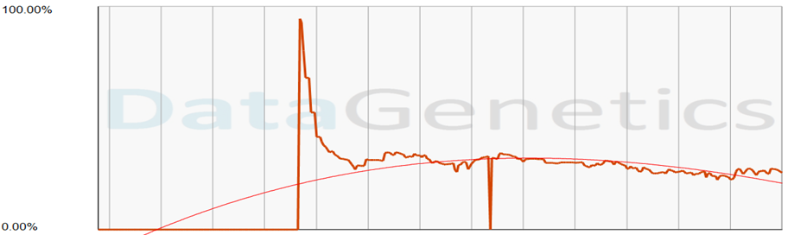
Café World - Engagement

Slide 25
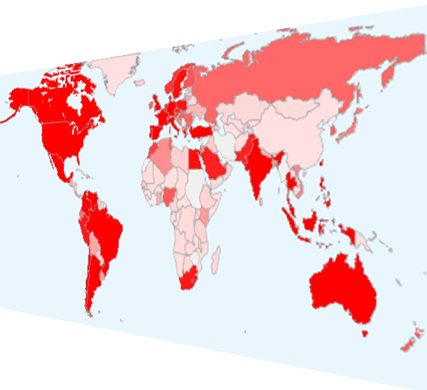

Where in the World?

Slide 26
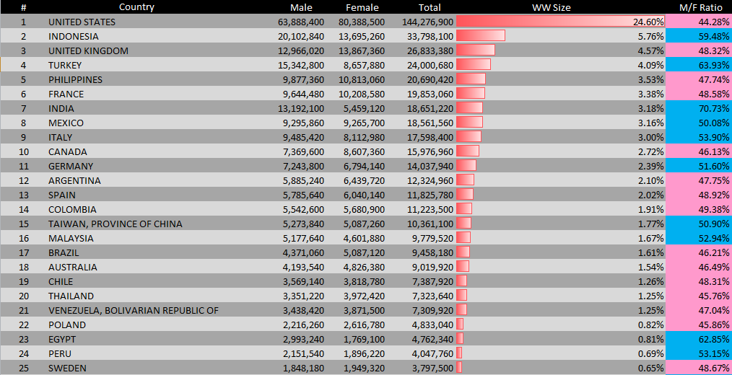
Top 25 countries on facebook
Top 25 countries account for 79% of all FaceBook registered accounts.
After Venezuela, no country accounts for more than 1%.

Slide 27
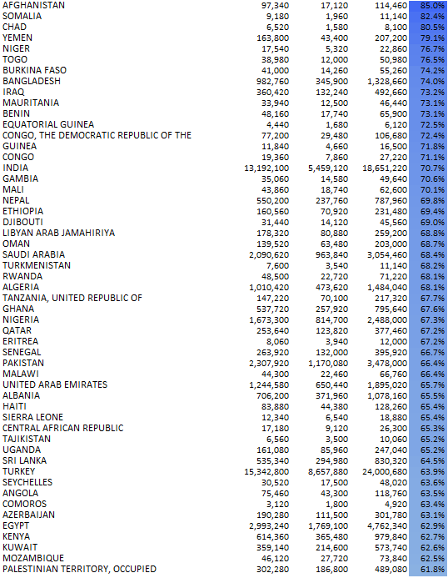
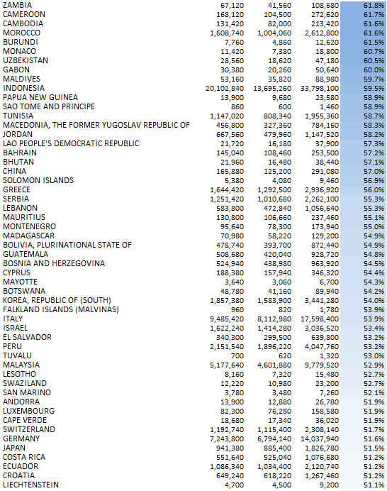
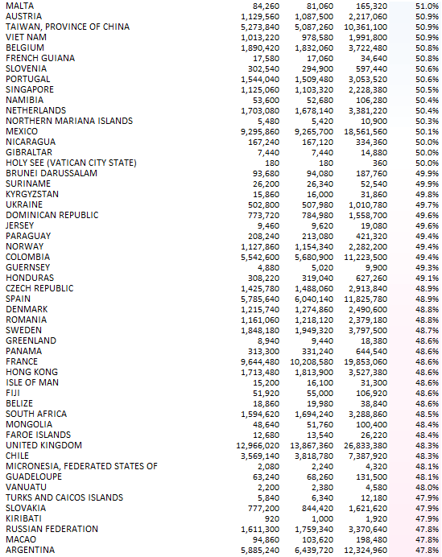
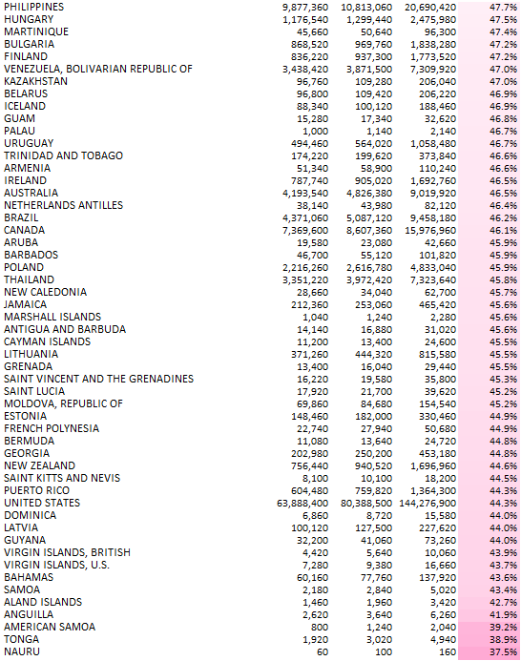
Gender breakdown of FaceBook users Worldwide
Male dominant
Female dominant
India 70.7% male
Indonesia 59.5% male
UK 48.3% male
USA 44.3% male

Slide 28
Demographics

Slide 29
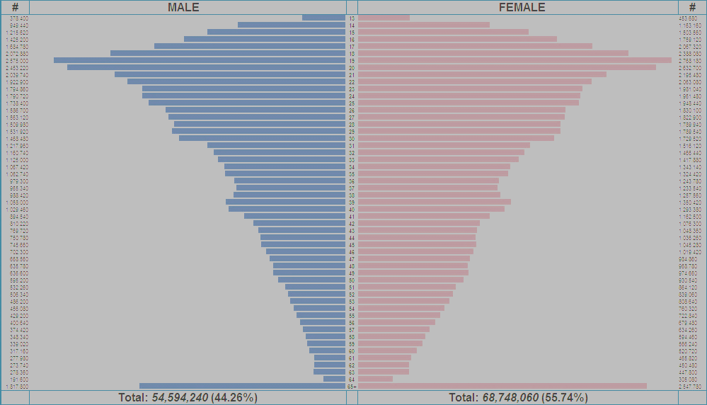
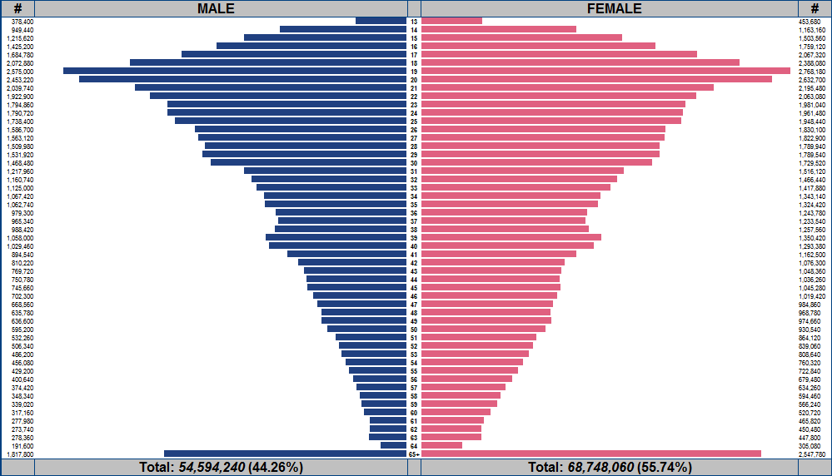
facebook Demographics
13
Male
Female
AGE
65+

Slide 30
facebook Demographics
Many users of college age.
In USA large number of members over 65

Slide 31
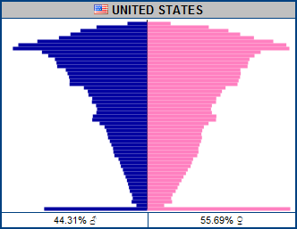
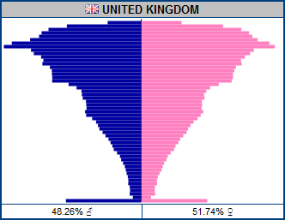
Similar Countries … Similar Profiles

Slide 32
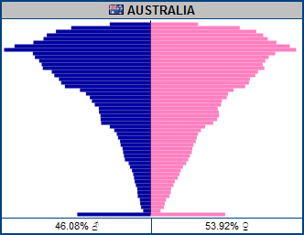
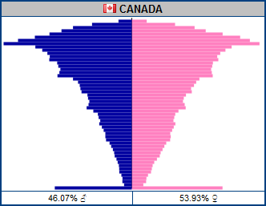
Similar Countries … Similar Profiles

Slide 33
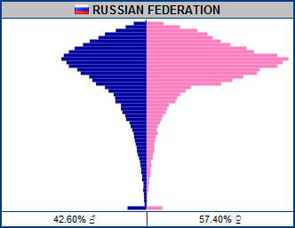
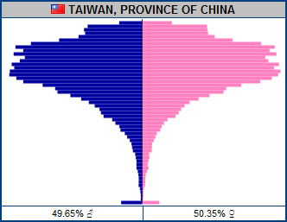
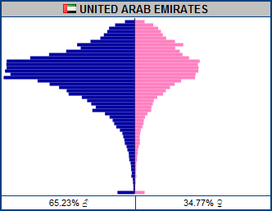
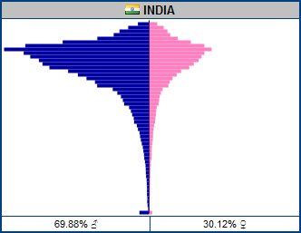
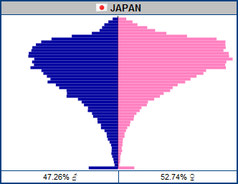
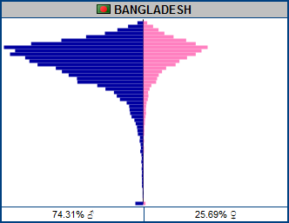
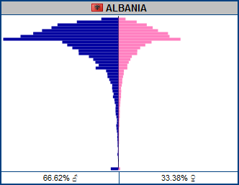
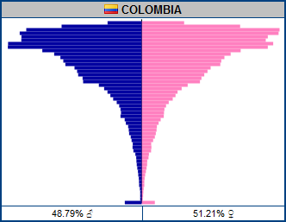
Different Countries … Different Profiles

Slide 34
Games and Interests

Slide 35
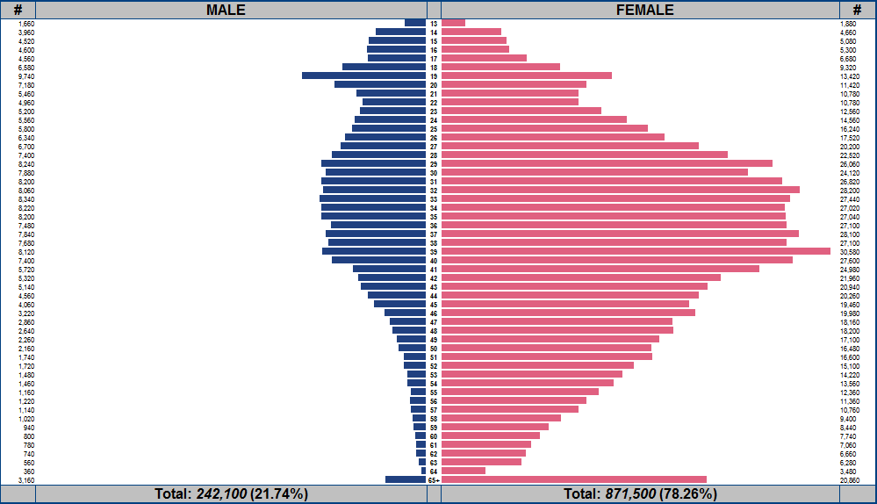
Bejeweled Blitz

Slide 36
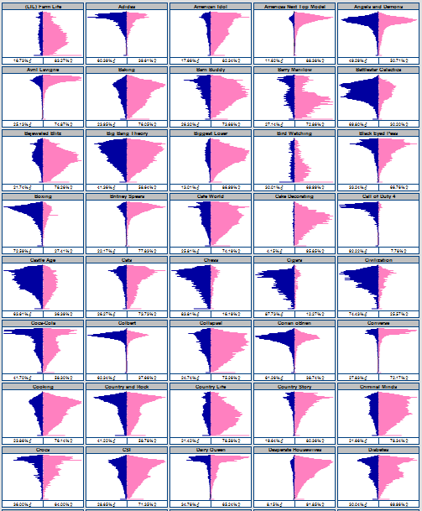
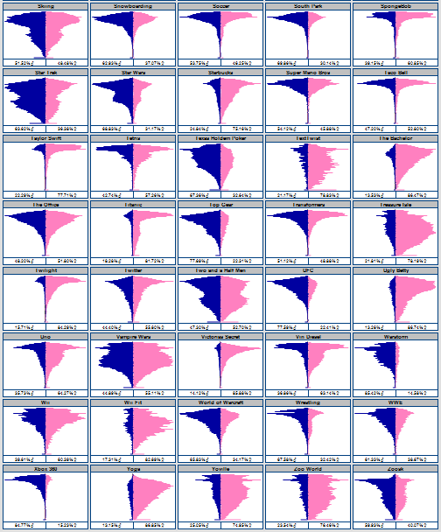
Call of Duty 4
Tetris
Country and Rock
Fishing
Hunting
NASCAR
Black Eyed Peas
Star Trek
Star Wars
Yoville
Texas Holdem Poker
Warstorm
Happy Island
Pet Society
Fishville
Collapse!
Taylor Swift
Transformers
Country Life
Harry Potter
Britney Spears
Mobsters 2 - Vendetta
Castle Age
Vampire Wars
Twilight
Mobsters
World of Warcraft
Zoosk
Civilization
Pepsi
NFL
Converse
Jersey Shore
Victorias Secret
MTV
Coca-Cola
Pillow Fight
Sims 3
Super Mario Bros
Mafia Wars
Happy Aquarium
Cafe World
Jigsaw Puzzles
Barn Buddy
Country Story
Mythbusters
Avril Lavigne
Red Bull
Disney
Johhny Depp
Titanic
Starbucks
Red Hot Chili Peppers
Lord of the Rings
SpongeBob
McDonalds
Scrabble
(LIL) Farm Life
Dilbert
Investing
Farm Town
Law and Order
TextTwist
Farmville
Treasure Isle
Doodle Jump
Playboy
Dr Phil
Island Paradise
Zoo World
Fish World
Bejeweled Blitz
Roller Coaster Kingdom
Justin Bieber
Conan oBrien
Jay Leno
Michael Jackson
James Bond
James Patterson
Angels and Demons
Roller Coasters
Chess
Mahjong Dimensions
Mahjong
Petville
Uno
Elvis
Frank Sinatra
Soccer
Cigars
Golf
Jogging
Pilates
Yoga
Puma
Adidas
Nike
Reebok
Lifetime
Colbert
Howard Stern
Big Bang Theory
Ellen Degenerous
Dr Who
Lost
Top Gear
WWE
Wrestling
Jui Jitsu
Martial Arts
MMA
UFC
Boxing
NCIS
Cooking
Sewing
Knitting
Martha Stewart
Horses
Makeup
Fashion
Cake Decorating
Greenhouse
Bird Watching
Dogs
Plants
Cats
Flowers
Gardening
Baking
The Bachelor
Crocs
Jeep
The Office
Saturday Night Live
Scrubs
South Park
Family Guy
Simpsons
Heroes
Ugly Betty
Battlestar Galactica
Dunkin Donuts
Pizza Hut
Taco Bell
Scuba Diving
Skiing
Snowboarding
iTunes
Barry Manilow
Dairy Queen
Lady Gaga
Vin Diesel
Criminal Minds
Two and a Half Men
How I met your Mother
Medium
Ghost Whisperer
Biggest Loser
Americas Next Top Model
Sex and the City
Desperate Housewives
CSI
American Idol
Happy Pets
Mind Jolt Games
Restaurant City
Twitter
iPHONE
iPad
Pokemon
Nintendo DS
Xbox 360
PS3
Diabetes
Monopoly
Settlers of Catan
Megan Fox
Rock Band
Foursquare
Guitar Hero
Oprah Winfrey Show
Halo
Wii Fit
Wii

Slide 37
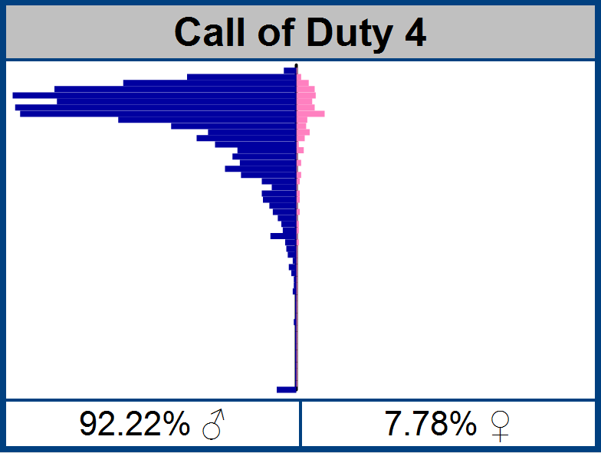
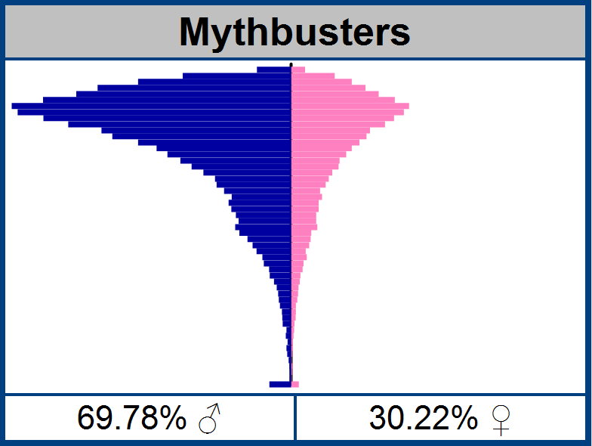
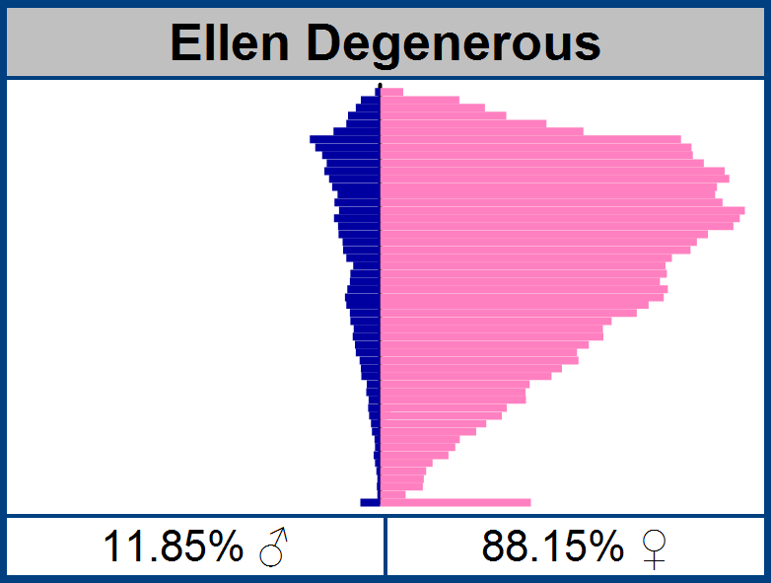
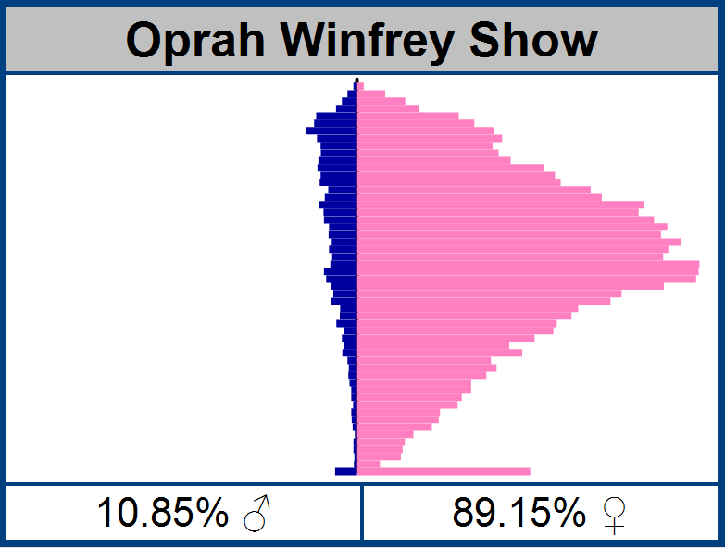

Slide 38
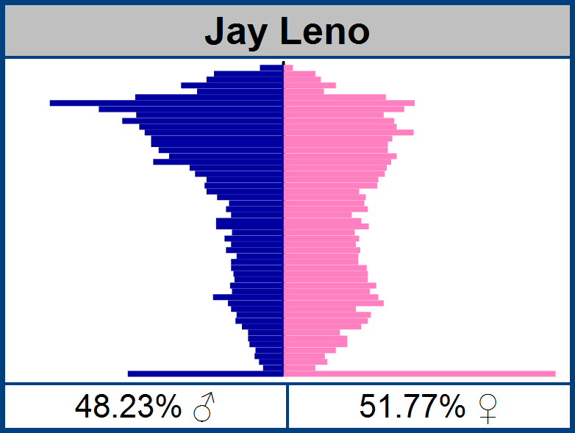
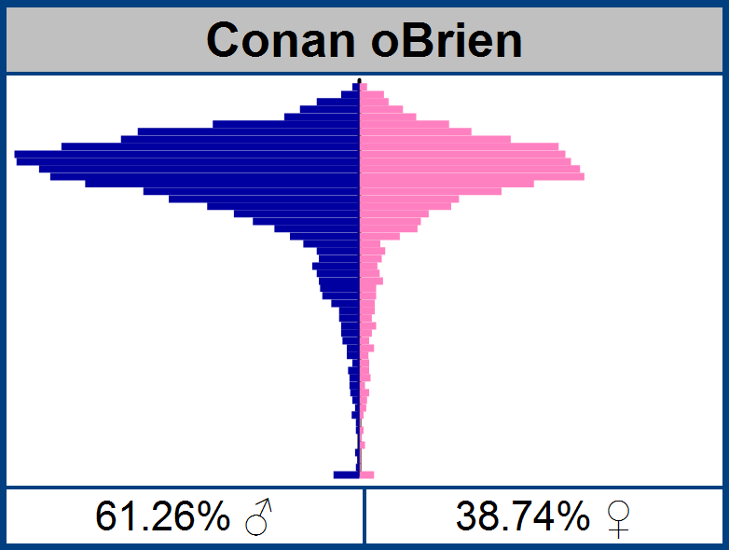
Jay Leno vs. Conan

Slide 39
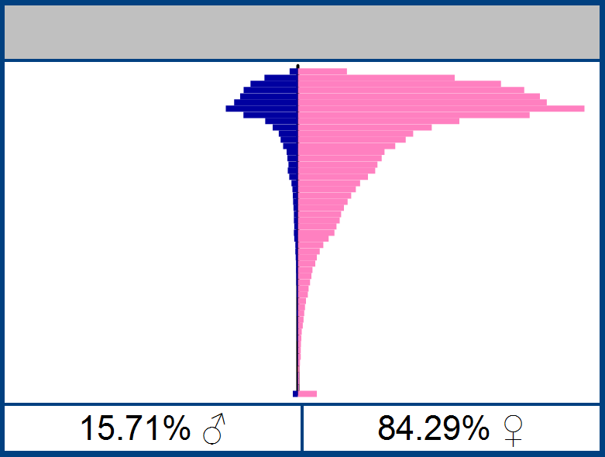
Quiz Time – Guess the movie
Answer: Twilight™

Slide 40
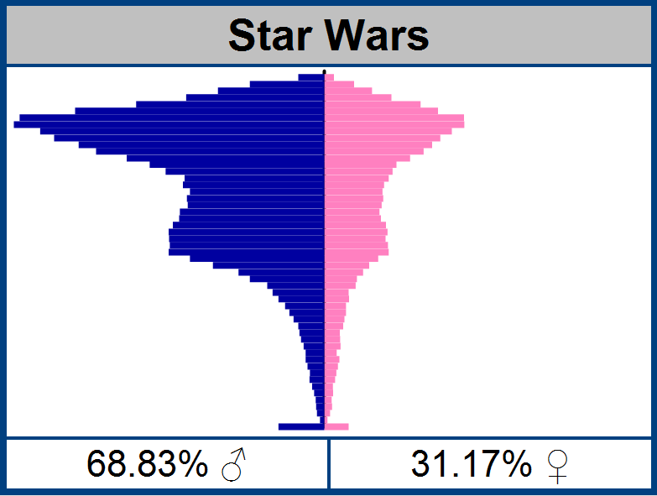
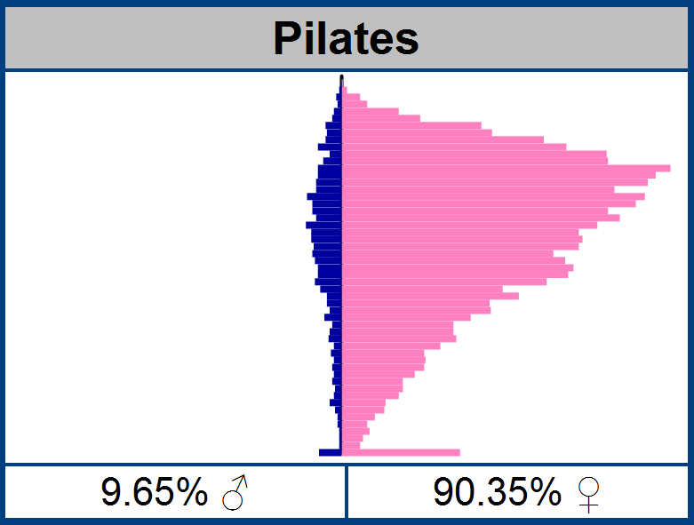
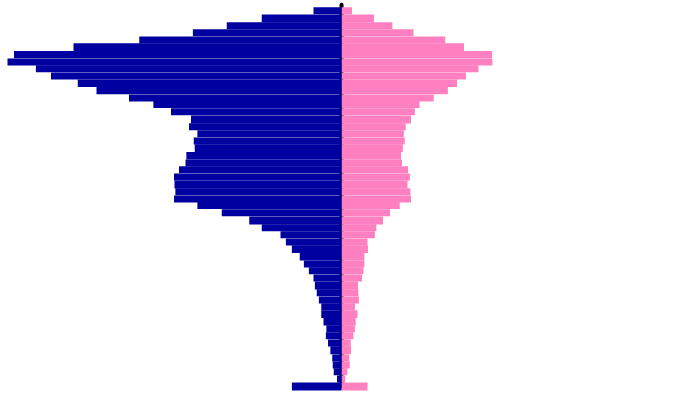
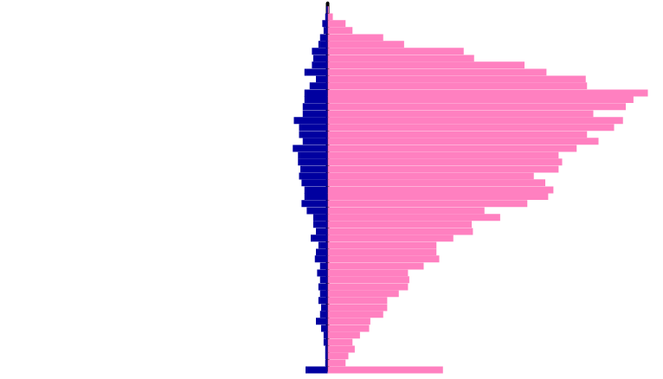
Comparing Demographic “Genes”
38.41% correlation

Slide 41
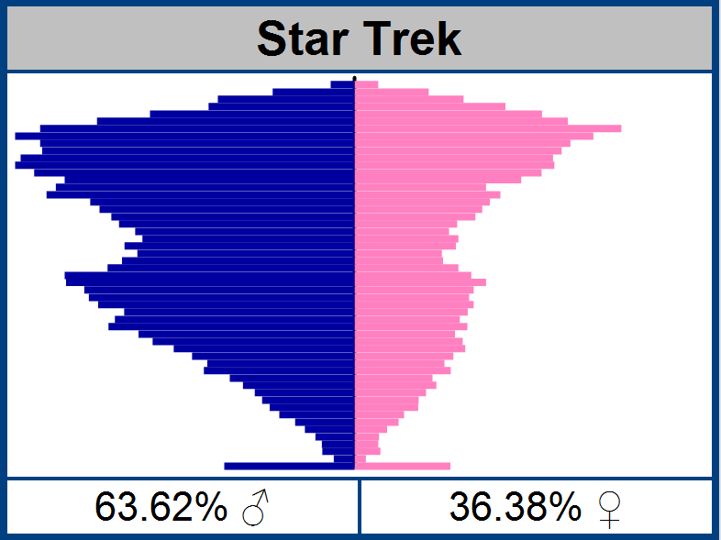
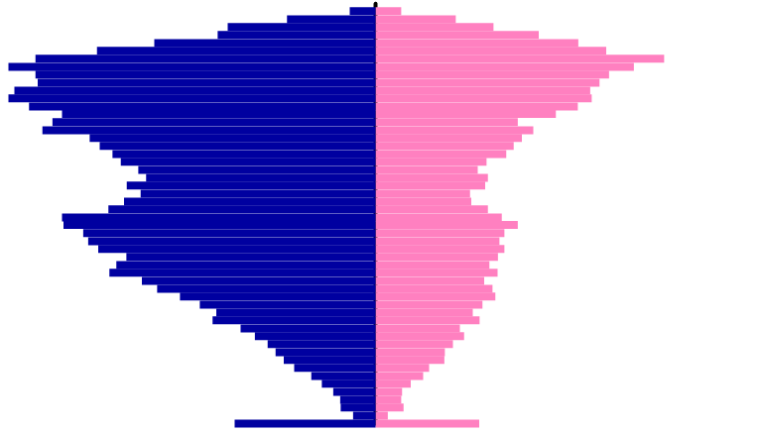
Comparing Demographic “Genes”
80.89% correlation

Slide 42
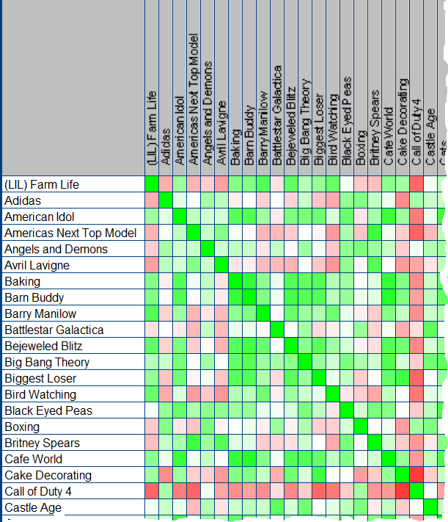
Cross correlation between brands

Slide 43
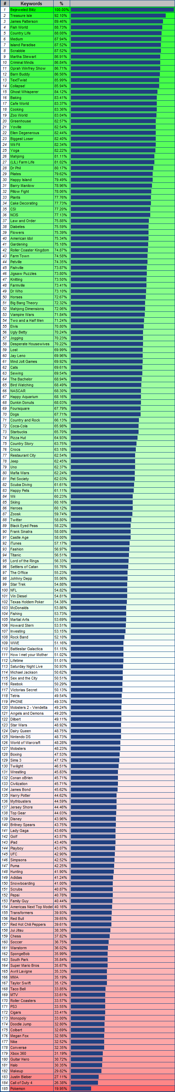

Bejeweled Blitz Affinity

Slide 44

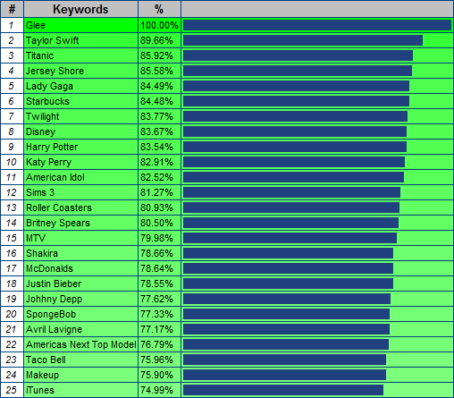
What are fans of glee on facebook interested in?

Slide 45
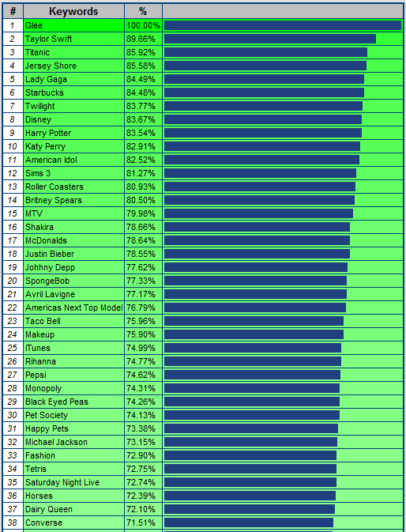
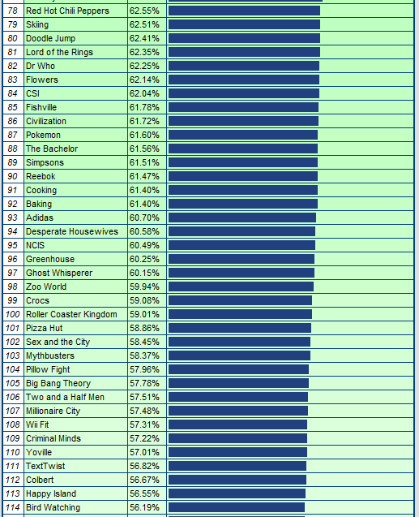




Slide 46

Affinity for Games

Slide 47
TV Shows

Slide 48
Music

Slide 49
Drinks, Fast Food and Footwear

Slide 50
Hobbies, Animals and Misc.

Slide 51
Micro transactions

Slide 52

Propensity to pay?
0.8% users spend
2.1% users spend
3.0% users spend
2.6% users spend
2.4% users spend
Sorority Life, % users who spend by age
Source: “Rules to Monetize By …”, Playdom 2010

Slide 53


Are you targeting your game to the paying audience?
O
$
Even if this game had 5x the traffic, it would not generate the same revenue
Would you like to have the largest game on facebook, or the most profitable?

Slide 54

Micro-transaction types
Bling
Accelerators
Power-ups
Avatars
Fashion
Accessories
Things that do not adjust the balance of the game
Kill 10 more Orcs
= or =
Pay 10 gold coins
Pay to get 10 gold coins to get +10% attack bonus for 12 hours
+10%
Time
Money

Slide 55
The economic beauty of micro-transactions
Price
The “Tall” Tail …
$19.95
$6.95
The Long Tail …
Volume

Slide 56



Big brands are starting to get it

Slide 57

MIT research
When playing games, people are at 95-99% “focused attention”
(As measured by pupil dilation, skin resistance, pulse, movement, breathing, brain activity …)
This blows away all other media
With just 15 seconds exposure to a brand, there is >80% unaided recall.
Sponsors can receive “Halo” effect by having their brands associated with success screens and level completion events.

Slide 58

Pitching to potential Sponsors

Slide 59
Honeymoon period for brand owners with fans!
43% of fans visit facebook several times a day.
50% of fans come to facebook for entertainment.
92% say that being a fan has a positive impact in recommending to friends.
52% recommend others to follow the brand.
84% of fans consume (regularly/ocassionally) the brand.
There is no disconnect between brands followed on facebook and regular consumers.
An average of 9 brands are followed by users.
Source: DDB, October 2010

Slide 60
Advice to Social Game Developers

Slide 61
You’re a Service not a Product

Slide 62

Measure Everything!
Analytics is now just as important as game design!

Slide 63

A/B Testing
It’s not just for adverts!
Use tools. Measure baseline.
Tweak, then measure again.
Denominators are large, so even minor changes can result in $$.
It’s all about the “tastes of the fish, not the tastes of the fisherman”.
Look at everything: prices, tooltips, position, offers …
Play
or
Join

Slide 64

We’re now on the second generation of Social Games
Generation #1 – Build it, and throw it live immediately.
Fix and modify it live. Those days are over!
Generation #2 – Get it mechanics reasonably polished before general release.
“You don’t get a second chance to make a first impression”
Today’s early adopters of new games …
… Virally introduce more people to your game
… Typically spend more over lifetime

Slide 65
The End
Nick@DataGenetics.com

