Slide 1
Nick Berry
Demographic analysis of FaceBook users
M.Eng, ARAeS, CIPP
All logos and trademarks in this presentation are property of their respective owners.

Slide 2

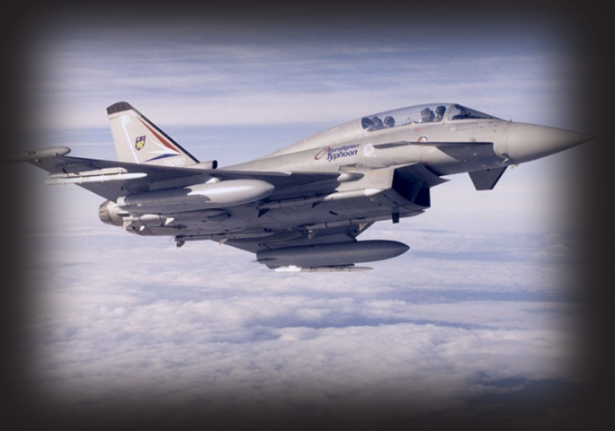



Biography – Nick Berry
1988
1994
2008
2010

Slide 3

Just how big is it?

Slide 4
Year End Registrations (MM)

Slide 5

Just how big is FaceBook?
6.8 billion people on the planet
2.0 billion people connected to the internet
600 million registered FaceBook accounts
30% of the connected World already has a Facebook account!

Slide 6
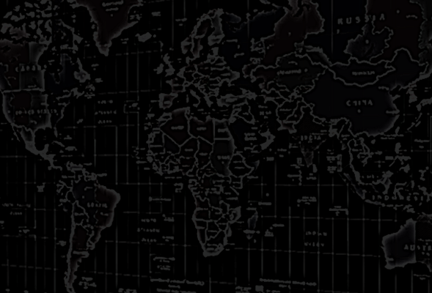
If facebook were a country …
#1 China
#2 India
#3 facebook
… it would the 3rd largest in the World.

Slide 7
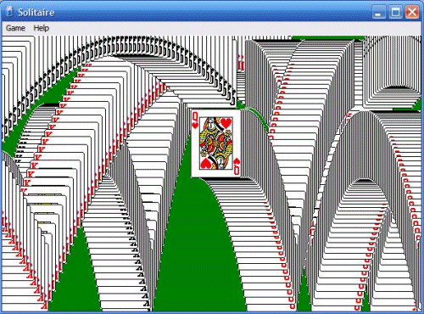
What is the most popular Windows application of all time?

Slide 8
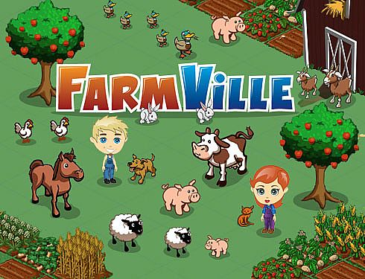




People love to play games
The top FaceBook applications are all games

Slide 9



FaceBook gaming is big business
“Disney Buys Playdom in $763 Million Deal, Becoming Hollywood Leader in Social Games”
“Not Playing Around. EA Buys Playfish For $300 Million, Plus a $100 Million Earnout.”
“Zynga Issues Shares at a $4 Billion Valuation”

Slide 10
Top FaceBook Game
Peaked at 84 MM Monthly Active Users (MAU).
32 MM distinct people used the application at least once a day (DAU).
Close to 40% of all their users visit the application every single day!

Slide 11
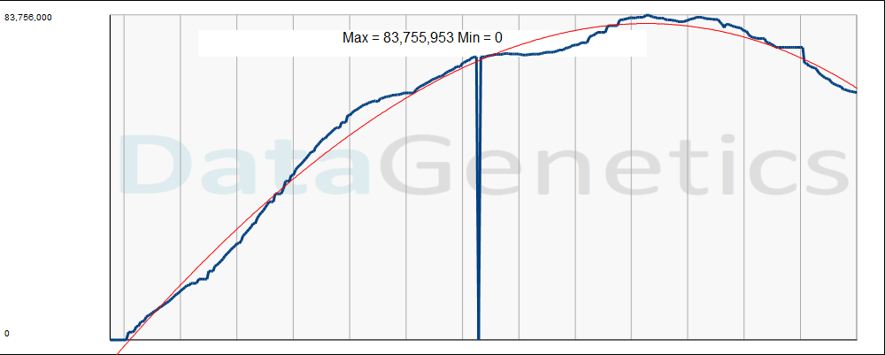
Farmville - MAU

Slide 12


Effect of FaceBook on traditional Casual Gaming web sites
Peak Population
Data courtesy of

Slide 13
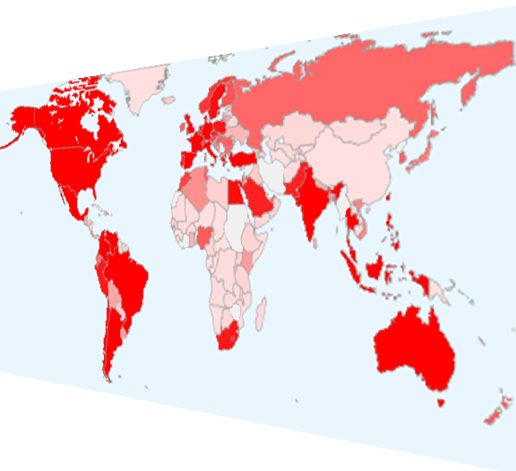

Where in the World?

Slide 14
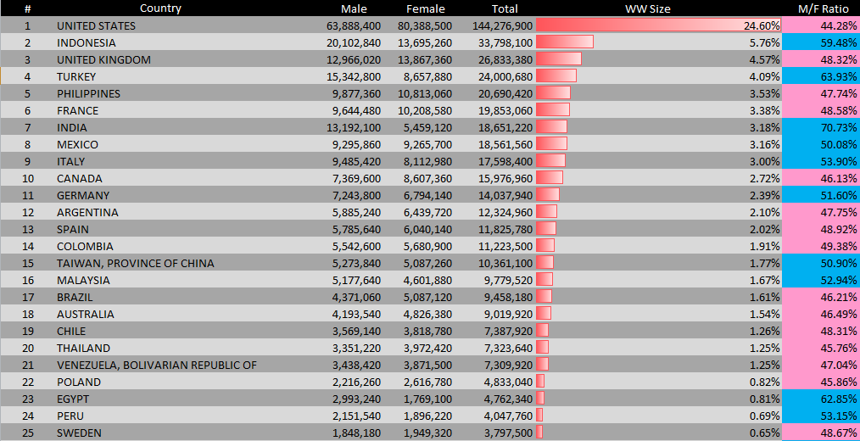
Top 25 countries on facebook
Top 25 countries account for 79% of all FaceBook registered accounts.
After Venezuela, no country accounts for more than 1%.

Slide 15
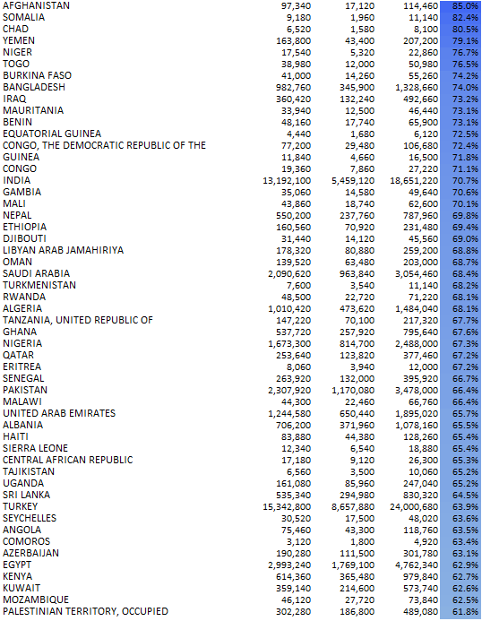
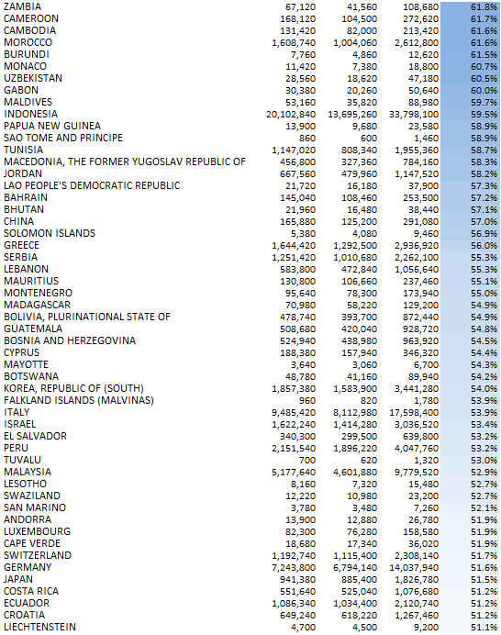
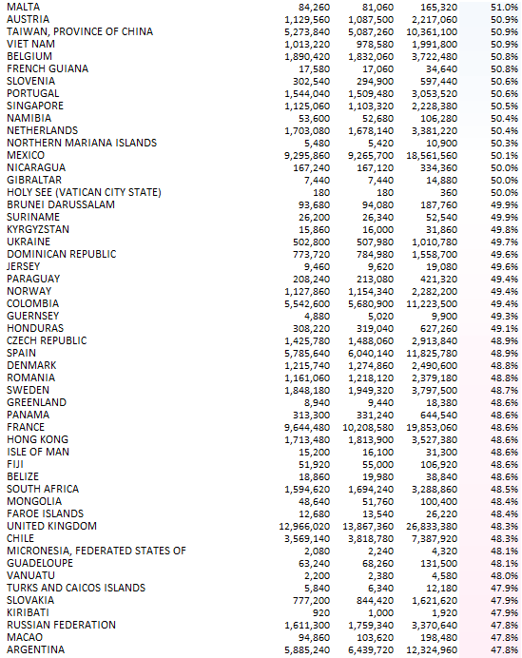
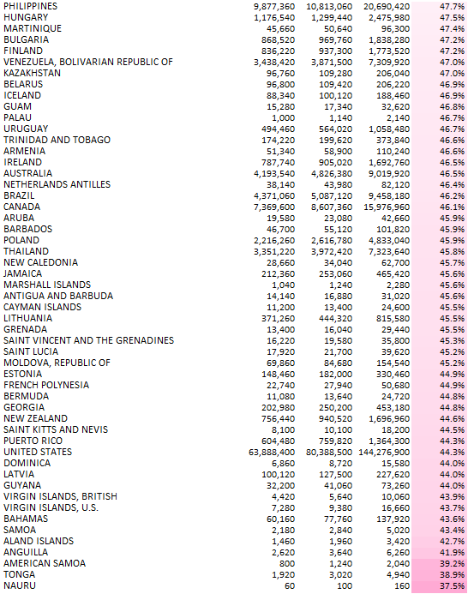
Gender breakdown of FaceBook users Worldwide
Male dominant
Female dominant
India 70.7% male
Indonesia 59.5% male
UK 48.3% male
USA 44.3% male

Slide 16
Worldwide Registrations – Social Networks

Slide 17
Demographic Breakdown

Slide 18
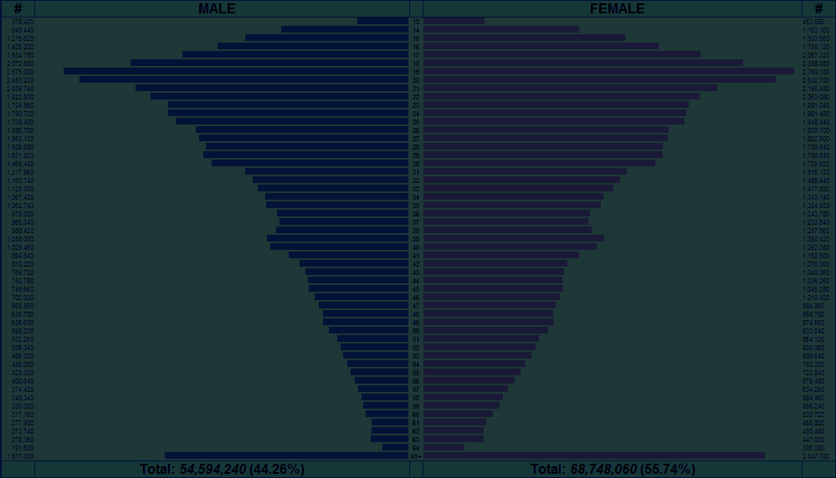
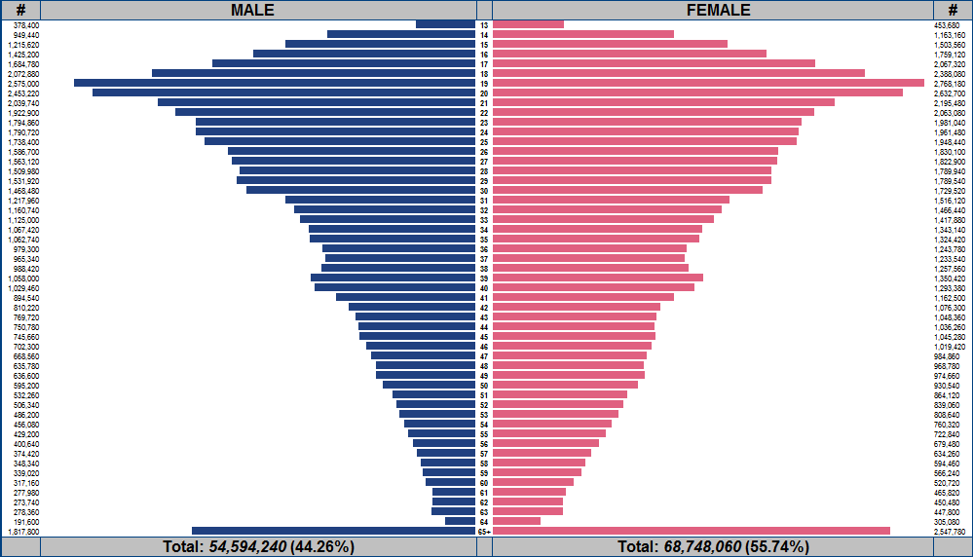
FaceBook Demographics
Male
13
Female
AGE
65+

Slide 19
FaceBook Demographics
Many users of college age.
In USA large number of members over 65

Slide 20
Different Countries

Slide 21
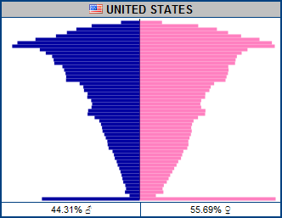
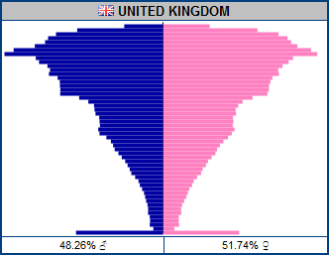
Similar Countries … Similar Profiles

Slide 22
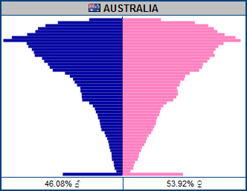
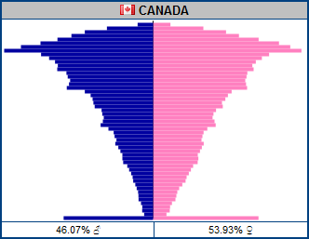
Similar Countries … Similar Profiles

Slide 23
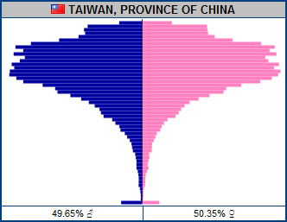
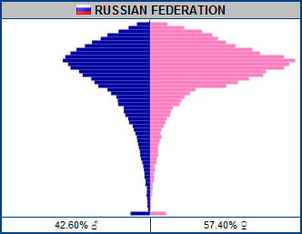
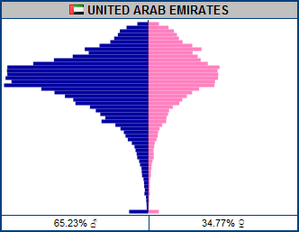
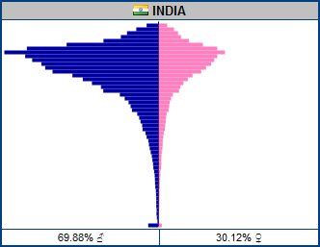
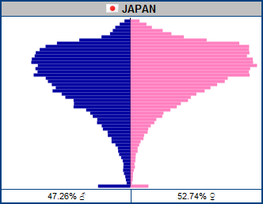
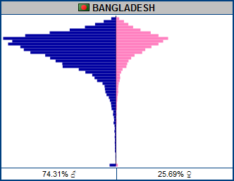
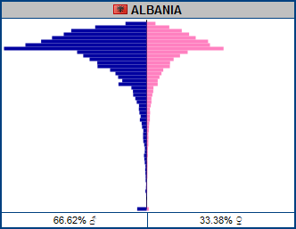
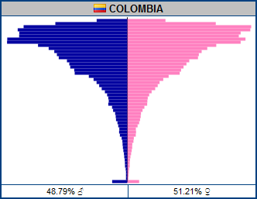
Different Countries … Different Profiles

Slide 24
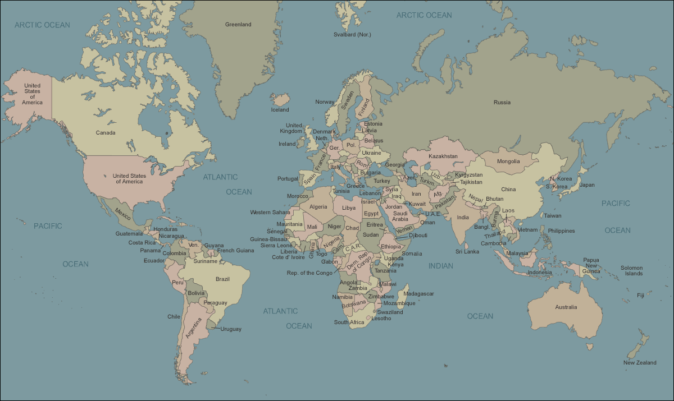
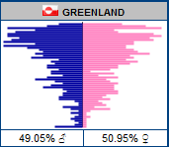
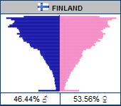
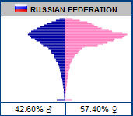
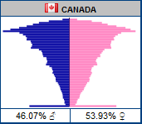
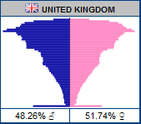
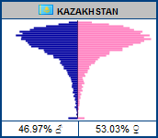
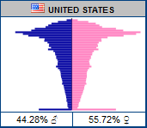
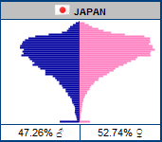
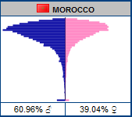
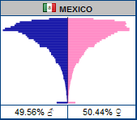
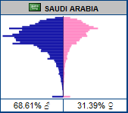
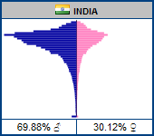
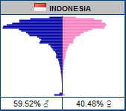
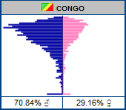
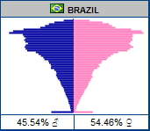
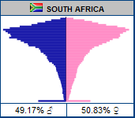
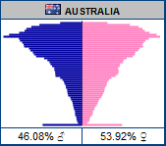
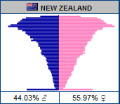
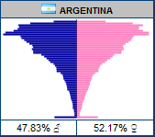

Slide 25
Interests

Slide 26
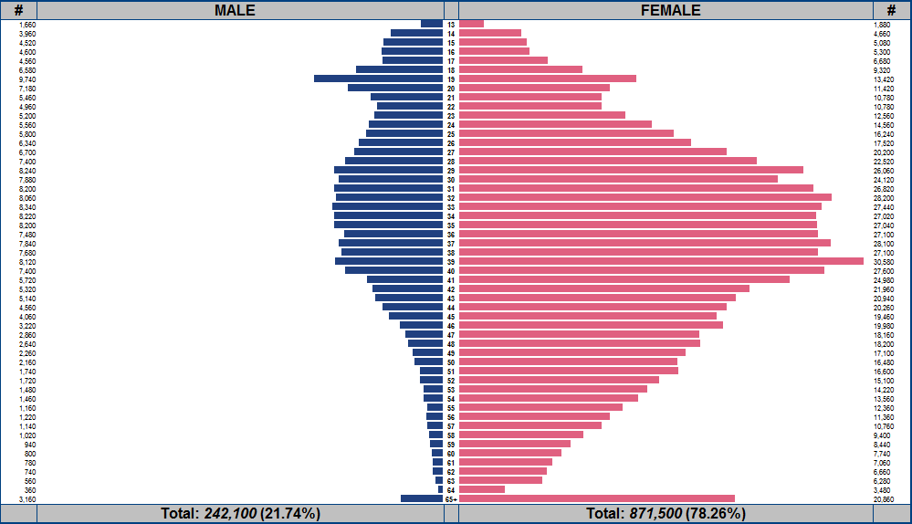
Bejeweled

Slide 27
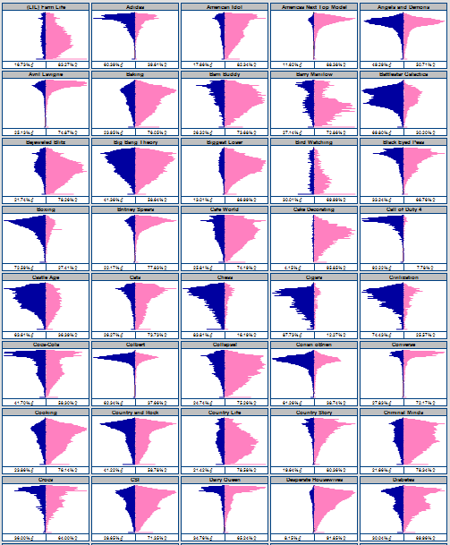
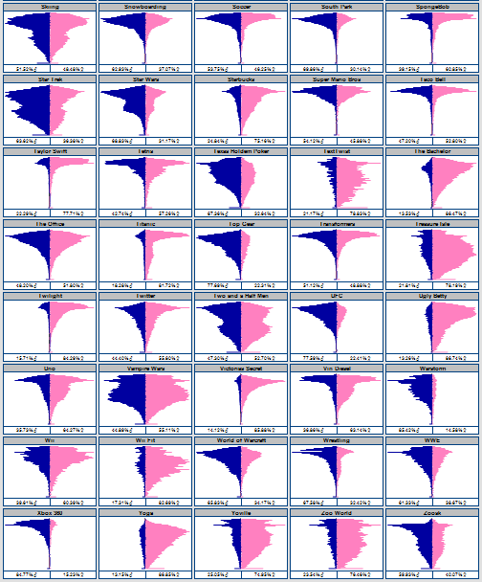
Call of Duty 4
Tetris
Country and Rock
Fishing
Hunting
NASCAR
Black Eyed Peas
Star Trek
Star Wars
Yoville
Texas Holdem Poker
Warstorm
Happy Island
Pet Society
Fishville
Collapse!
Taylor Swift
Transformers
Country Life
Harry Potter
Britney Spears
Mobsters 2 - Vendetta
Castle Age
Vampire Wars
Twilight
Mobsters
World of Warcraft
Zoosk
Civilization
Pepsi
NFL
Converse
Jersey Shore
Victorias Secret
MTV
Coca-Cola
Pillow Fight
Sims 3
Super Mario Bros
Mafia Wars
Happy Aquarium
Cafe World
Jigsaw Puzzles
Barn Buddy
Country Story
Mythbusters
Avril Lavigne
Red Bull
Disney
Johhny Depp
Titanic
Starbucks
Red Hot Chili Peppers
Lord of the Rings
SpongeBob
McDonalds
Scrabble
(LIL) Farm Life
Dilbert
Investing
Farm Town
Law and Order
TextTwist
Farmville
Treasure Isle
Doodle Jump
Playboy
Dr Phil
Island Paradise
Zoo World
Fish World
Bejeweled Blitz
Roller Coaster Kingdom
Justin Bieber
Conan oBrien
Jay Leno
Michael Jackson
James Bond
James Patterson
Angels and Demons
Roller Coasters
Chess
Mahjong Dimensions
Mahjong
Petville
Uno
Elvis
Frank Sinatra
Soccer
Cigars
Golf
Jogging
Pilates
Yoga
Puma
Adidas
Nike
Reebok
Lifetime
Colbert
Howard Stern
Big Bang Theory
Ellen Degenerous
Dr Who
Lost
Top Gear
WWE
Wrestling
Jui Jitsu
Martial Arts
MMA
UFC
Boxing
NCIS
Cooking
Sewing
Knitting
Martha Stewart
Horses
Makeup
Fashion
Cake Decorating
Greenhouse
Bird Watching
Dogs
Plants
Cats
Flowers
Gardening
Baking
The Bachelor
Crocs
Jeep
The Office
Saturday Night Live
Scrubs
South Park
Family Guy
Simpsons
Heroes
Ugly Betty
Battlestar Galactica
Dunkin Donuts
Pizza Hut
Taco Bell
Scuba Diving
Skiing
Snowboarding
iTunes
Barry Manilow
Dairy Queen
Lady Gaga
Vin Diesel
Criminal Minds
Two and a Half Men
How I met your Mother
Medium
Ghost Whisperer
Biggest Loser
Americas Next Top Model
Sex and the City
Desperate Housewives
CSI
American Idol
Happy Pets
Mind Jolt Games
Restaurant City
Twitter
iPHONE
iPad
Pokemon
Nintendo DS
Xbox 360
PS3
Diabetes
Monopoly
Settlers of Catan
Megan Fox
Rock Band
Foursquare
Guitar Hero
Oprah Winfrey Show
Halo
Wii Fit
Wii

Slide 28
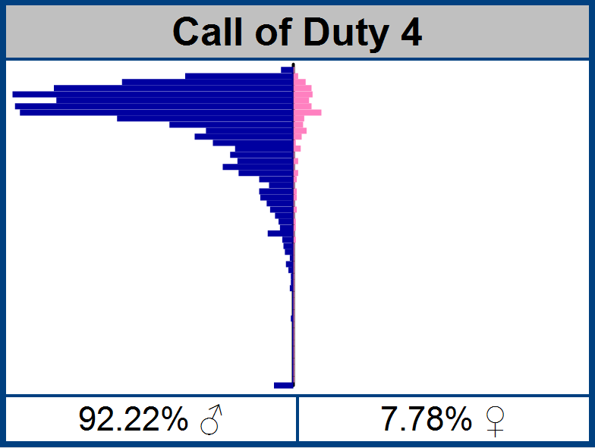
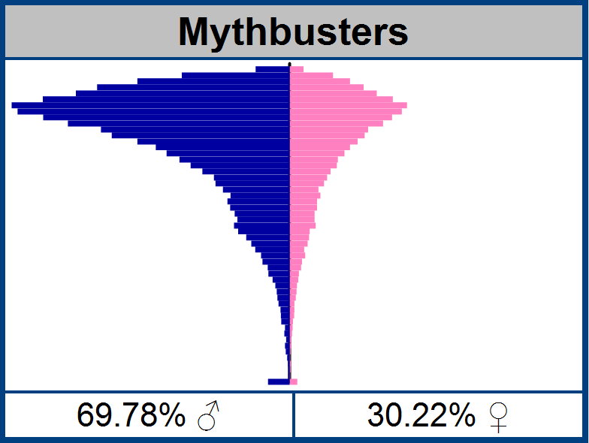



Slide 29


Jay Leno vs. Conan

Slide 30

Quiz Time – Guess the movie
Answer: Twilight

Slide 31




Comparing Demographic “Genes”
38.41% correlation

Slide 32


Comparing Demographic “Genes”
80.89% correlation

Slide 33
Affinities

Slide 34

Cross correlation between brands

Slide 35


Slide 36


Bejeweled Blitz Affinity

Slide 37


What are fans of glee on facebook interested in?

Slide 38






Slide 39

Affinity for Games

Slide 40
TV Shows

Slide 41
Music

Slide 42
Drinks, Fast Food and Footwear

Slide 43
Hobbies, Animals and Misc.

Slide 44

Zoosk

Slide 45


Time Lapse

Slide 46
TV

Slide 47
Hobbies

Slide 48
Music

Slide 49
Relationship Status

Slide 50


FaceBook allows users to specify their status
63.4% specified their relationship status
USA

Slide 51
Status differences by Gender (USA)
 | ALL | Just Males | Just Female
Single | 21.3% | 24.1% | 19.0%
In Relationship | 14.8% | 13.8% | 15.5%
Engaged | 2.6% | 2.3% | 2.9%
Married | 24.7% | 20.9% | 27.7%
(unspecified) | 36.6% | 38.8% | 34.8%
20.9%
23.7%
 | BOTH | Just Males | Just Female
Single | 20.9% | 23.7% | 18.9%
In Relationship | 12.9% | 12.5% | 13.5%
Engaged | 2.4% | 2.2% | 2.6%
Married | 26.7% | 22.7% | 30.2%
(unspecified) | 37.1% | 38.9% | 34.8%
12.9%
12.5%
13.5%
2.6%
26.7%
22.7%
30.2%
+/- Changes since iDate Paris 2010

Slide 52
Status differences by Gender (USA/Mexico)
 | ALL | Just Males | Just Female
Single | 21.3% 17.0% | 24.1% 16.5% | 19.0% 17.6%
In Relationship | 14.8% 10.4% | 13.8% 9.4% | 15.5% 11.3%
Engaged | 2.6% 1.6% | 2.3% 1.5% | 2.9% 1.8%
Married | 24.7% 7.6% | 20.9% 6.5% | 27.7% 8.8%
(unspecified) | 36.6% 63.3% | 38.8% 66.1% | 34.8% 60.5%
 | BOTH | Just Males | Just Female
Single | 20.9% | 23.7% | 18.9%
In Relationship | 12.9% | 12.5% | 13.5%
Engaged | 2.4% | 2.2% | 2.6%
Married | 26.7% | 22.7% | 30.2%
(unspecified) | 37.1% | 38.9% | 34.8%

Slide 53
All the single ladies (USA) …
Percentage reporting themselves as “Single”
AGE

Slide 54
Market Opportunity
More Single Males
X
More Single Females

Slide 55

What are you looking for?
In the US, 39% of FaceBook users provide this information
(Up from 35% iDate 2010)
In Mexico, 30% provide this information
 | Interested in Men | Interested in Women
I am a Man … | 2.27% | 97.73%
I am Woman … | 91.58% | 8.42%
2.65%
97.35%
70.75%
29.25%

Slide 56

26% of FaceBook users in USA claim to have graduated college …
… of these 21% described their MAJOR

Slide 57
Micro transactions

Slide 58


Propensity to pay?
0.8% users spend
2.1% users spend
3.0% users spend
2.6% users spend
2.4% users spend
Sorority Life, % users who spend by age
Source: “Rules to Monetize By …”, Playdom 2010

Slide 59


Are you targeting your game to the paying audience?
O
$
Even if this game had 5x the traffic, it would not generate the same revenue

Slide 60

Pitching to potential Advertisers

Slide 61

Micro-transaction types
Bling
Accelerators
Power-ups
Avatars
Fashion
Accessories
Things that do not adjust the balance of the game
Kill 10 more Orcs
= or =
Pay 10 gold coins
Pay to get 10 gold coins to get +10% attack bonus for 12 hours
+10%
Time
Money

Slide 62
The economic beauty of micro-transactions
Price
The “Tall” Tail …
$19.95
$6.95
The Long Tail …
Volume

Slide 63
The End
Questions?
Nick@DataGenetics.com
1010101011100110011011110110010010011001111100101001001001001001001001001001100111011011100110111101001001110011011011011011000011111001110111001100110011001110011001001011101110110110100101

Slide 64
Appendix

Slide 65



Big brands are starting to get it

Slide 66
Honeymoon period for brand owners with fans!
43% of fans visit facebook several times a day.
50% of fans come to facebook for entertainment.
92% say that being a fan has a positive impact in recommending to friends.
52% recommend others to follow the brand.
84% of fans consume (regularly/ocassionally) the brand.
There is no disconnect between brands followed on facebook and regular consumers.
An average of 9 brands are followed by users.
Source: DDB, October 2010

Slide 67

MIT research
When playing games, people are at 95-99% “focused attention”
(As measured by pupil dilation, skin resistance, pulse, movement, breathing, brain activity …)
This blows away all other media
With just 15 seconds exposure to a brand, there is >80% unaided recall.
Sponsors can receive “Halo” effect by having their brands associated with success screens and level completion events.

Slide 68
Other Social Networks

Slide 69
# | Site | Size | Notes
1 | Facebook | 506,000,000 | General
2 | Qzone | 200,000,000 | General. In Simplified Chinese; caters for mainland China users
3 | Habbo | 162,000,000 | General for teens. Over 31 communities worldwide. Chat Room and user profiles.
4 | MySpace | 130,000,000 | General
5 | Windows Live Spaces | 120,000,000 | Blogging (formerly MSN Spaces)
6 | Bebo | 117,000,000 | General
7 | Orkut | 100,000,000 | General. Owned by Google Inc. Popular in India and Brazil
8 | Friendster | 90,000,000 | General. Popular in Southeast Asia. No longer popular in the western world
9 | Vkontakte | 81,500,000 | Social Network for Russian-speaking world including former Soviet republics. Biggest site in Russia
10 | hi5 | 80,000,000 | General. Popular in India, Mongolia, Thailand, Romania, Jamaica, Central Africa and Latin America. Not very popular in the USA.
11 | Twitter | 75,000,000 | General. Micro-blogging, RSS, updates
12 | LinkedIn | 75,000,000 | Business and professional networking
13 | Tagged | 70,000,000 | General. Subject to quite some controversy about its e-mail marketing and privacy policy
14 | Badoo | 69,000,000 | General, Meet new people, Popular in Europe and LatAm
15 | Netlog | 65,126,000 | General. Popular in Europe, Turkey, the Arab World and Canada's Québec province. Formerly known as Facebox and Redbox.
16 | Flixster | 63,000,000 | Movies
17 | MyLife | 51,000,000 | Locating friends and family, keeping in touch (formerly Reunion.com)
18 | Classmates.com | 50,000,000 | School, college, work and the military
19 | Odnoklassniki | 45,000,000 | Connect with old classmates. Popular in Russia and former Soviet republics
20 | Flickr | 32,000,000 | Photo sharing, commenting, photography related networking, worldwide
21 | WeeWorld | 30,000,000 | Teenagers - 10 to 17
22 | Viadeo | 30,000,000 | Global Social Networking and Campus Networking available in English, French, German, Spanish, Italian and Portuguese
23 | Last.fm | 30,000,000 | Music
24 | MyHeritage | 30,000,000 | family-oriented social network service
25 | Xanga | 27,000,000 | Blogs and "metro" areas

Slide 70
# | Site | Size | Notes
26 | Mixi | 24,300,000 | Japan
27 | Cyworld | 24,000,000 | General. Popular in South Korea.
28 | Skyrock | 22,000,000 | Social Network in French-speaking world
29 | Fotolog | 20,000,000 | Photoblogging. Popular in South America and Spain
30 | BlackPlanet | 20,000,000 | African-Americans
31 | myYearbook | 20,000,000 | General, Charity
32 | Friends Reunited | 19,000,000 | UK based. School, college, work, sport and streets
33 | LiveJournal | 17,565,000 | Blogging. Popular in Russia and among the Russian-speaking diaspora abroad.
34 | StudiVZ | 17,000,000 | University students, mostly in the German-speaking countries. School students and those out of education sign up via its partner sites schülerVZ and meinVZ.
35 | Sonico.com | 17,000,000 | General. Popular in Latin America and Spanish and Portuguese speaking regions.
36 | Renren | 15,000,000 | Significant site in China. Was known as 校内 (Xiaonei) until August 2009.
37 | Plaxo | 15,000,000 | Aggregator
38 | Geni.com | 15,000,000 | Families, genealogy
39 | Nasza-klasa.pl | 11,000,000 | School, college and friends. Popular in Poland
40 | StumbleUpon | 10,600,000 | Stumble through websites that match your selected interests
41 | Hyves | 10,100,000 | General, Most popular in the Netherlands.
42 | WAYN | 10,000,000 | Travel and lifestyle
43 | Buzznet | 10,000,000 | Music and pop-culture
44 | Multiply | 10,000,000 | "Real world" relationships. Popular in Asia. Not popular in the western world
45 | Care2 | 9,962,000 | Green living and social activism
46 | CaringBridge | 9,500,000 | Not for profit providing free websites that connect family and friends during a serious health event, care and recovery.
47 | deviantART | 9,040,000 | Art community
48 | delicious | 8,823,000 | Social bookmarking allowing users to locate and save websites that match their own interests
49 | XING | 8,000,000 | Business (primarily Europe (Germany, Austria, Switzerland) and China)
50 | Open Diary | 5,000,000 | First online blogging community, founded in 1998

Slide 71
# | Site | Size | Notes
51 | Livemocha | 5,000,000 | Online language learning - dynamic online courses in 35 languages - world’s largest community of native language speakers.
52 | Tuenti | 4,500,000 | Spanish-based university and High School social network. Very Popular in Spain
53 | Trombi.com | 4,000,000 | French subsidiary of Classmates.com
54 | weRead | 4,000,000 | Books
55 | iWiW | 4,000,000 | Hungary
56 | Ibibo | 3,500,000 | Talent based social networking site that allows to promote one's self and also discover new talent. Most popular in India.
57 | Cellufun | 3,000,000 | Mobile social game network, Number 8 US mobile website
58 | My Opera | 3,000,000 | Blogging, mobile blogging, sharing photos, connecting with friends. Global
59 | Bigadda | 3,000,000 | Indian Social Networking Site
60 | MocoSpace | 3,000,000 | mobile community, worldwide
61 | Draugiem.lv | 2,600,000 | General (primarily LV, LT, HU)
62 | Itsmy | 2,500,000 | Mobile community worldwide, blogging, friends, personal TV-shows
63 | Kiwibox | 2,400,000 | General. For the users, by the users, a social network that is more than a community.
64 | Grono.net | 2,000,000 | Poland
65 | Foursquare | 2,000,000 | Location based mobile social network
66 | Stickam | 2,000,000 | Live video streaming and chat.
67 | Vampirefreaks.com | 1,931,000 | Gothic and industrial subculture
68 | TravBuddy.com | 1,588,000 | Travel
69 | CouchSurfing | 1,560,000 | Worldwide network for making connections between travelers and the local communities they visit.
70 | Nexopia | 1,400,000 | Canada
71 | CafeMom | 1,250,000 | Mothers
72 | Fubar | 1,200,000 | dating, an "online bar" for 18 and older
73 | LunarStorm | 1,200,000 | Sweden

