Slide 1
Beginners Guide to Growth Hacking
Nick Berry
M.Eng, ARAeS, CIPP
Data Scientist, facebook

Slide 2
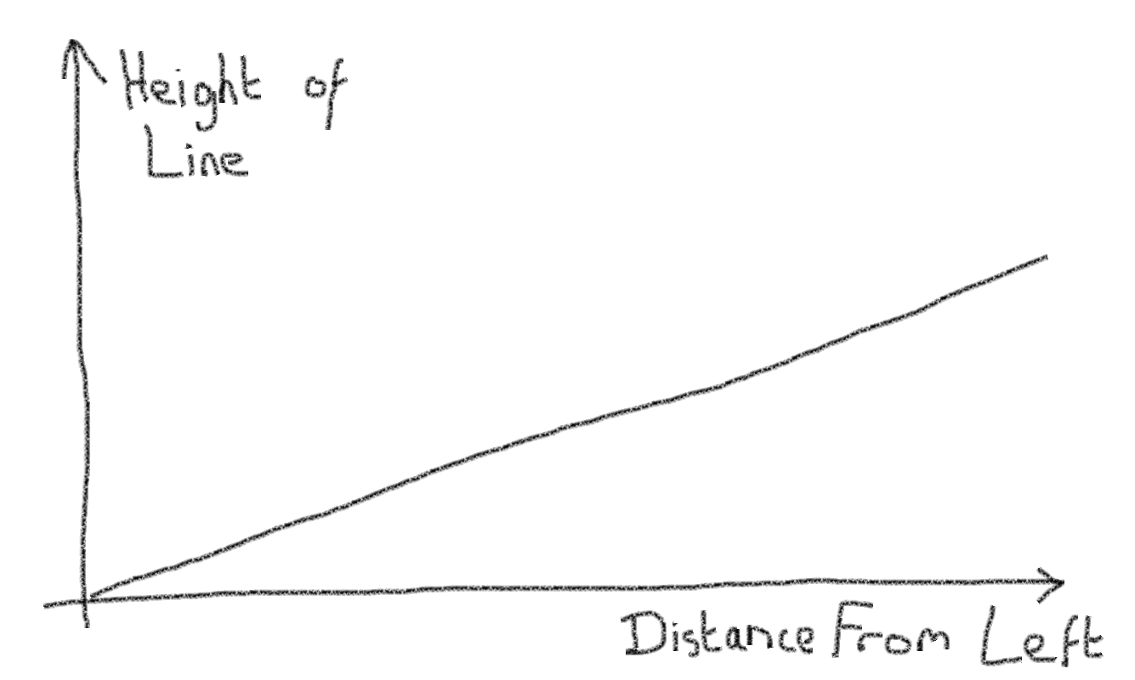
What is growth hacking?

Slide 3
What is growth hacking?
Sean Ellis, 2010
“A growth hacker is a person whose true north is growth.”
Some better quotes:
“Non-traditional ways for growing your traffic/adoption.”
“More focus on the objective than the process.”
“Typically innovative”
“Out of the box”
WTF?

Slide 4

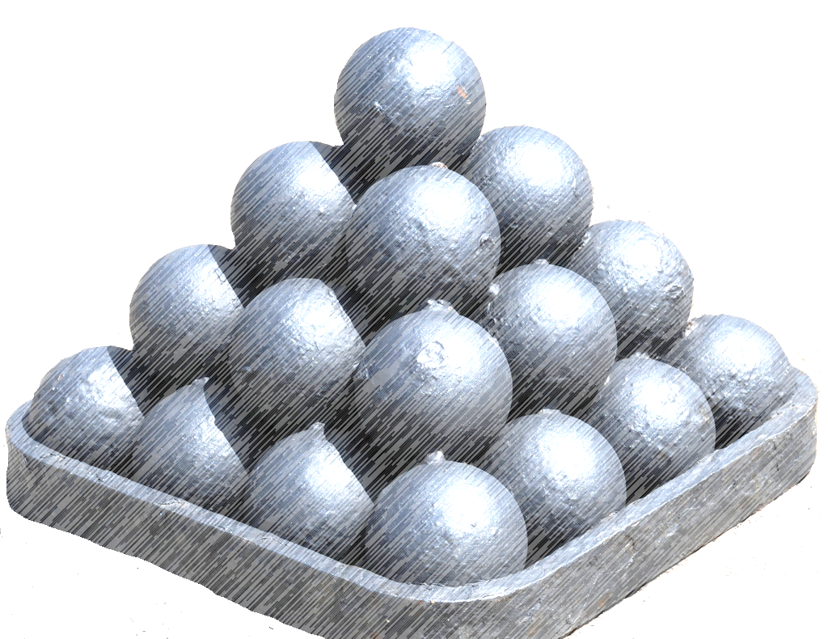
There are no silver cannonballs
There are no silver bullets
There is no “Secret Tool Box”
(The secret is in the mindset, not the toolset)

Slide 5

Differences between growth hacking and traditional marketing
Mature marketing for established business, happy with 5-10% growth
Startups, looking for 10,000%+ growth!
You need scalable solutions

Slide 6
Difference between growth hacking and marketing?
Marketing is more established, longer frequency.
Typically indies and startups don’t have access to brand equity or installed base.
Shoe string budgets.
More uncertainty with untested product.
Marketing has budgets, planned in advance.
“Budgets make people lazy. They begin to think in traditional terms and don’t innovate.”
-(Michael Birch, co-founder of Bebo)

Slide 7
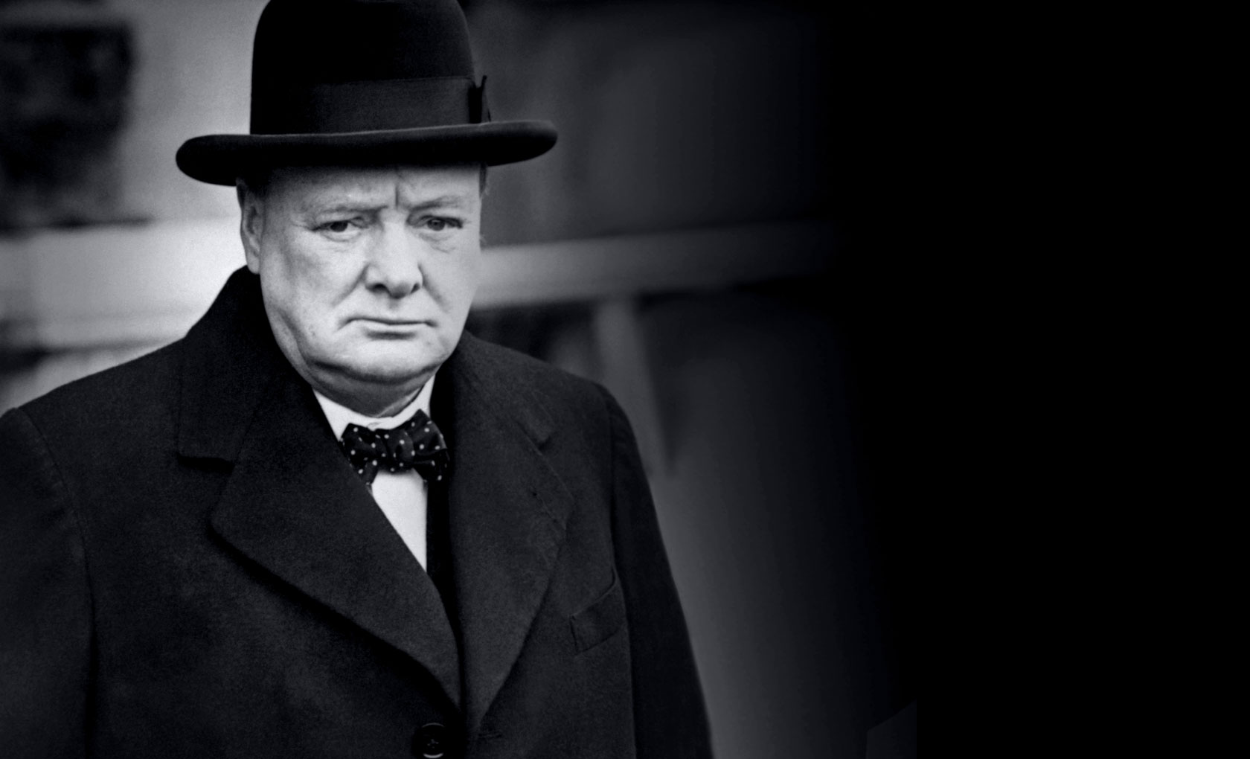
“Gentlemen, We Have Run Out Of Money; Now We Have to Think!”
- Sir Winston Churchill

Slide 8
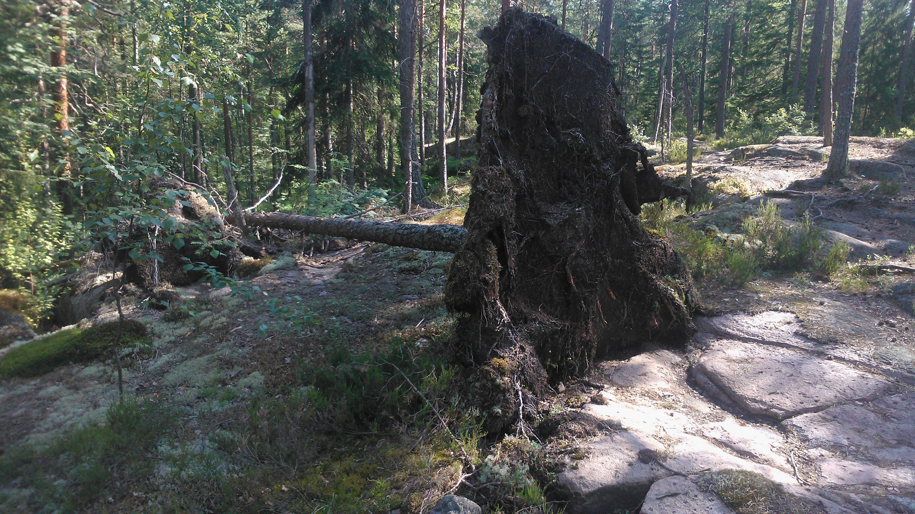
"If a tree falls in a forest and no one is around to hear it, does it make a sound?"
Image: hugovk (flickr)

Slide 9


If you build it, they will come (NOT!)
If you have the greatest game in the world, and nobody knows about it, it’s just the greatest game in the world that nobody knows about!
Content is King!
Distribution is God!

Slide 10

Visibility is oxygen
“We were kind of naïve. We thought if we made a really good product it would just sell, but that’s not the case”
Quiz Up
Image: jcolman (flickr)

Slide 11
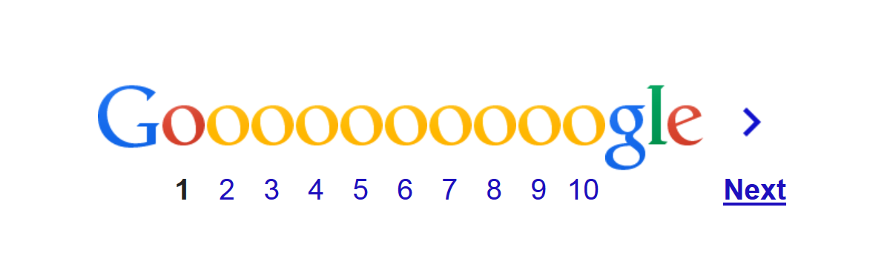

Search:
best social game
About 1,570,000,000 results (0.58 seconds)
How often do you click here?

Slide 12
86% of all apps downloaded from the AppStore are from the top 10 charts.

Slide 13
User acquisition costs are probably your single biggest expense?
$1.80 CPI*
*PlayFirst, Login 2013

Slide 14
History is written by the victors
You don’t hear about the failures, by definition.
Just because it worked for someone else, you can’t just replay.

Slide 15
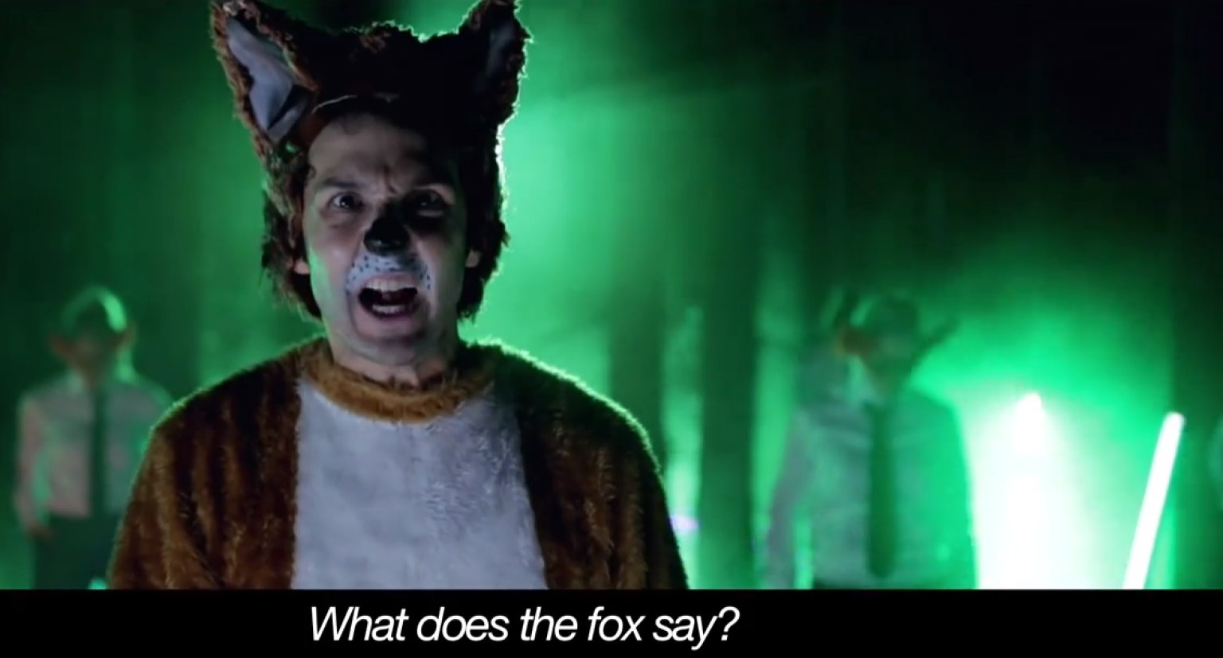
431,690,628 views
354,925,206 views

Slide 16
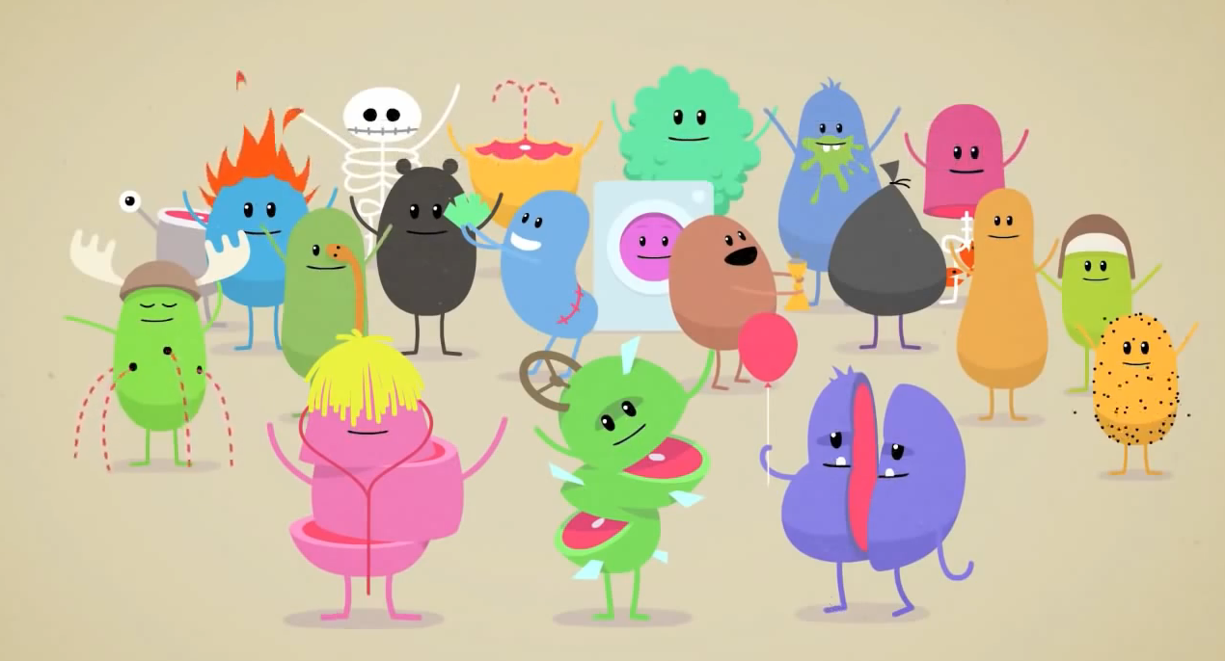

Dumb Ways to Die
84,809,085 views

Slide 17


Slide 18
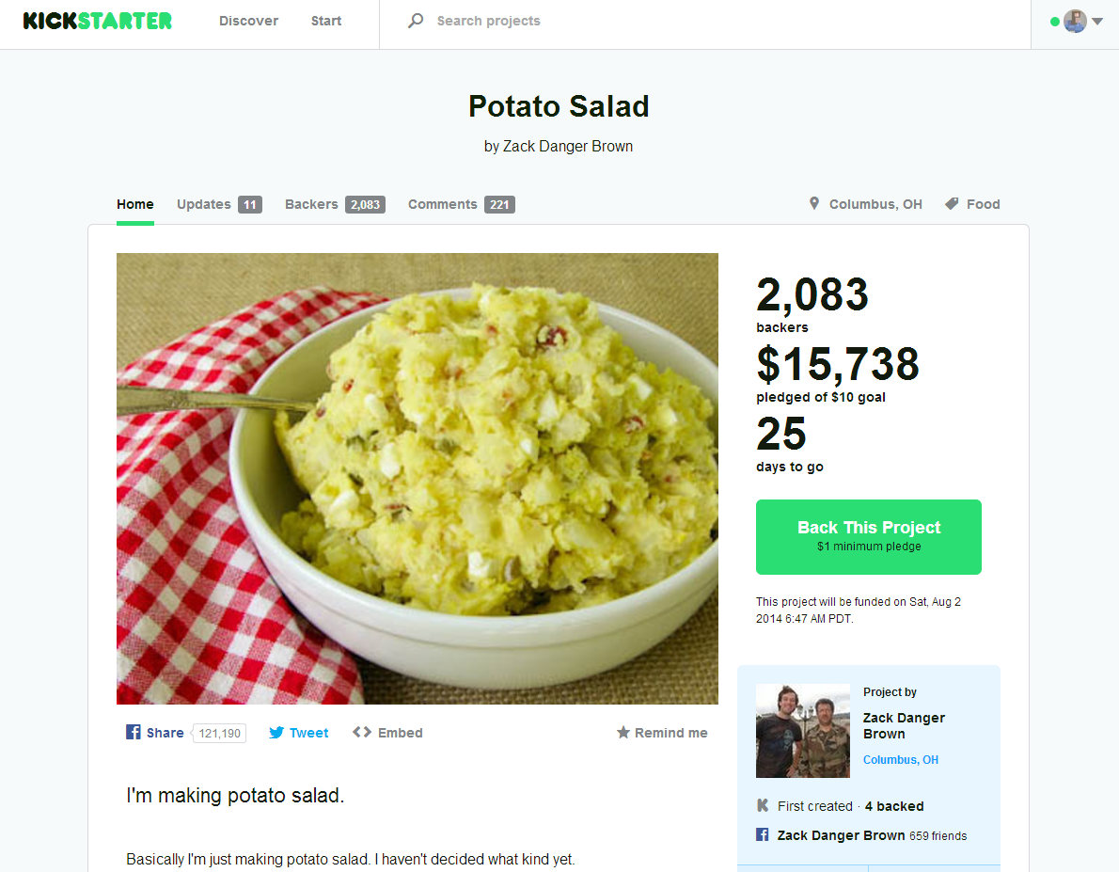
$62,147

Slide 19
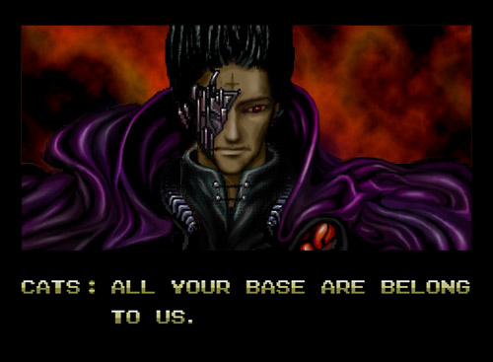
Make people want to share, not because they are told to share

Slide 20
At the end of the day. It’s the product.
You have a good restaurant because you serve great food, not because you tell people you have great food.
Players Hate Bad Games too!
Growth hacking without a good product is like being a dodgy used car salesman.

Slide 21
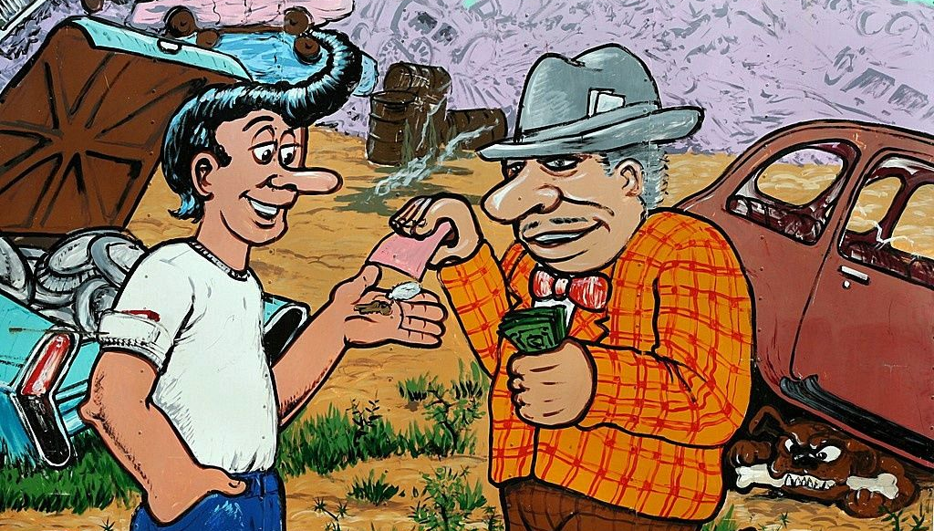
Serve great food, don’t be a used-car salesman. Build great product!
Image: TexasEagle (flickr)

Slide 22
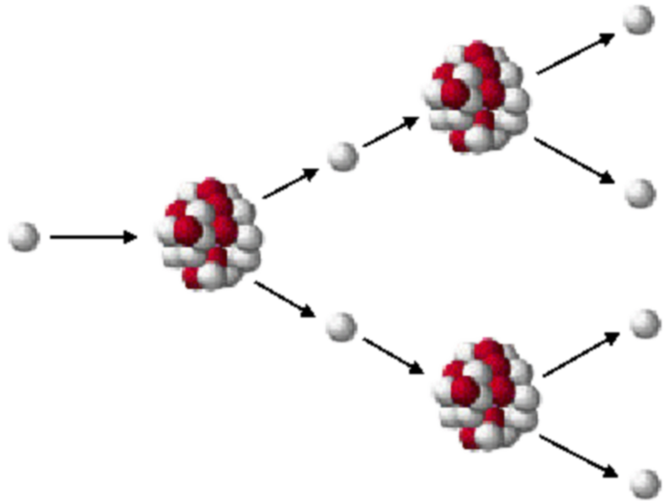
Virality [K-Factor]
Get your users to be your ambassadors
Scales easily
Leverages existing communications networks
(Uses other resources, not yours!)

Slide 23
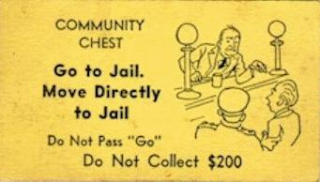
A/B Testing
If you are not doing A/B testing, go home.
Yes, it is that important!

Slide 24
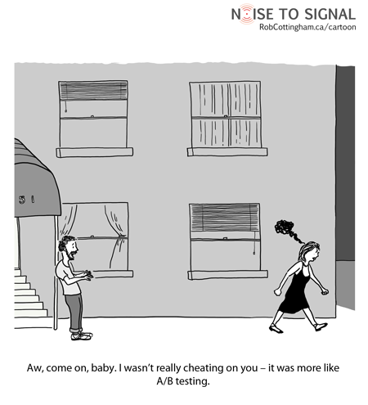

Slide 25
It’s the tastes of the fish, not the tastes of the fisherman
Don’t be a Prima donna
Data levels all arguments

Slide 26
Iteration is the name of the game
Try
Learn (from results and mistakes)
Iterate
“There is no such thing as a failed experiment, only experiments with unexpected outcomes.”
- Buckminster Fuller
You have to measure everything!
If you don’t, how do you know if you got better or worse?

Slide 27
If you don’t measure anything, how can you see if you’ve improved?
“He uses statistics as a drunken man uses lamp-posts ...
... for support rather than illumination!”
Andrew Lang

Slide 28
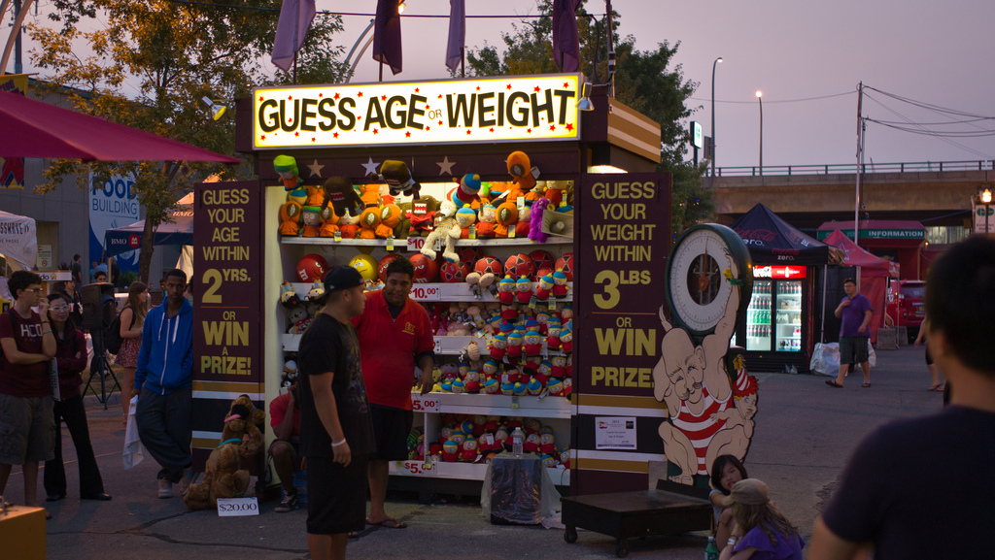
Image: Brendan Lynch (flickr)
Be DATA DRIVEN. Adapt (and fast!)
Testing always beats guessing!

Slide 29

Image: BBC
“I never guess. It is a capital mistake to theorize before one has data. Insensibly one begins to twist facts to suit theories, instead of theories to suit facts.”
Sherlock Holmes
(Sir Arthur Conon Doyle)

Slide 30
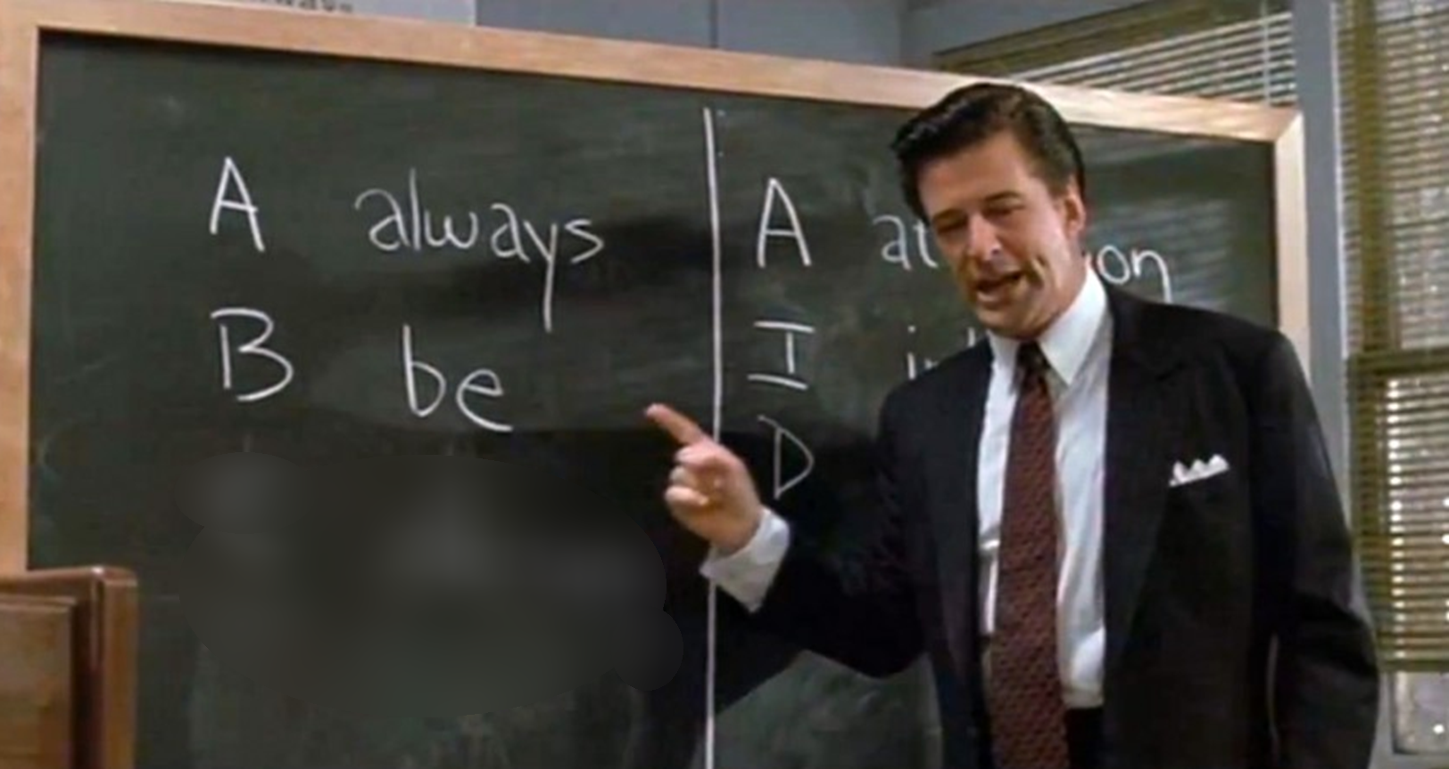
T testing
Image: Glengarry Glen Ross – New Line Cinema

Slide 31
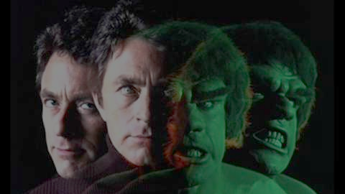
You won’t like me when I’m angry …
The Credible Hulk
… because I always back up my rage with facts, data and documented sources!
Image: MARVEL

Slide 32
“Errors using inadequate data are much less than those using no data at all.”
- Charles Babbage

Slide 33

ARM
How much water is in the bath?

Slide 34

Daily Active People
DAU is a measure of the water in the tub
Source
Sink

Slide 35

What problem are you trying to solve …?
Sink
Source
…Very different problems to solve.

Slide 36
Metrics
A
cquisition
“The price of light is less than the cost of darkness.”
- Arthur C. Nielsen
E
ngagement
R
etention
Make dashboards for these TODAY!
M
onetization

Slide 37

The First Date
Image: unchose (flickr)

Slide 38

Your job is to line-up the blind dates …
You are in the eyeball delivery business
Acquisition

Slide 39

Image: jesjon87 (flickr)
Can you get a second date?

Slide 40
Only 16% of apps get a third date!*
How quickly can you get your customers to that “aha” moment?
Engagement
*Compuware Survey, 2013

Slide 41
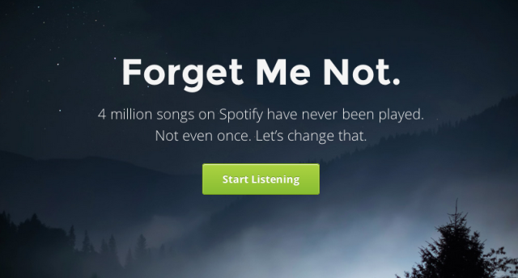
Forgetify …
Over 20%
… the long tail of content

Slide 42
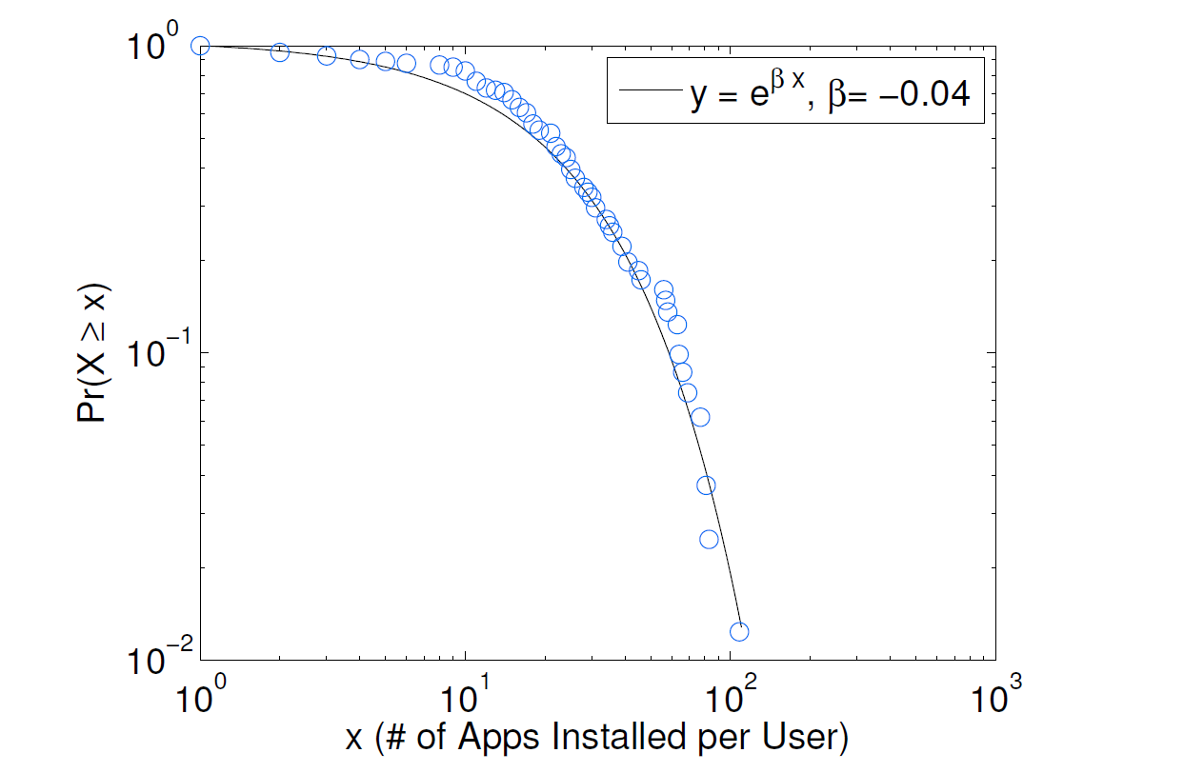
Composite Social Network for Predicting Mobile Apps Installation
Wei Pan and Nadav Aharony and Alex (Sandy) Pentland, MIT Media Lab 2011
Most people have small number of apps

Slide 43
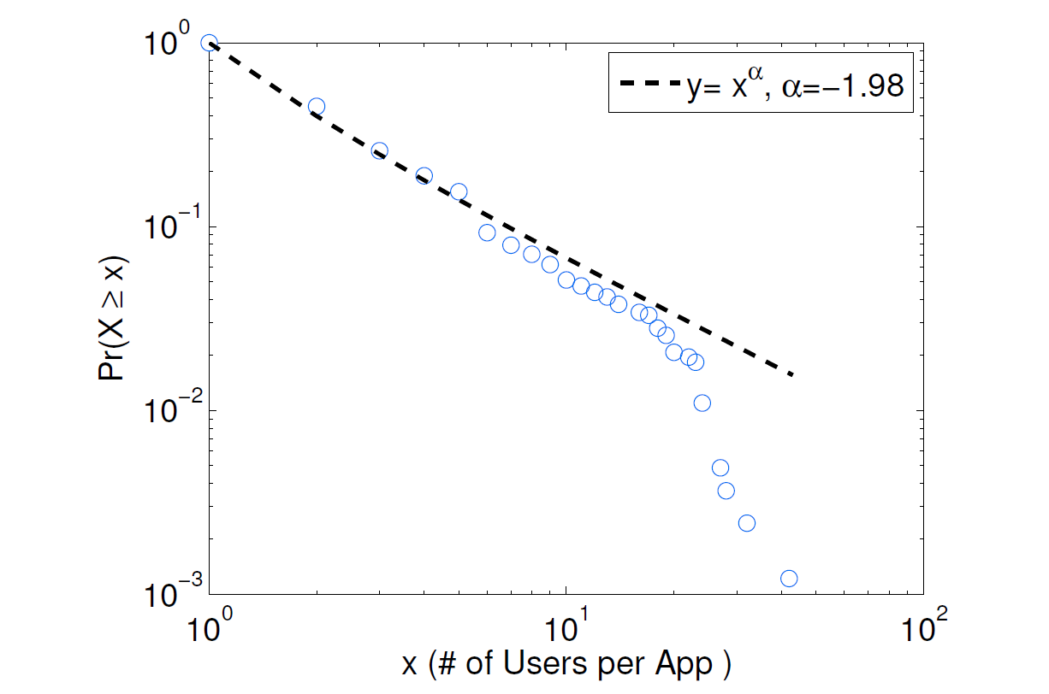
Few apps are popular!

Slide 44
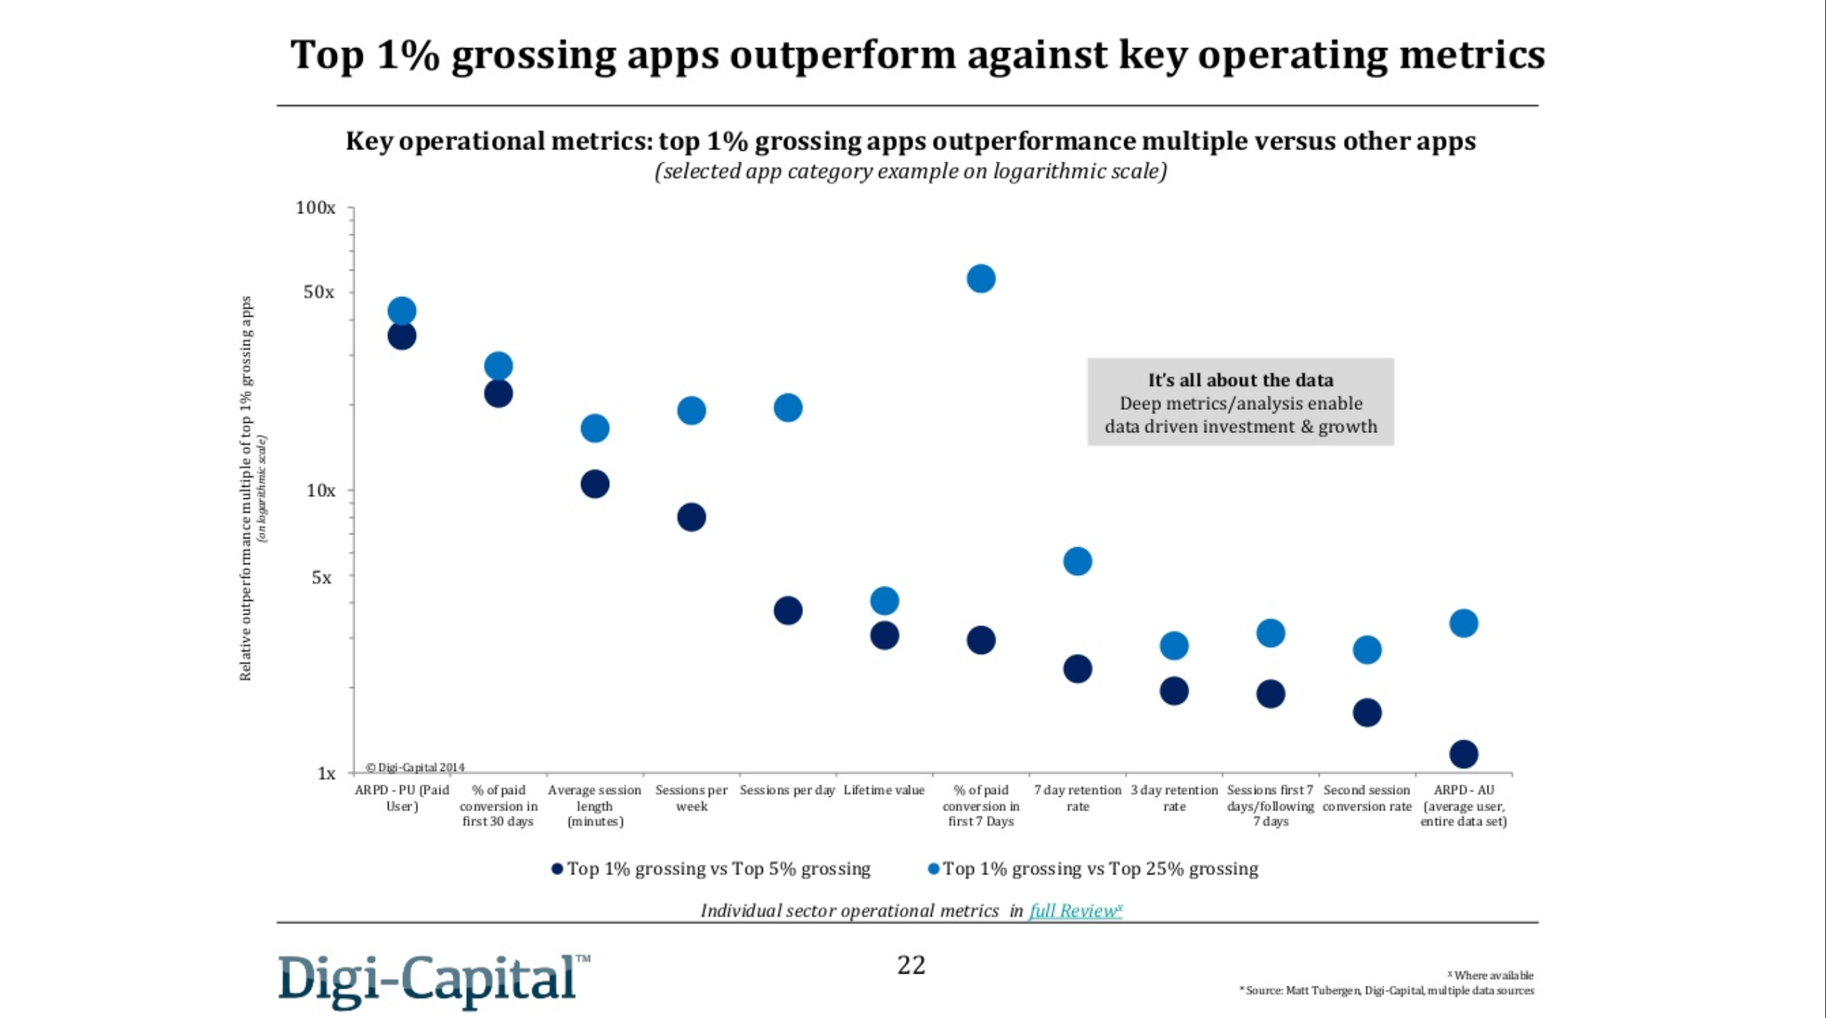

Slide 45
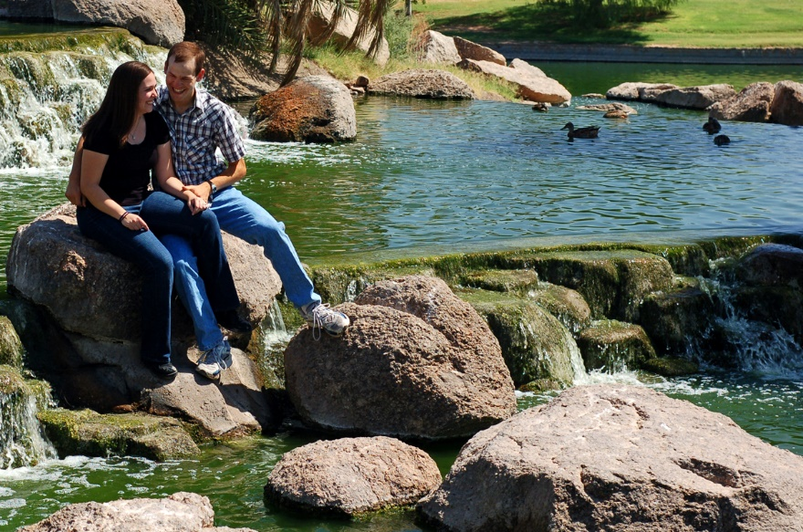
A relationship
Image: Garry Wilmore (flickr)

Slide 46

Fix the bucket first
Buckets with holes probably need fixing more than they need more water
Retention

Slide 47
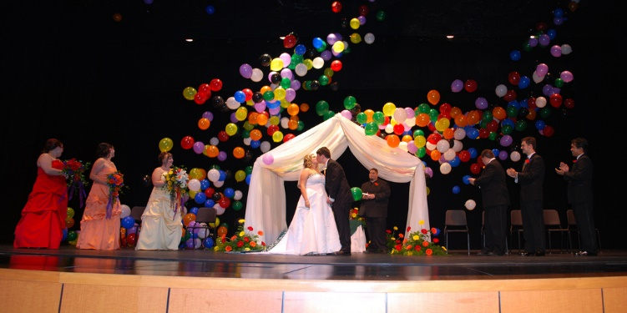
Wedding
Image: Alex Gorzen (flickr)

Slide 48
Life Time Value (Marathon, not sprint)
Take care, often the most valuable users can be your early adopters
(and they can be some of your strongest emissaries).
You don’t get a second chance to make a first impression.
(Hard to balance with software as a service).
Monetization
CPI < LTV

Slide 49
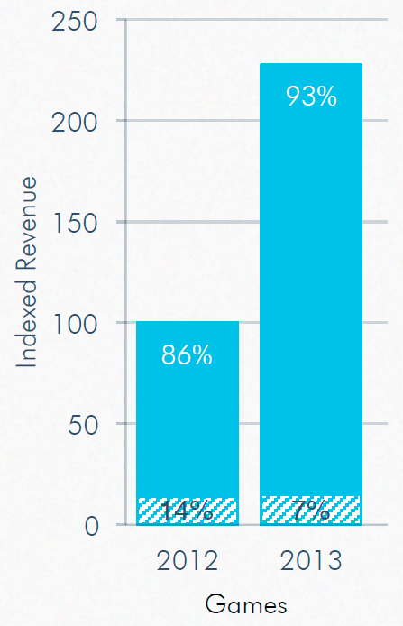
93% of games revenue is freemium on mobile
You need ongoing good relationships with your customers
Source: App Annie 2013 retrospective report

Slide 50
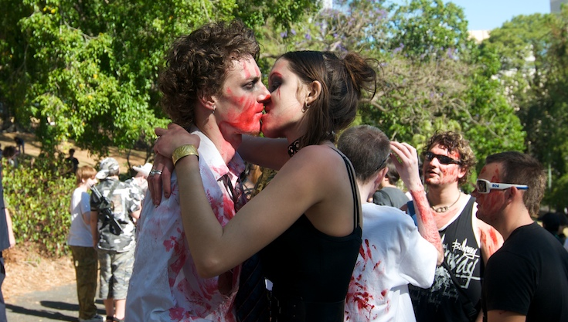
Resurrection
Image: yinyang (flickr)

Slide 51




Resurrection
Nordeus spent $3.5k on re-engagement campaign on facebook …
… gained over $121k in immediate return.
It’s cheaper to bring someone back from the dead than find someone new

Slide 52

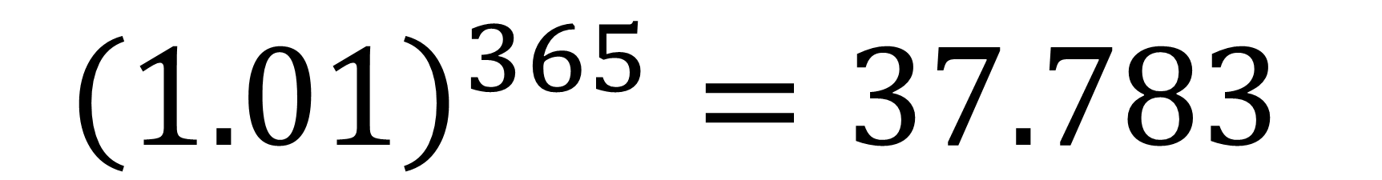
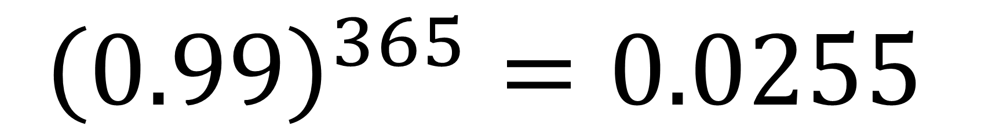
Keep at it – Everything compounds!
$${\left(1.01\right)}^{365}=37.783$$
$${\left(0.99\right)}^{365}=0.0255$$

Slide 53
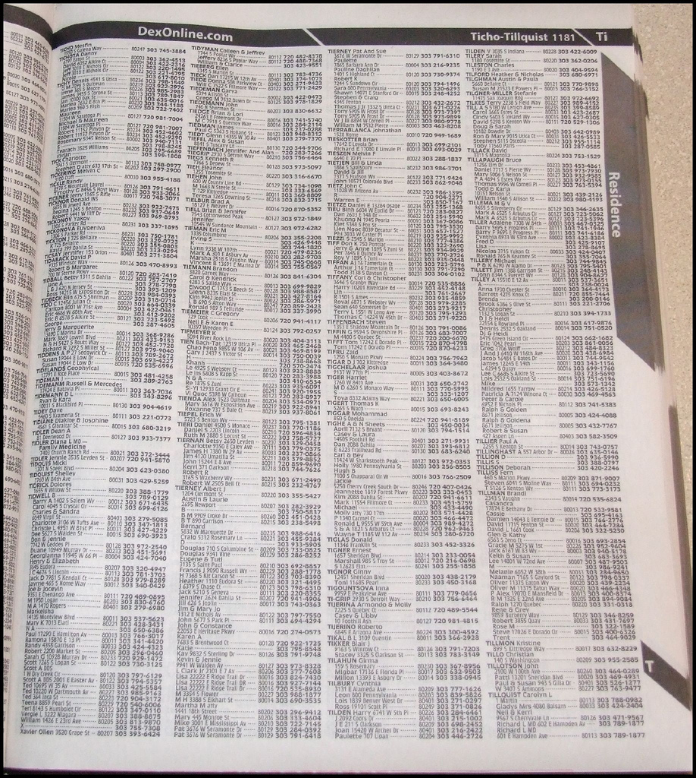

Growth Hacking is not new …
AAA Plumbing
Heathrow Hilton
Hilton at Heathrow
London Heathrow Hilton
LHR Hilton
(Lil) Green Patch?

Slide 54
Carpe diem quam minimum credula postero
Carpe diem
One should do all one can today to make one's future better.
Seize the day; seize every opportunity!

Slide 55


It’s a lot of science, but there is some luck.
When fortune shines on you, be ready to exploit.

Slide 56

The Fire hose of media content
Image: Official U.S. Navy Imagery

Slide 57
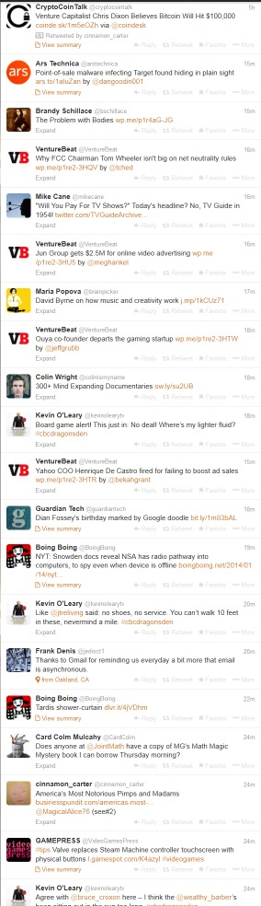
Content Fire Hose
You have seconds to get noticed.
Retweeted/Shared or commented upon
Need some friction

Slide 58
Creative Headlines
The secret to …
How to avoid the biggest mistake …
Are you one of the 15% of people who …
Little know ways to …
The top 10 things everyone should …
What gets you to click?

Slide 59
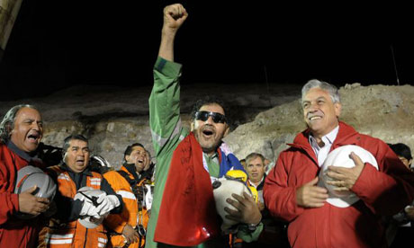

2010 Copiapó mining accident, Chile
Est. 1 billion viewers around the world watching the rescue live
Est. $41m of ‘free’ airtime
$41m
Photograph: Alex Ibanez/AP

Slide 60
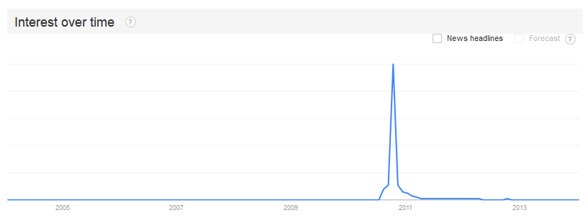
Chilean Miners
Seize every opportunity
Opportunity can happen at any time. Be ready!

Slide 61
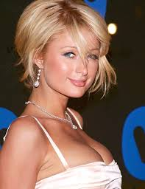

Paris Hilton banned from Hotel …
Paris Hilton is also banned from …
<Insert your message here>

Slide 62
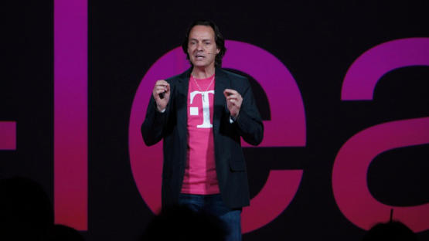
T-Mobile CEO crashes AT&T’s CES party and gets booted by security
Image: Devindra Hardawar/VentureBeat
T-Mobile CEO John Legere

Slide 63
So many possible ingredients
Blogging
Podcasts
Webinars
eBooks
White Papers
Guides
Infographics
Conferences
SEO
Keywords
Publishing partners
Affiliate marketing
Link sharing
Social Media
Contests
Email
Install base marketing
App store/Marketplaces
Paid Installs
Ads
Tweets
Backlinking
Incentives
Word of mouth
TV
Radio
facebook

Slide 64


Get noticed any way you can

Slide 65


Which icon would you use for a kids game?
Test - Don’t guess !!

Slide 66
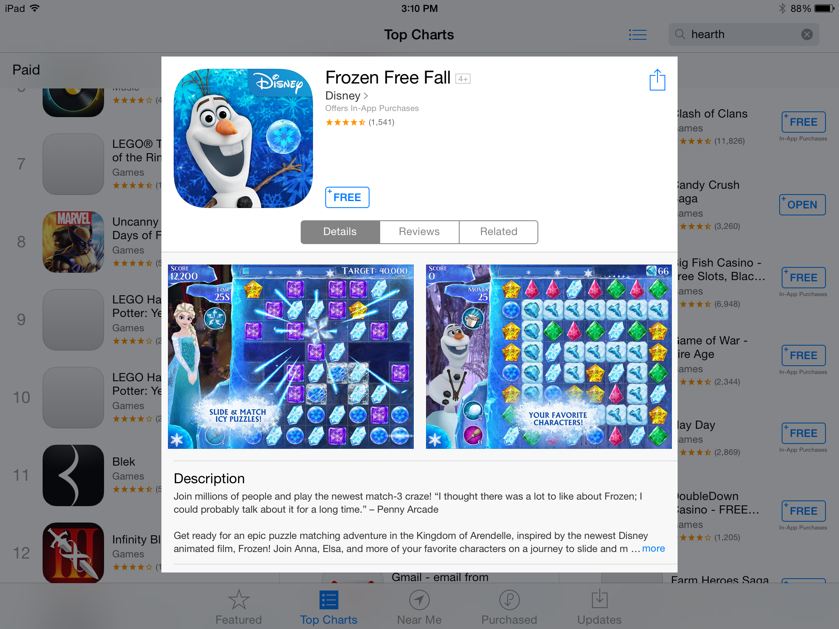
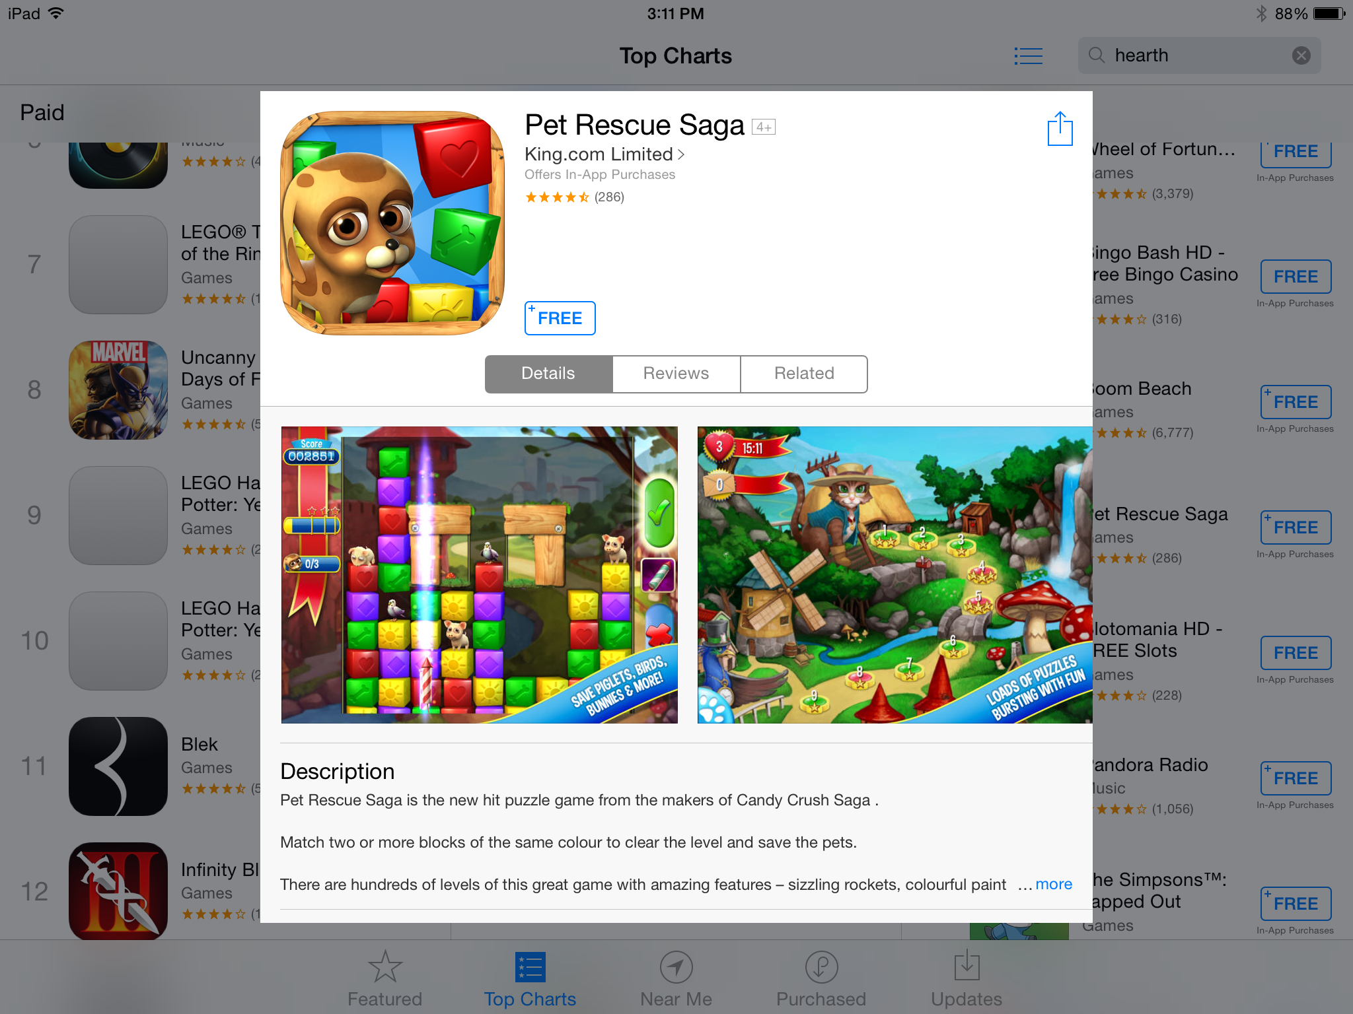
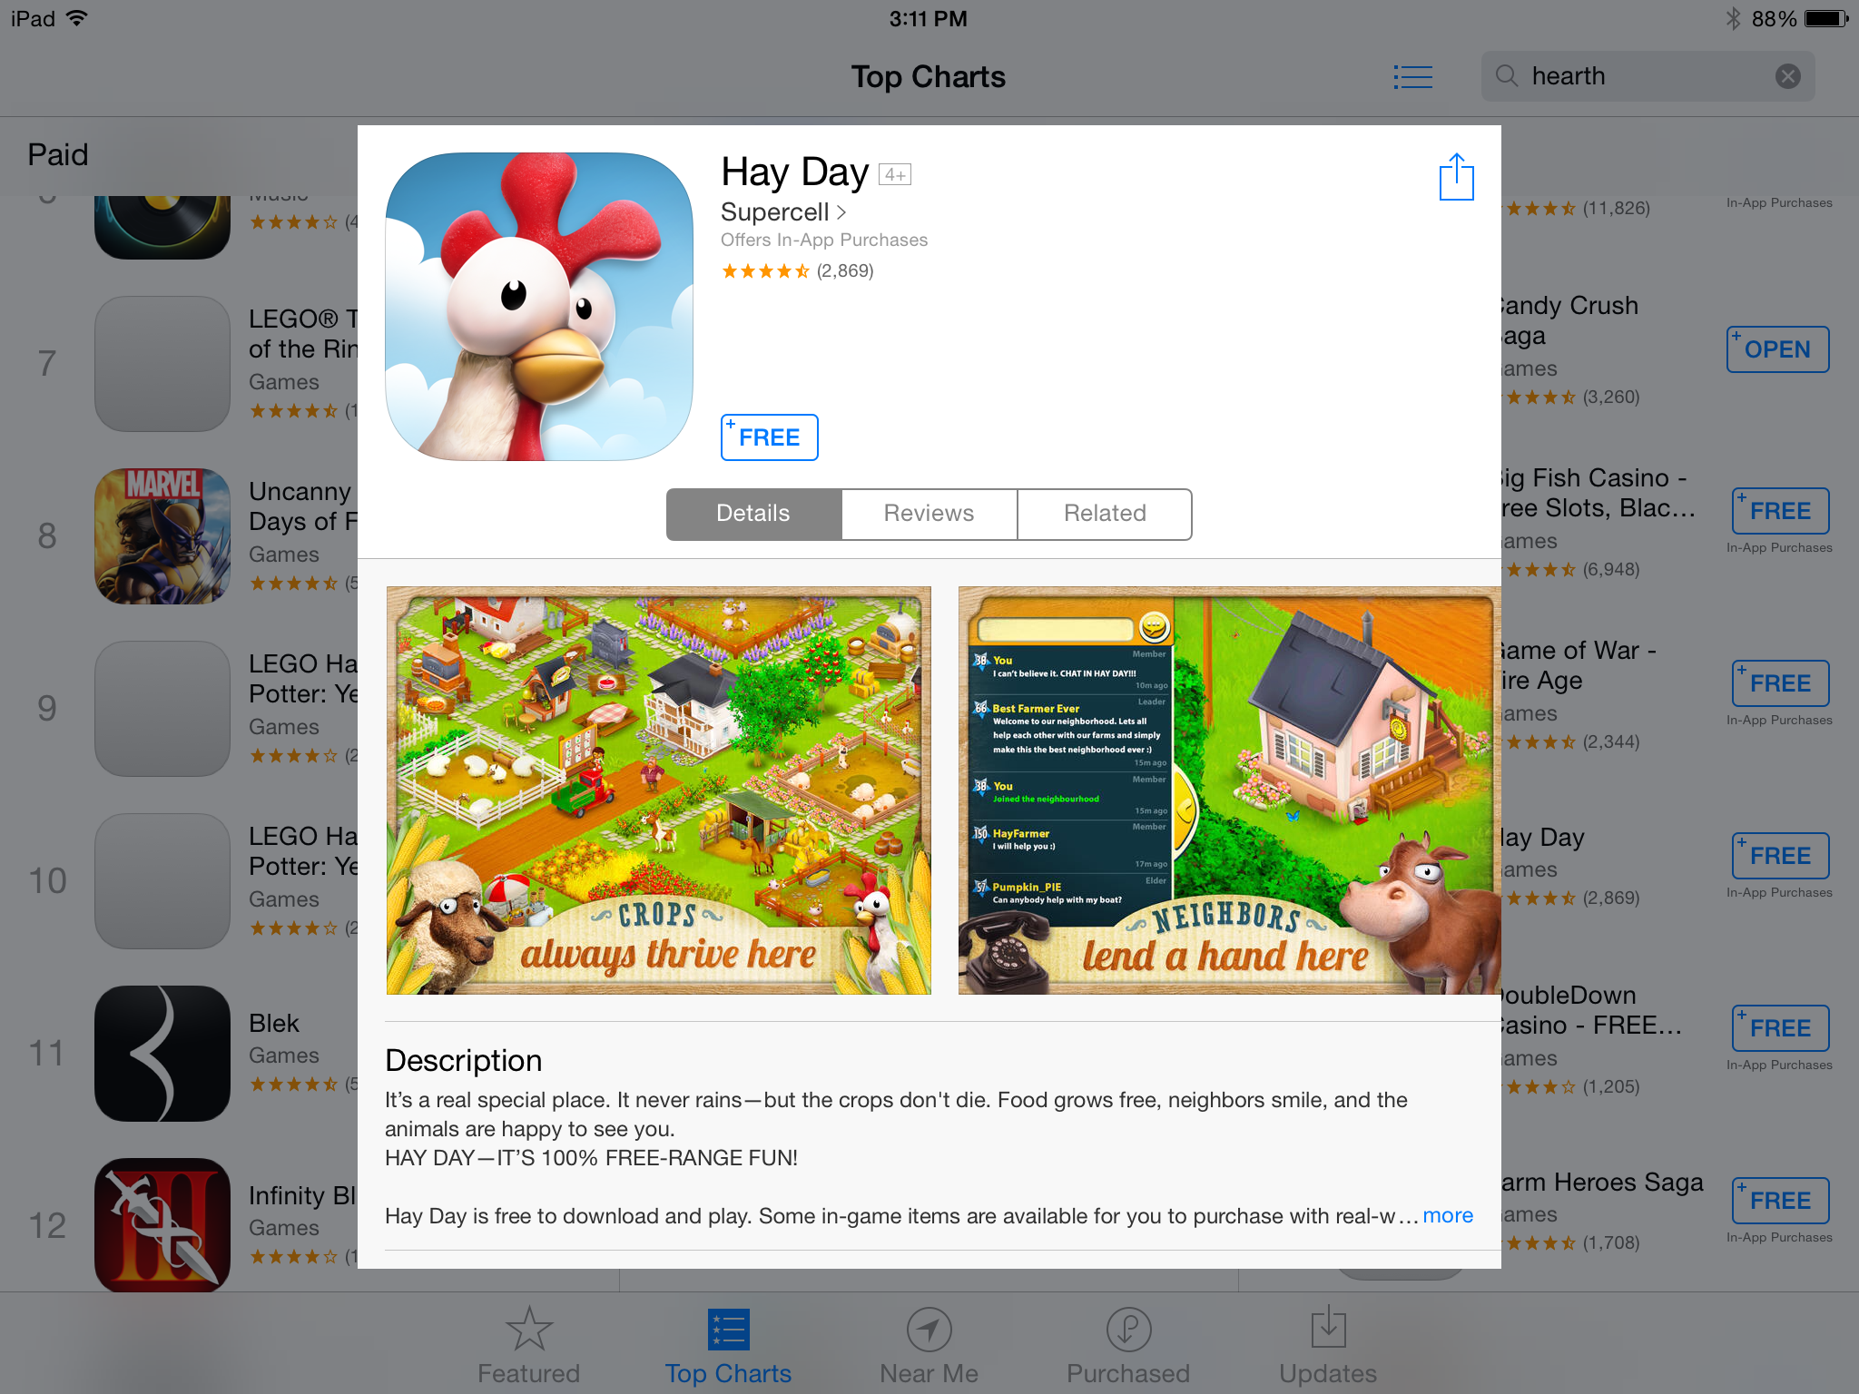

Slide 67

50 Shades of Blue
“Switching the shade of blue used on advertising links in Gmail and Google search earned the company an extra $200m a year in revenue!”
Dan Cobley – Google UK Managing Director

Slide 68

Fuzzy Trace Theorem
Short Term:
Specific Details
Long Term:
Gist
What will you remember
about this presentation?

Slide 69
If facebook integration is not part of your strategy, you are crazy!

Slide 70

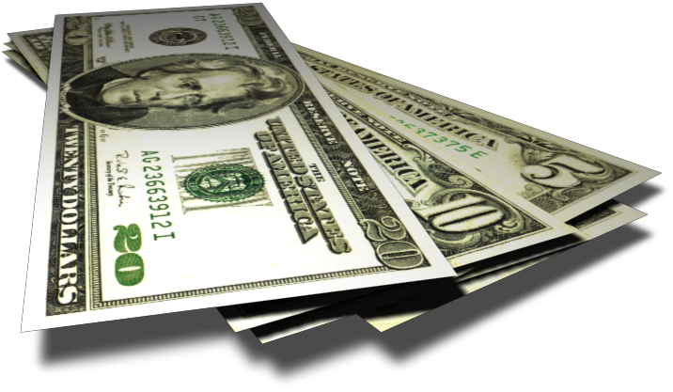
Don’t leave green on the screen!
Facebook connected players convert better into paying users! (cf. Non-facebook)
Facebook connected players spend more!
“… are nine times more likely to spend money than players who don’t connect with Facebook”
“Players who log in with Facebook are three times more likely to return to its games and seven times more likely to spend money in them.”
Wooga
Storm8
“Facebook users spend 85 percent more!”
Dragonplay

Slide 71
We’re now on the second generation of Social Games
Generation #1
Build it, and throw it live immediately.
Fix and modify it live. Those days are over!
Generation #2 Get it mechanics reasonably polished before general release.
“You don’t get a second chance to make a first impression”
Today’s early adopters of new games:
- Virally introduce more people to your game
- Typically spend more over lifetime
Don’t be a bad date!

Slide 72
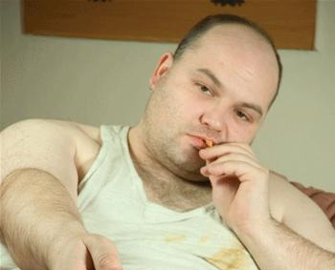
“I can change”
Don’t be a bad first date!

Slide 73
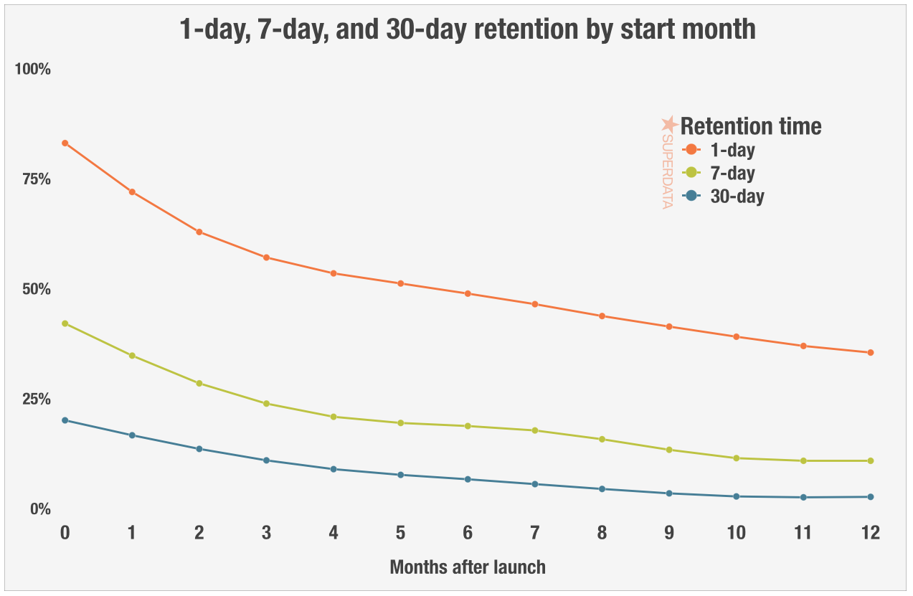
Source: http://www.superdataresearch.com/blog/understanding-mmo-retention

Slide 74
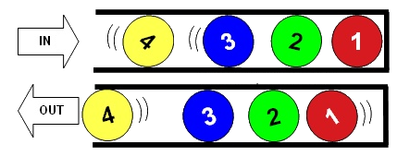
First In, Last Out
On average, 6.21% of players who logged in for the first time in the 1st month a game is released will log on one year after their first login.
By comparison, only one tenth of players (0.63%) who logged in for the first time in the 12th month after a game is released will log one year after their first login.
Source: http://www.superdataresearch.com/blog/understanding-mmo-retention

Slide 75
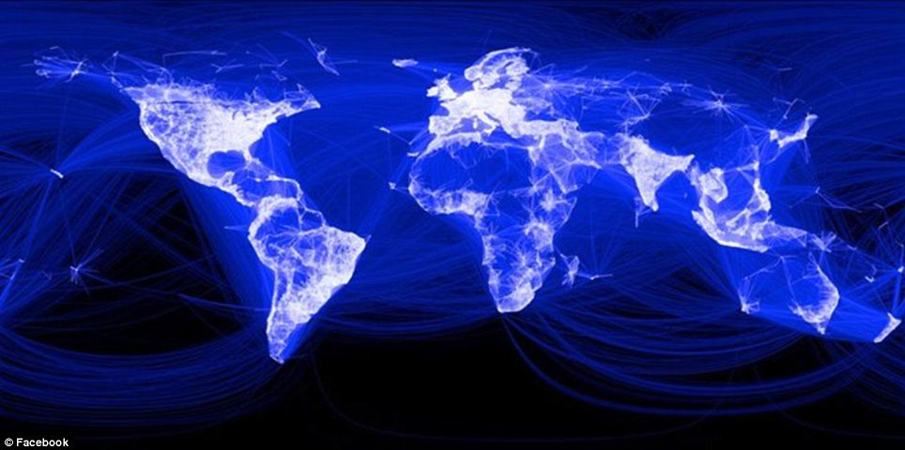
Facebook Worldwide Monthly Active Users
MM
Q1 2015
1.44B

Slide 76
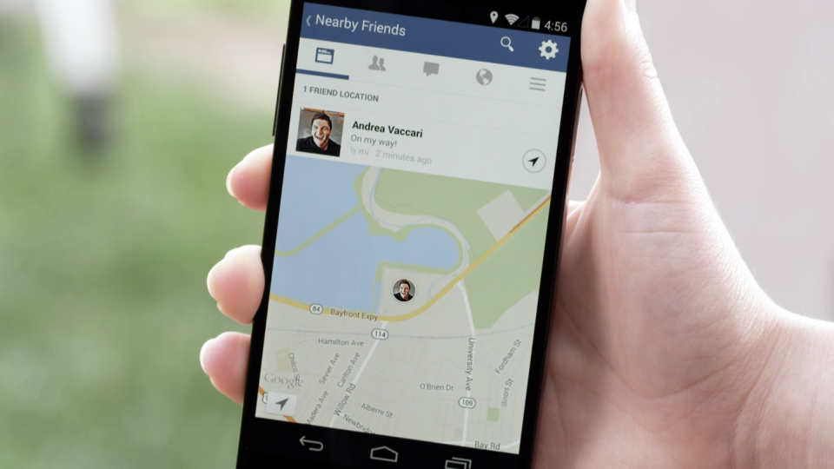

Over 1.248 billion
monthly active people
(Q1 2015)

Slide 77

People take out their phone, on average, 250/day.
(Up from 221 times/day last year)
The World is moving mobile
*
Avg mobile games approx 8 minute session time for a total of 30-50 minutes a day.
Re-think for "Touch-first" (Different from "Hover for hints" with mouse pointer)
*Techmark Study, UK

Slide 78
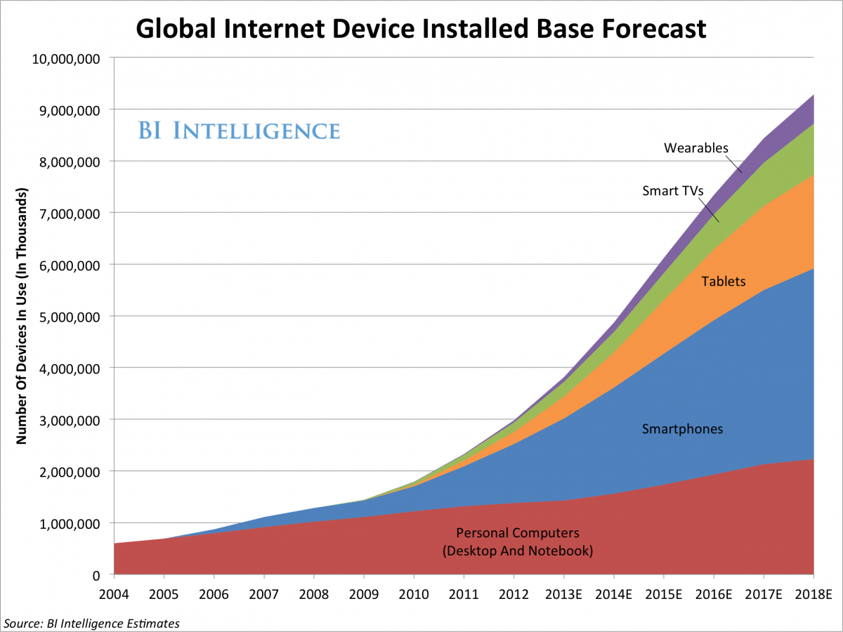


Slide 79
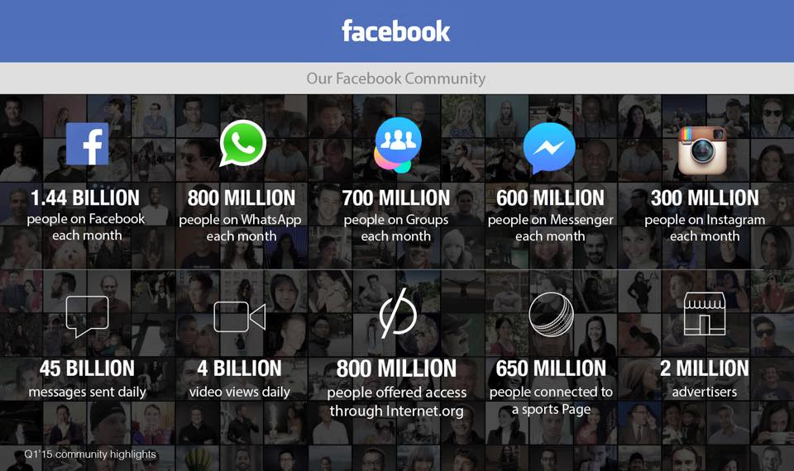

Slide 80
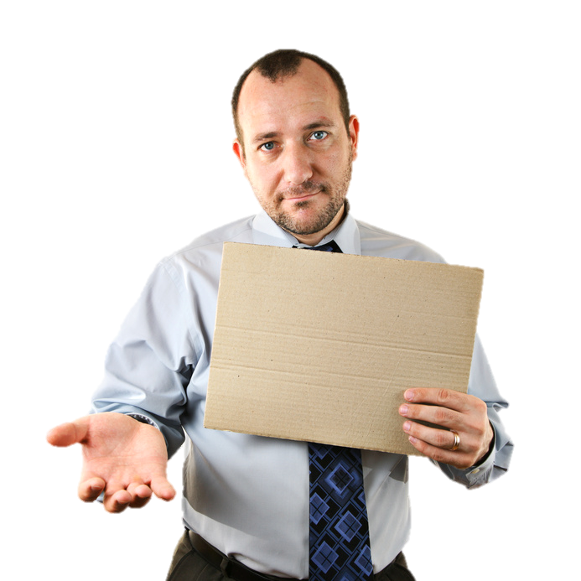
How do I find a good growth hacker?
Loves data, and understands it.
Curious, even a little naughty/edgy. Experimental.
    What can I get away with?
    What would happen if?
    What if we changed?
Leverages opportunities.
Moves fast.
Creates scalable solutions
Seizes all chances for visibility.
Develop a GROWTH culture. Bake it in.
Data Scientist
“The Sexiest Job of the 21st Century”
– Harvard Business Review

Slide 81


“Your job title states you’re a hacker — if you’re not breaking down walls and challenging the way of doing thing, you’re doing it wrong.” Dan-ya, Growth Hacker
It’s not about unicorns

Slide 83
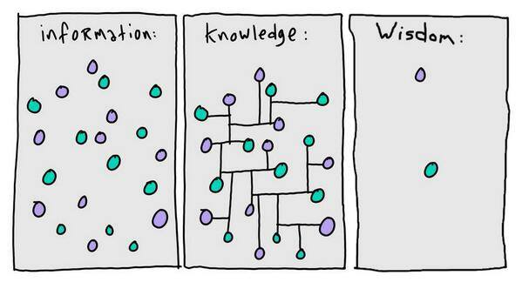

Slide 84
Appendix – Why people share?
Aaron Isaksen, NYU Game Innovation Lab
Social Currency
Triggers
Emotions
Public
Practical Value
Stories

Slide 85

1. Social Currency
“Check out this funny video”
We share what makes us look cool!
“This game is awesome, you should check it out”
“Look what I found”
“Look at my highscore!”

Slide 86
2. Triggers
Ohh, that reminds me of something I saw …
Pick a game based on a current meme
Think of something that is easily triggered
Do everything you can to give people chances to remember to share your app

Slide 87

3. Emotion
Awe, excitement, laughter, anger (but not sadness).
“Look at these cats”
“I can’t wait to see this movie, check out this trailer”

Slide 88
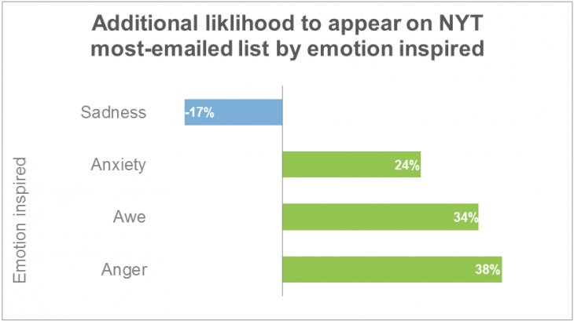

Slide 89
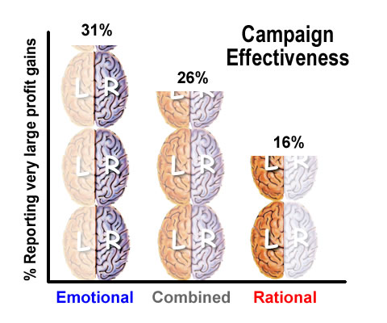
Source: IPA databank
(Study of successful advertising campaigns)

Slide 90
4. Public
It might sound obvious, but people share things when it is easy to share!
Also things like leaderboards and video sharing, like Everyplay
Don’t make it hard!

Slide 91
5. Practical Value
You share things that you think others might get value from.
“I think you’ll find this useful”
“This will be perfect to help you with …”

Slide 92

6. Stories
People share stories, not facts.
“I called their support line to complain, and they ended up being so helpful …”
“Dude! This game rocks so much, that I ended up playing it half the night, then I overslept and missed …”

Slide 93
Search
Goods
Experience
Goods

Slide 94
Search Goods
Commodity Products.
You know what you’re going to get without trying it.
Easy to sell/buy
This is fulfillment, not sales.

Slide 95
Experience Goods
You don’t know what it is until you try it!
You need to research it before buying
This is what demos do
Adverts, trailers, previews, videos, animations.
This is why F2P games is now the dominant play genre.
The game is it’s best advert.
Your goal should be to move your product from an experience product to a search product. EDUCATION

Slide 96
Anchoring
Sow quality seeds early
Later reviews/comments are biased by first reviews.

Slide 98




Slide 99
