Slide 1
How to Harvest the Gold in your Game Sales Database
Nick Berry, M.Eng, ARAeS, CIPP
President, DataGenetics
All logos and trademarks in this presentation are property of their respective owners.

Slide 2

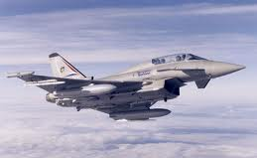


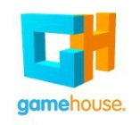
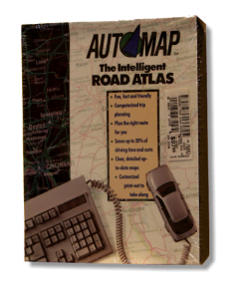
Biography
1988
1994
2008
2010

Slide 3
Agenda
What is Social Gaming?
Why is it so popular?
How to find out more about download customers
Examples

Slide 4
What is a Social Game?
“But they’re not social!”
“A game played on a Social Network”
(After all, “Casual Games” are not casual either!)
P
P
Not Work!
So what is a game?
“Any non-obligatory activity that is performed for fun!”

Slide 5
A Social Game is …
… any non-obligatory activity that is performed, for fun, on a Social Network.

Slide 6
Why are Social Games so Popular?
Players broadcast their indulgences, performances and achievements (both actively and passively).
In no more than a couple of clicks, exposed users can be having fun, and jumping on the latest bandwagon of distraction.
Facebook has exposed people to copious quantities of non-essential activities and provided easy channels to announce participation in these entertainments to others.
Discoverability
Accessibility
Whilst social could be considered a poor
adjective to describe games when many games are solo activities, these activities do earn it the moniker social because they offer a shared experience. Albeit asynchronously, all the people who have enjoyed the same activity have been down the same path.
Camaraderie
Curiosity, Invitation, Peer Pressure, Challenge.

Slide 7
What do you know about your existing customers?

Slide 8
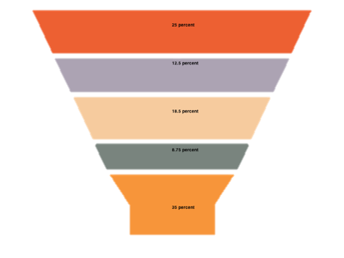



Social Game Developers have it “easy”
Age=18
Age=49
Age=23
Age=38
Age=27
Age=17
Age=58
Age=16

Slide 9

What do you know about your Deluxe Download customers?

Slide 10
Sales Database
Sales Date
Sales Value
Credit card Name
Credit card Number
2/3/2001
$6.95
Nicholas Berry
3713 xxxx xxxx 9980
2/3/2001
$6.95
Nicholas Berry
3713 xxxx xxxx 9980
2/3/2001
$6.95
Nicholas Berry
3713 xxxx xxxx 9980
2/3/2001
$6.95
Nicholas Berry
3713 xxxx xxxx 9980

Slide 11
What’s in a name? (Gender)
Taylor
Jessica
Nicholas
What about androgynous names?

Slide 12
US Social Security Administration
NAME |  | Year | Frequency
Mary | F | 1967 | 25,320
Susan | F | 1967 | 22,259
Karen | F | 1967 | 21,544
Angela | F | 1967 | 19,537
Melissa | F | 1967 | 18,370
Patricia | F | 1967 | 17,745
Amy | F | 1967 | 16,130
Elizabeth | F | 1967 | 16,110
Christine | F | 1967 | 15,992
Laura | F | 1967 | 15,820
Julie | F | 1967 | 15,541
Cynthia | F | 1967 | 15,336
Donna | F | 1967 | 14,789
Tina | F | 1967 | 14,154
Deborah | F | 1967 | 14,004
Database of all registered names in USA since 1880
complete with gender.

Slide 13
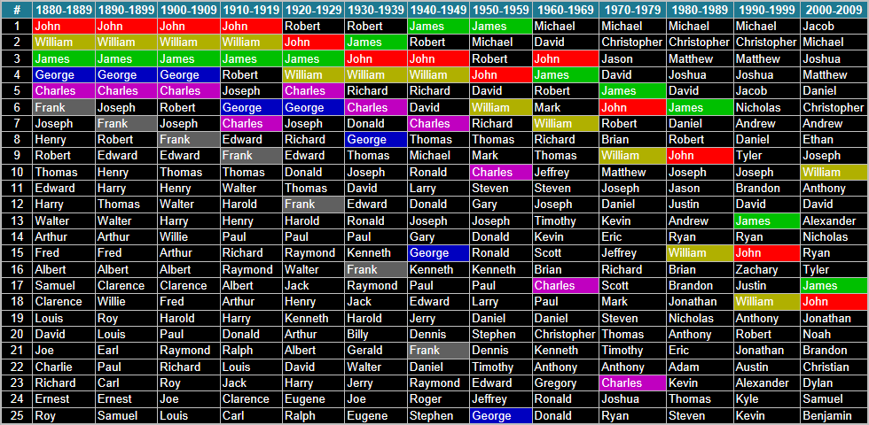
History of Male Names

Slide 14
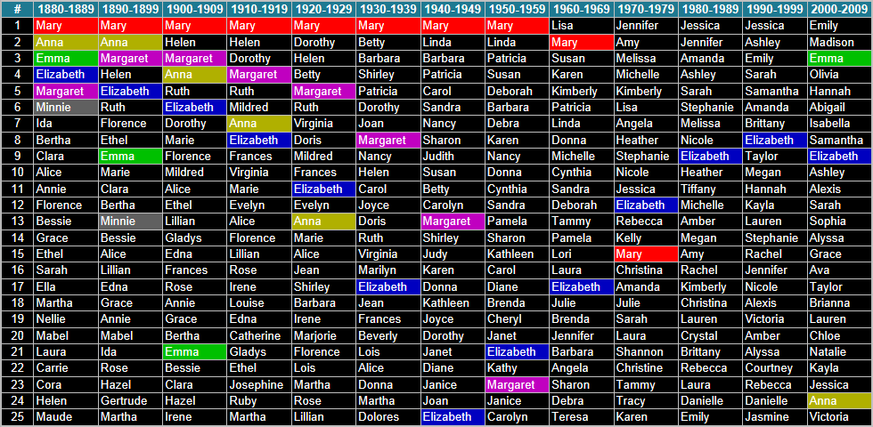
History of Female Names:

Slide 15

Scrabble™ Score
Score | Letters
1 | A , E , I , O , U , L , N , R , S , T
2 | D , G
3 | B , C , M , P
4 | F , H , V , W , Y
5 | K
8 | J , X
10 | Q , Z
Creative spelling:
Z replacing S
Y replacing I
Izzabellah (33 points) instead of Issabella (11 points)
Kristyn (14 points) instead of Kristin (11 points)

Slide 16
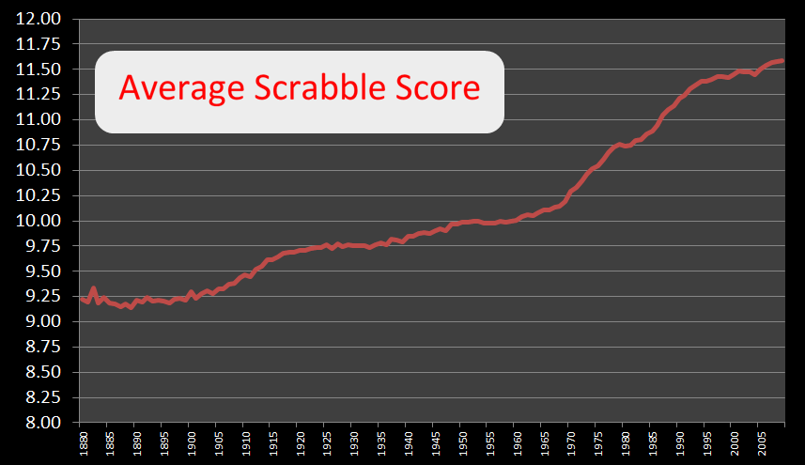
Trivia – Highest scoring name in the 86,987 distinct names in the SSA database is:
Jazzmyne (scoring 38 points)

Slide 17
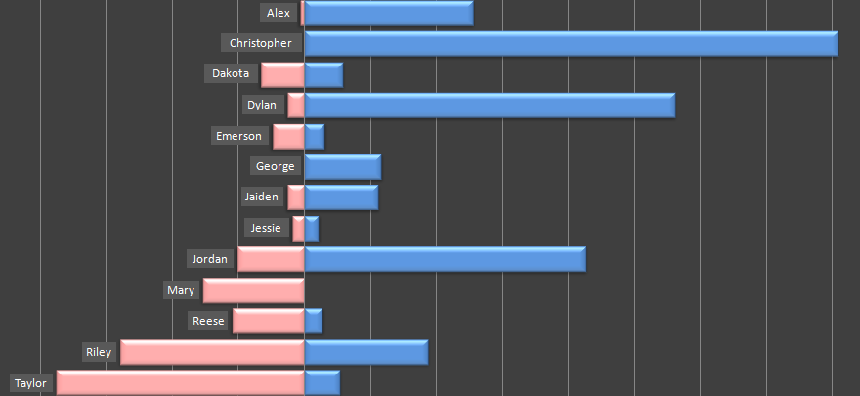
Returning to Androgynous names
2009 Data

Slide 18
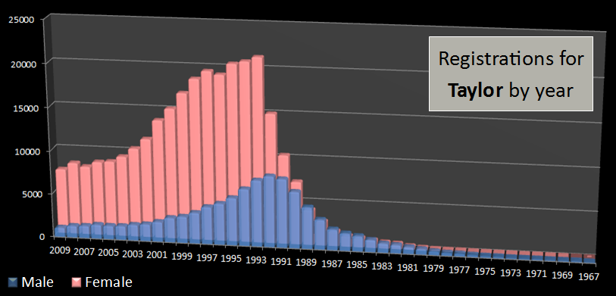
Taylor over the years

Slide 19
Nobody lives forever
Males named Taylor who are still alive
Male %
Number of male Taylors born in 2012 (still alive) +
Number of male Taylors born in 2011 (still alive) +
Number of male … +
Number of male Taylors born in 1940 (still alive) +
…
Female %
Number of female Taylors born in 2012 (still alive) +
Number of female Taylors born in 2011 (still alive) +
Number of female … +
Number of female Taylors born in 1940 (still alive) +
…
Females named Taylor who are still alive

Slide 20
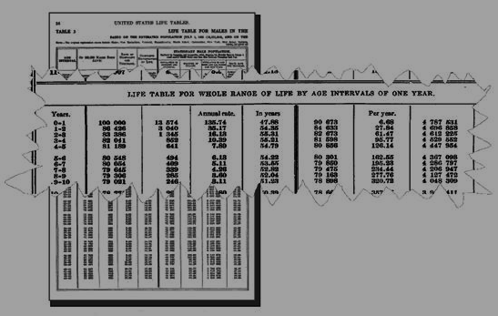
Life (Death) tables
1901 Life Tables
CDC/NCHS – Center for Disease Control and Prevention/National Center for Health Statistics

Slide 21
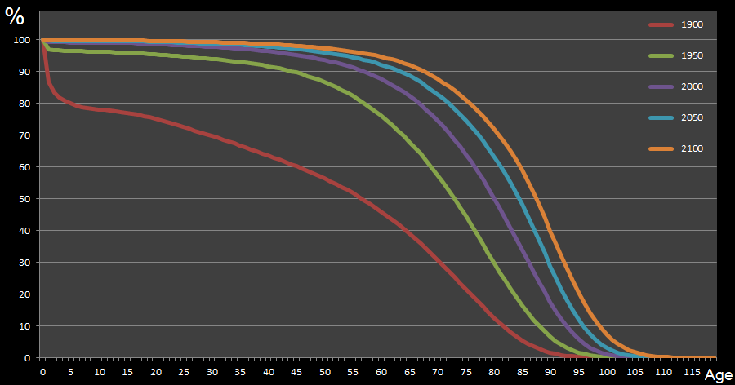
Life (Death) Percentage chance of reaching a specified age.
65
92.1%
88.7%
82.4%
67.9%
39.1%

Slide 22
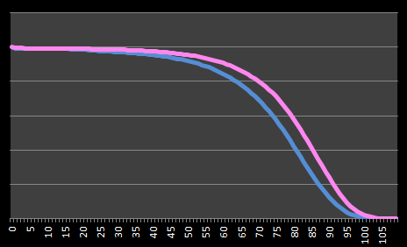
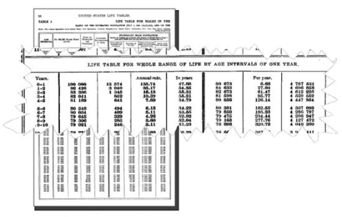
Gender Differences
100%
Percentage Chance of Reaching Specified Age
0%

Slide 23
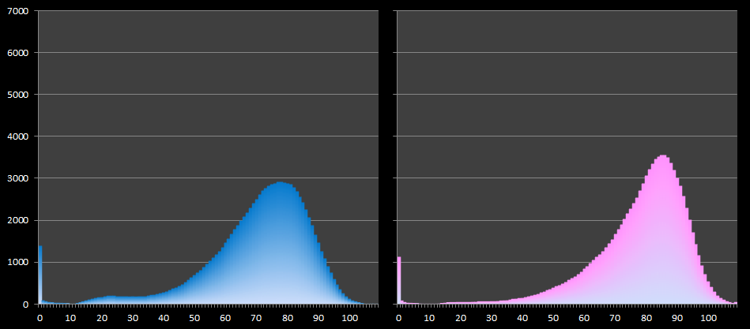
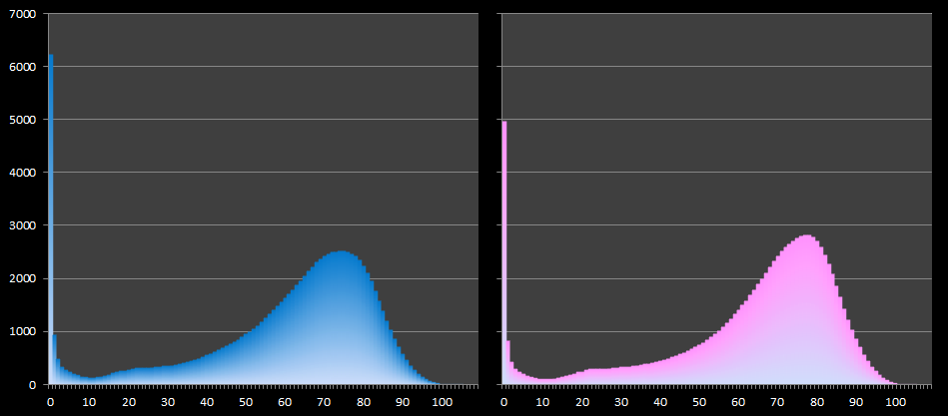
Gender Differences – Age at Death
Male
Female
1930
1980
Age at Death (per 100,000)

Slide 24
Multiply

Slide 25
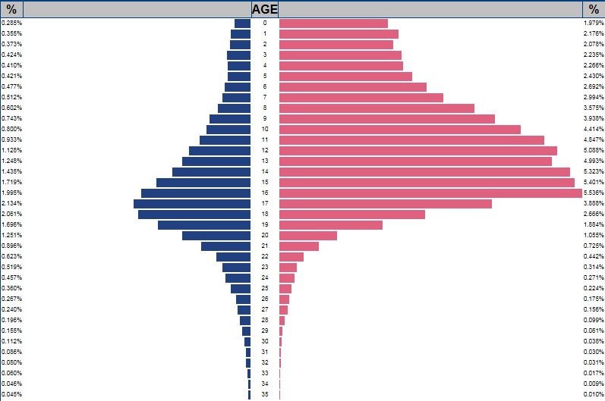
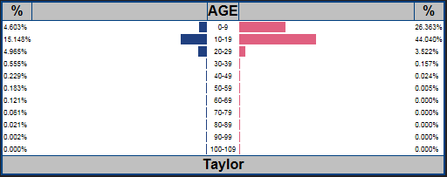
Taylor
Probability density function

Slide 26
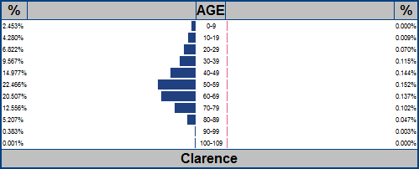
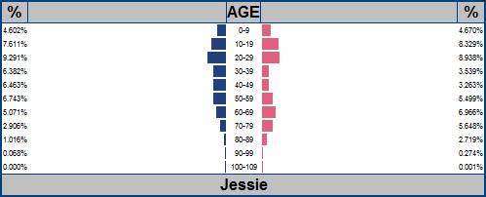
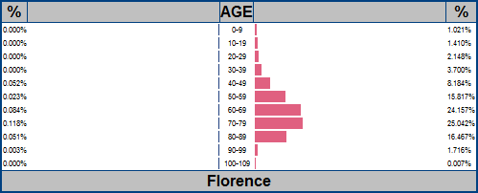
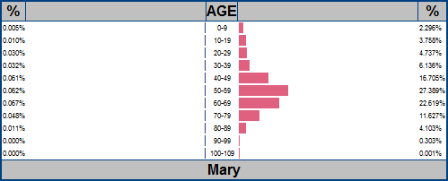
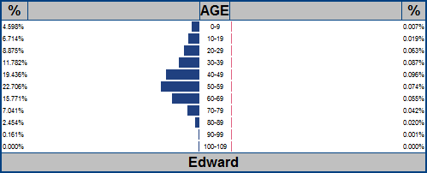
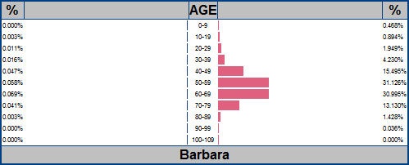
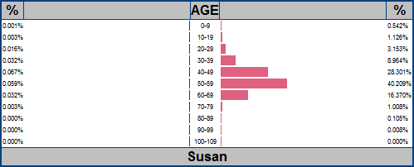
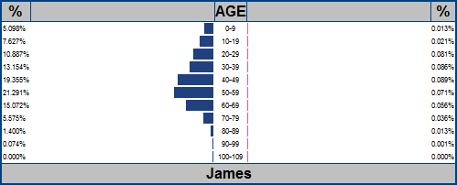
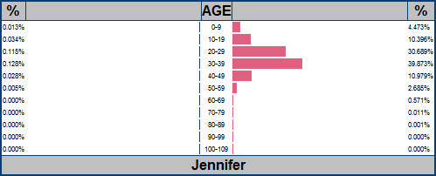
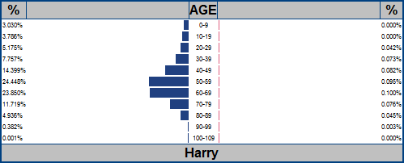
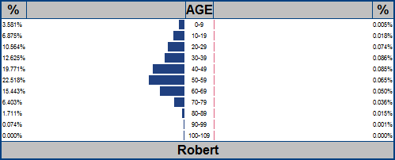
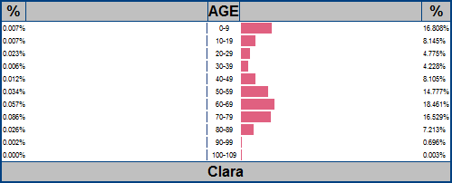
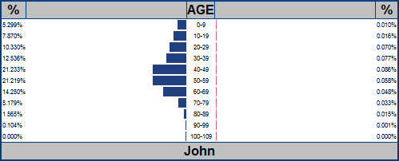
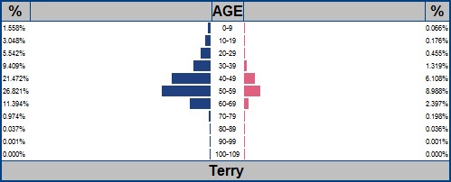
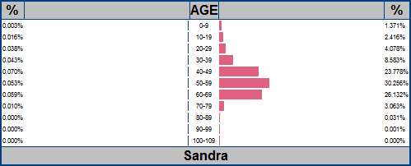
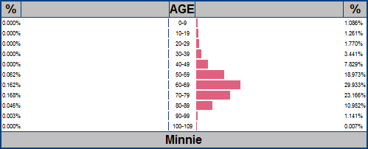
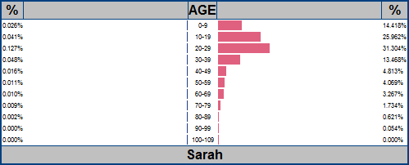
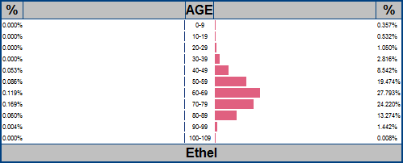
Who names their child “Ethel” these days?
Probability Density Functions

Slide 27

Facebook demographics

Slide 28
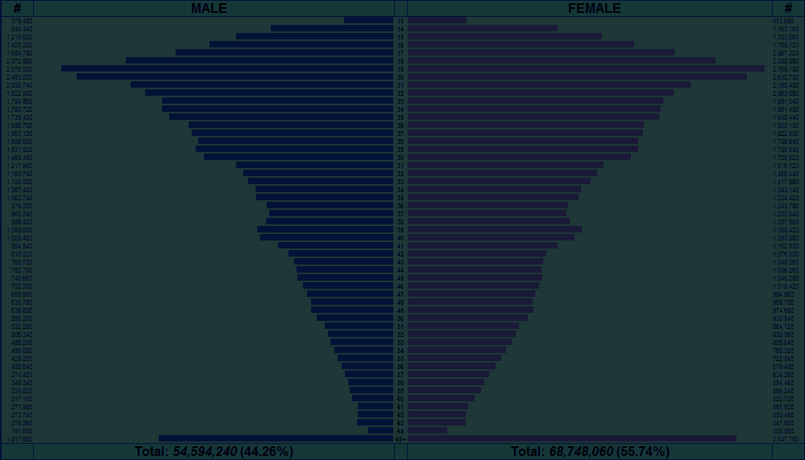
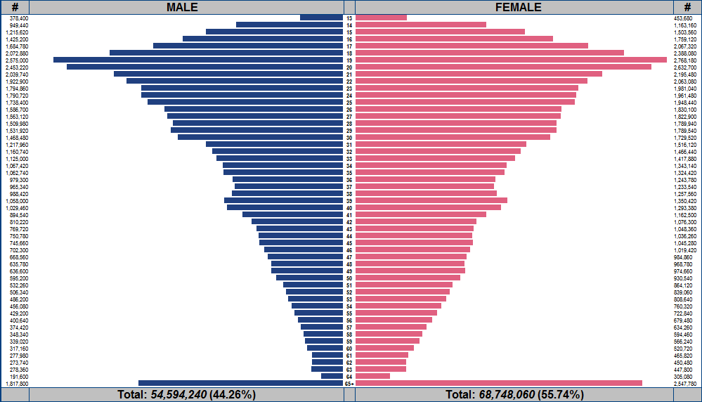
FaceBook Demographics
Male
13
Female
AGE
65+

Slide 29
FaceBook Demographics
Many users of college age
In USA large number of members over 65

Slide 30
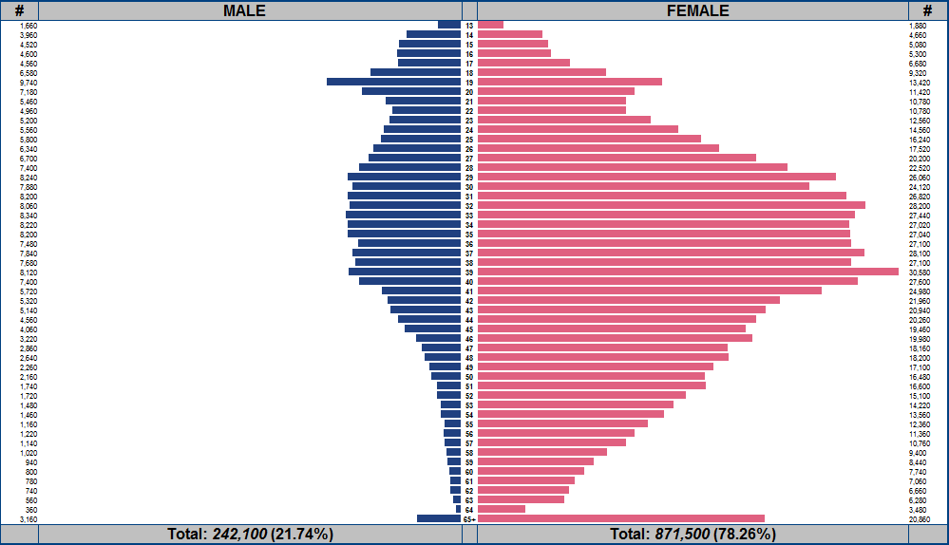
Bejeweled

Slide 31
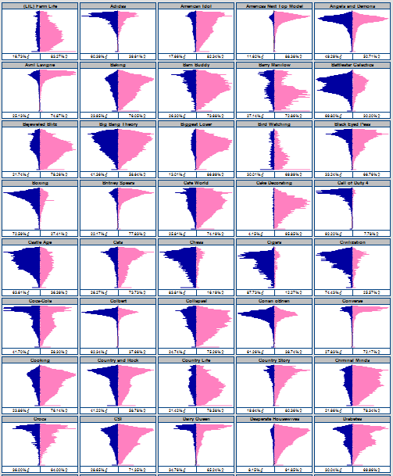
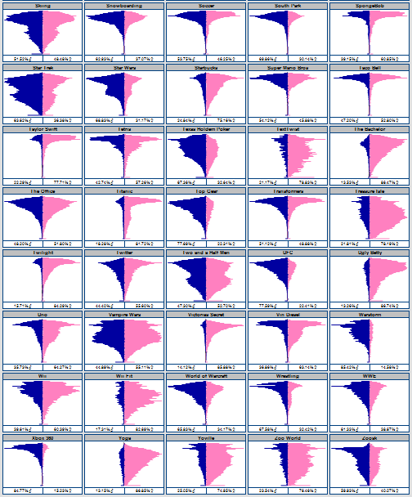
Call of Duty 4
Tetris
Country and Rock
Fishing
Hunting
NASCAR
Black Eyed Peas
Star Trek
Star Wars
Yoville
Texas Holdem Poker
Warstorm
Happy Island
Pet Society
Fishville
Collapse!
Taylor Swift
Transformers
Country Life
Harry Potter
Britney Spears
Mobsters 2 - Vendetta
Castle Age
Vampire Wars
Twilight
Mobsters
World of Warcraft
Zoosk
Civilization
Pepsi
NFL
Converse
Jersey Shore
Victorias Secret
MTV
Coca-Cola
Pillow Fight
Sims 3
Super Mario Bros
Mafia Wars
Happy Aquarium
Cafe World
Jigsaw Puzzles
Barn Buddy
Country Story
Mythbusters
Avril Lavigne
Red Bull
Disney
Johhny Depp
Titanic
Starbucks
Red Hot Chili Peppers
Lord of the Rings
SpongeBob
McDonalds
Scrabble
(LIL) Farm Life
Dilbert
Investing
Farm Town
Law and Order
TextTwist
Farmville
Treasure Isle
Doodle Jump
Playboy
Dr Phil
Island Paradise
Zoo World
Fish World
Bejeweled Blitz
Roller Coaster Kingdom
Justin Bieber
Conan oBrien
Jay Leno
Michael Jackson
James Bond
James Patterson
Angels and Demons
Roller Coasters
Chess
Mahjong Dimensions
Mahjong
Petville
Uno
Elvis
Frank Sinatra
Soccer
Cigars
Golf
Jogging
Pilates
Yoga
Puma
Adidas
Nike
Reebok
Lifetime
Colbert
Howard Stern
Big Bang Theory
Ellen Degenerous
Dr Who
Lost
Top Gear
WWE
Wrestling
Jui Jitsu
Martial Arts
MMA
UFC
Boxing
NCIS
Cooking
Sewing
Knitting
Martha Stewart
Horses
Makeup
Fashion
Cake Decorating
Greenhouse
Bird Watching
Dogs
Plants
Cats
Flowers
Gardening
Baking
The Bachelor
Crocs
Jeep
The Office
Saturday Night Live
Scrubs
South Park
Family Guy
Simpsons
Heroes
Ugly Betty
Battlestar Galactica
Dunkin Donuts
Pizza Hut
Taco Bell
Scuba Diving
Skiing
Snowboarding
iTunes
Barry Manilow
Dairy Queen
Lady Gaga
Vin Diesel
Criminal Minds
Two and a Half Men
How I met your Mother
Medium
Ghost Whisperer
Biggest Loser
Americas Next Top Model
Sex and the City
Desperate Housewives
CSI
American Idol
Happy Pets
Mind Jolt Games
Restaurant City
Twitter
iPHONE
iPad
Pokemon
Nintendo DS
Xbox 360
PS3
Diabetes
Monopoly
Settlers of Catan
Megan Fox
Rock Band
Foursquare
Guitar Hero
Oprah Winfrey Show
Halo
Wii Fit
Wii

Slide 32
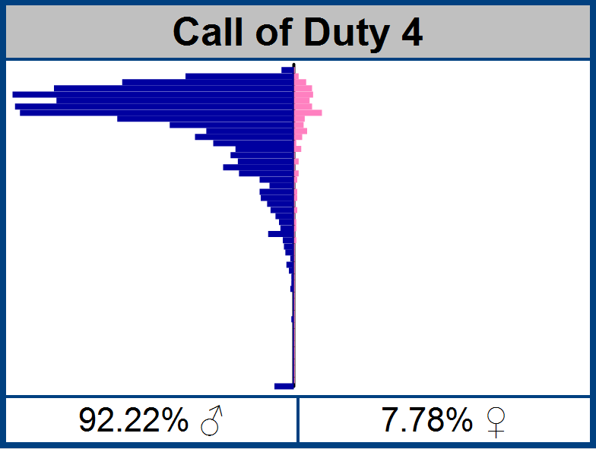
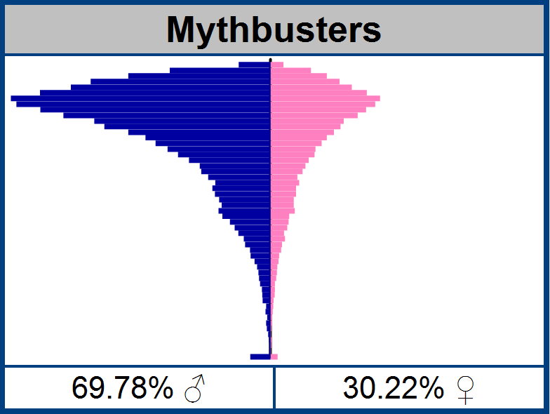
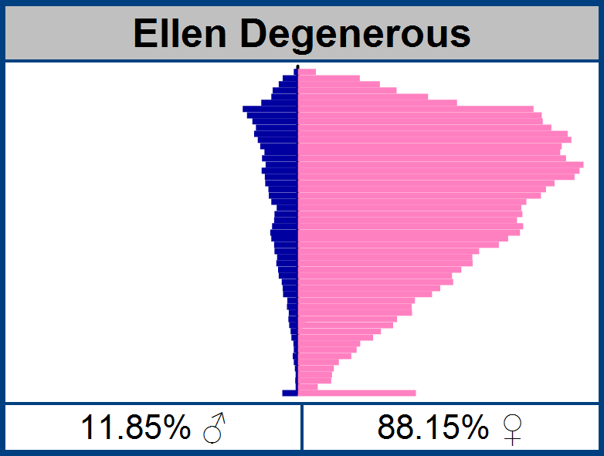
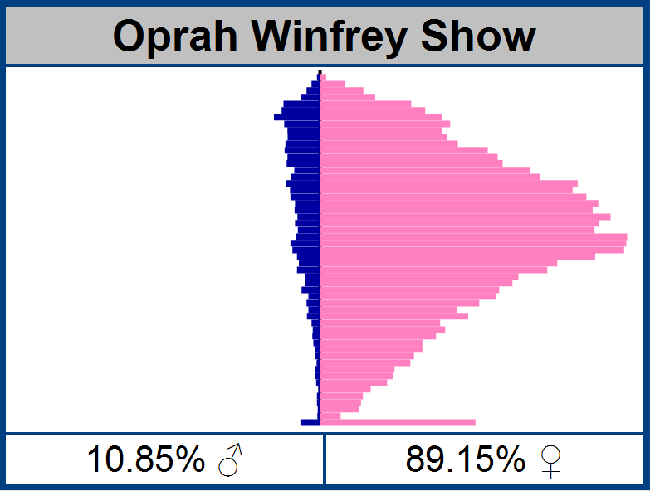

Slide 33
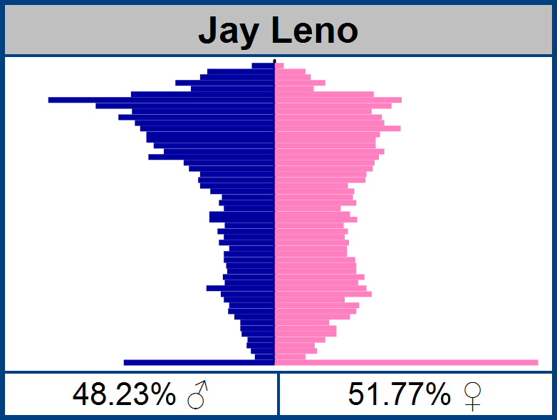
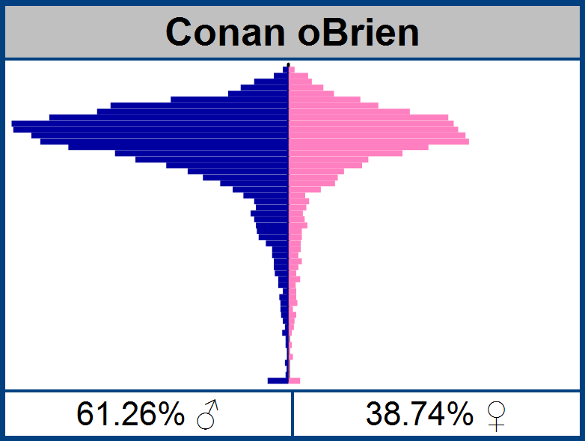
Jay Leno vs. Conan

Slide 34
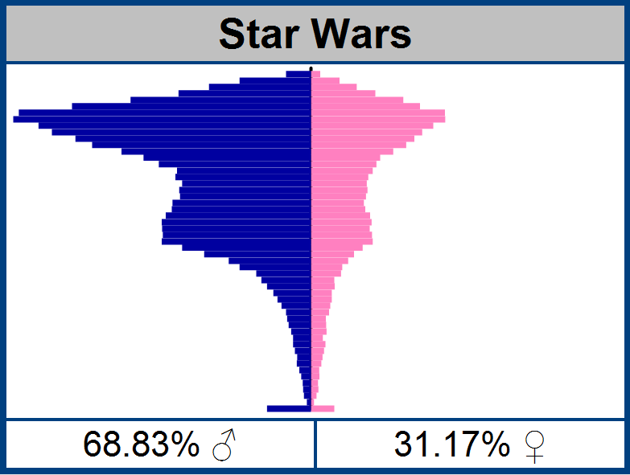
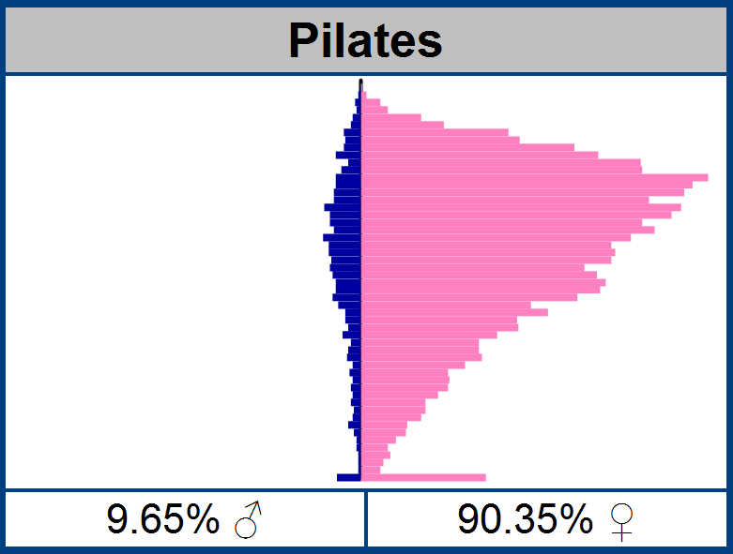
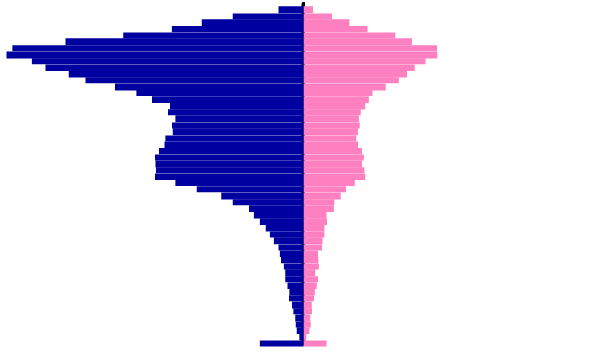
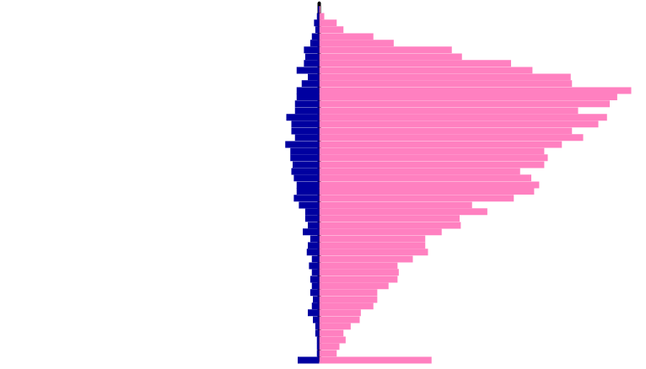
Comparing Demographic “Genes”
38.41% correlation

Slide 35


80.89% correlation

Slide 36


Bejeweled Blitz Affinity

Slide 37


What are fans of glee on facebook interested in?

Slide 38






Slide 39

Affinity for Games

Slide 40
TV Shows

Slide 41
Music

Slide 44

Example #1
GreatPokerHands
Texas Hold’em Poker Strategy cards sold at retail.

Slide 45


GreatPokerHands sales Database

Slide 46


GreatPokerHands Age/Gender Profile
Children under 18 do not have credit cards

Slide 47



GreatPokerHand Sales Correlations
45.63%
34.81%
25.72%

Slide 48

Results:

Slide 49

Example CPC Prices:
Texas Holdem $1.73
Golf (74.77%) $0.88
Texas Holdem $2.05 - $3.06
Scuba Diving (65.93%) $0.79 - $1.16
NASCAR (65.56%) $0.41 - $0.56

Slide 50

White House Visitor Logs

Slide 51


Every visitor to White House recorded, but no gender or age information …
1.95 million records available
1.95

Slide 52


Slide 53


Slide 54



Slide 55


Slide 56
The End
Slides available: DataGenetics.com/content.html
Email: Nick@DatGenetics.com

